Slide 1

APPROVALS
Managing Approval Requests Training Deck

Slide 2
Agenda
Reviewing Approval Requests
What's in a Request
Notes in a Request
Activity History of a Request
Reviewing Related Requests from the Employee
Communicating with the Employee
Request Conclusions
Cancelling a Request
Deleting a Request
Deactivating/Reactivating a Request

Slide 3
01
Reviewing Approval Requests

Slide 4
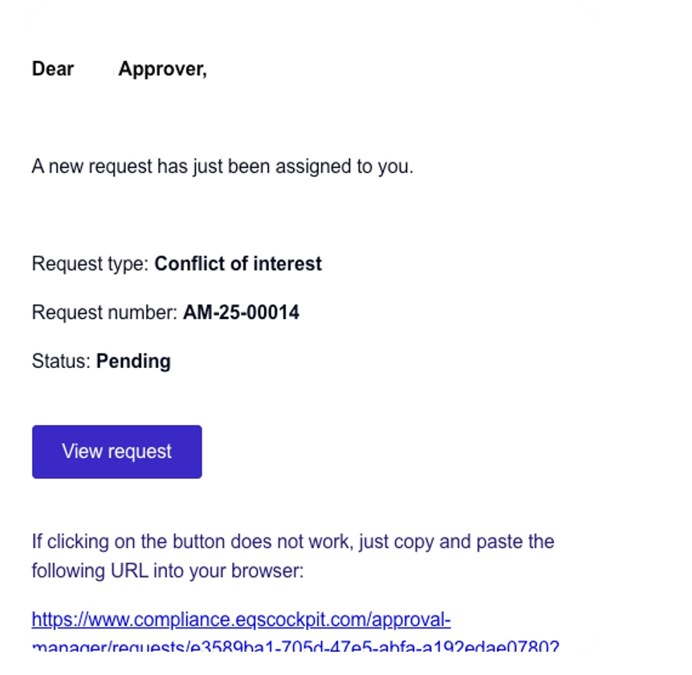
Reviewing Approval Requests
          When you are assigned to a request, you will receive an email.
          The link in the email will direct you to the request.

Slide 5
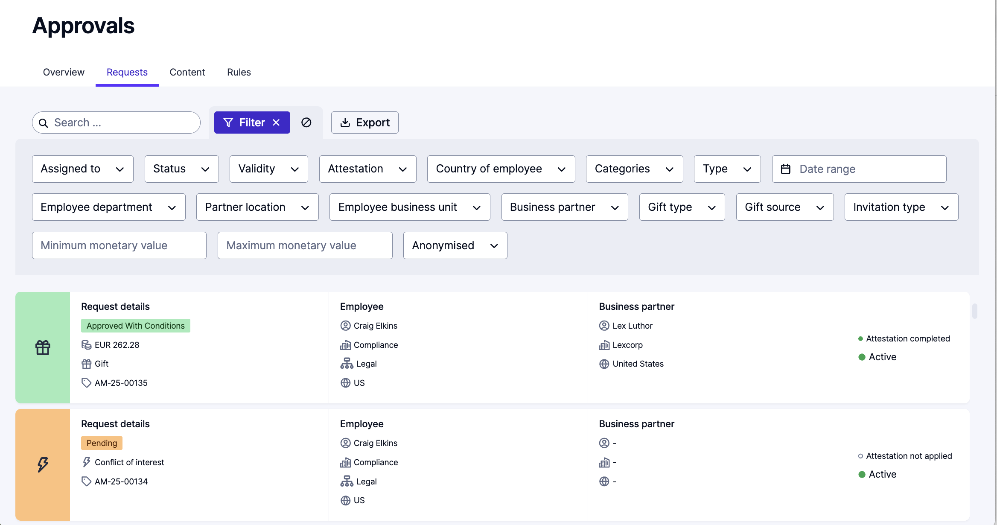
Reviewing Approval Requests
          You are also able to navigate to the request in Compliance COCKPIT.
          Choose Approvals from the hamburger menu in the upper left-hand corner.
          You will see a list of requests that you have access to.
          You can scroll to find a particular request or can use filters to find the request you are looking for.

Slide 6
02
What‘s in a Request

Slide 7


What‘s in a Request
  Requests contain information about activities, gifts, and/or potential conflicts of interest that an employee wants to disclose.
  The request will contain the name of the employee, the type of request, and the specific details, which may include attachments.

Slide 8
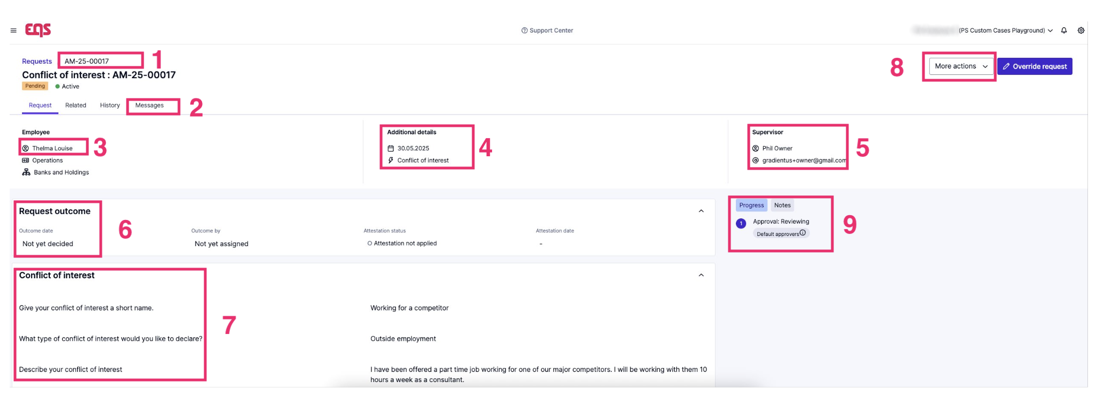
What‘s in a Request

Slide 9
What‘s in a Request
Key for the Request page
The ID and status of the request
Request tab – all information about the request
Related tab – all requests from this employee
History – the activity history of this request
Messages – communication with the employee and approver
The person who submitted the request
Additional details including type of request and date of request
Supervisor of the person who submitted the request (may not be if not included in the employee's user profile)

Slide 10
What‘s in a Request
Key for the Request page
6. The outcome or conclusion of the request, along with attestation status
7. Shows the information provided by the person who submitted the request
8. Actions such as cancellig a request, deleting a request, requesting an update, reactivating/deactivating a request, review outcome of request
9. Additional details including type of request and date of request

Slide 11
03
Reviewing Related Requests

Slide 12
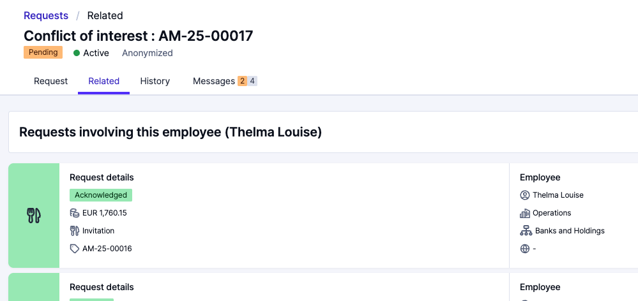

Reviewing Related Requests
    As you review the request, you might want to review other requests that the same employee has submitted that may be related to the request you are working on.
    Click the Related tab to review all other requests involving this employee.

Slide 13
04
Activity History

Slide 14
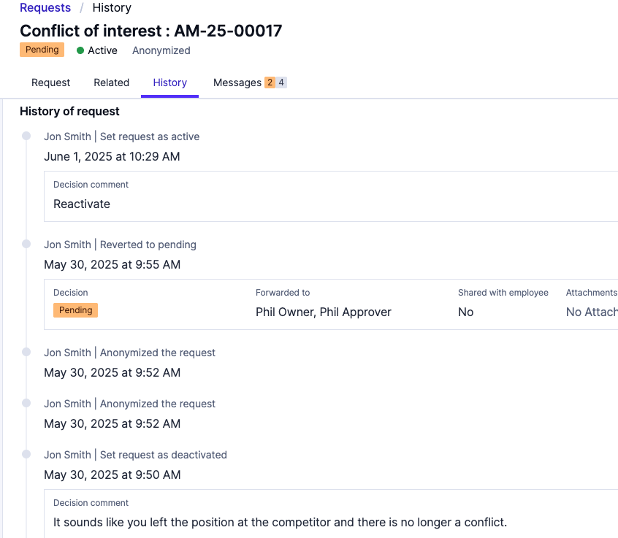
Reviewing Request Activity History
    If you need to review the activity history of the request, you can find the information under the History tab.

Slide 15
05
Communicating with the Requester

Slide 16
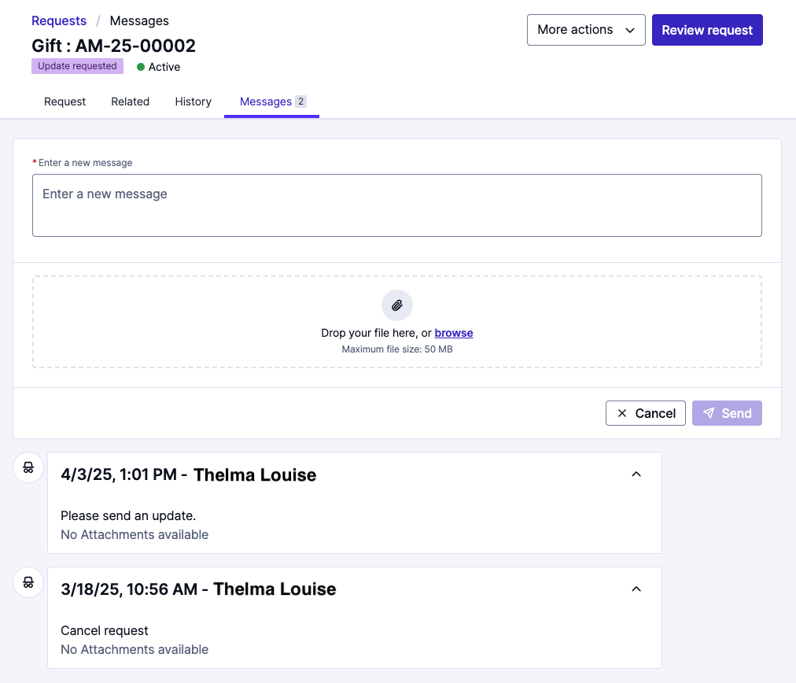
Communicating with the Requester
    During the lifetime of the request, you may need to communicate with the requester. You can do that in the Messages tab. You will also be able to review past communications with the requester here.
    To send a message to the requester, type in the message, add any attachments if needed, then click the Send button. The requester will get an email notification with a link straight to to the Messages tab.

Slide 17
06
Request Notes

Slide 18
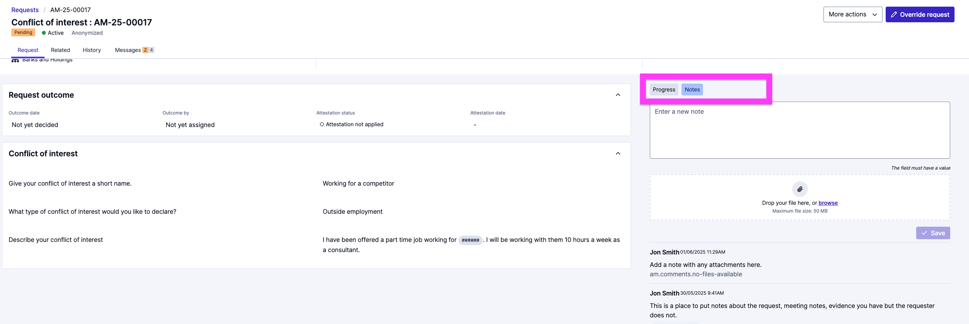
Request Notes
    To add any notes to the request such as meeting notes, interview notes, or any supplemental attachments click the Notes button on the right side of the screen in the Request tab.
    To make notes on the request, type in your notes and add any needed attachments, then click the Save button.
    The requestor will not see any Notes.

Slide 19
07
Request Conclusions

Slide 20
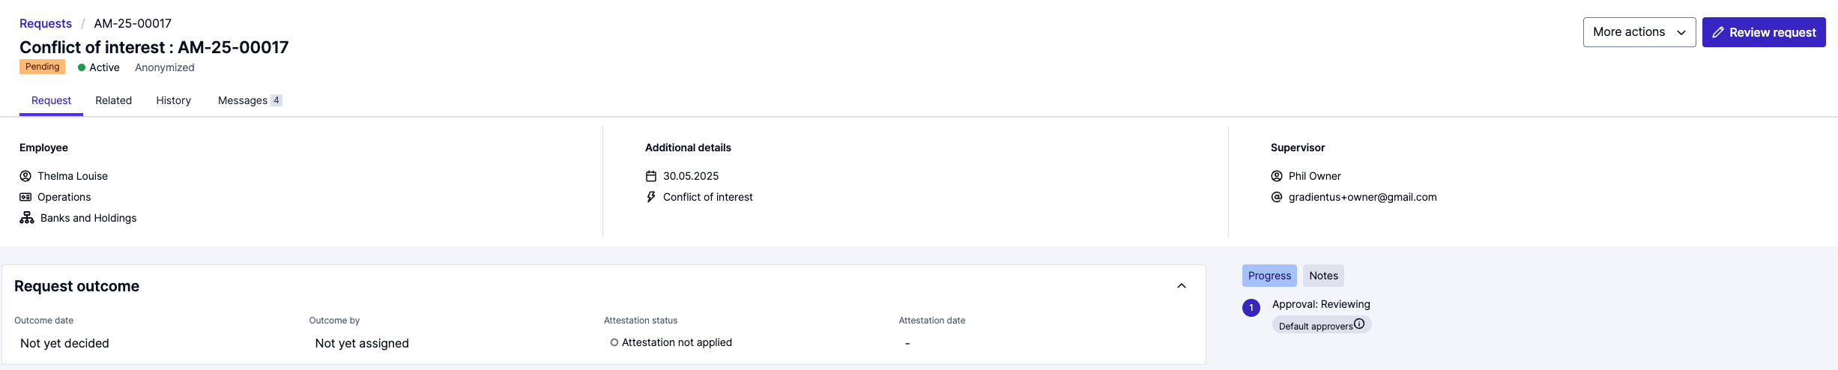
Request Conclusions
    To review and close out the request and communicate the decision with the requester, click on the Review request button on the right side of the screen.

Slide 21
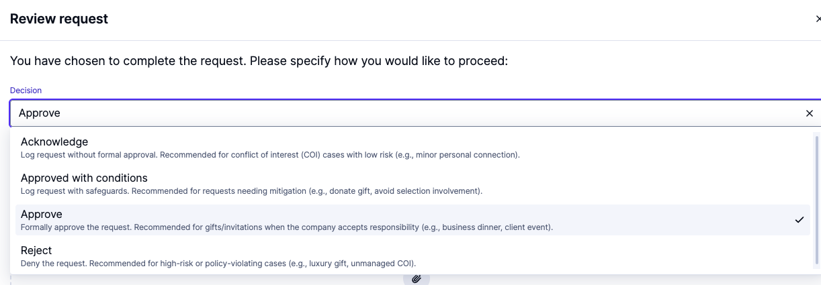
Request Conclusions
    Choose the decision

Slide 22
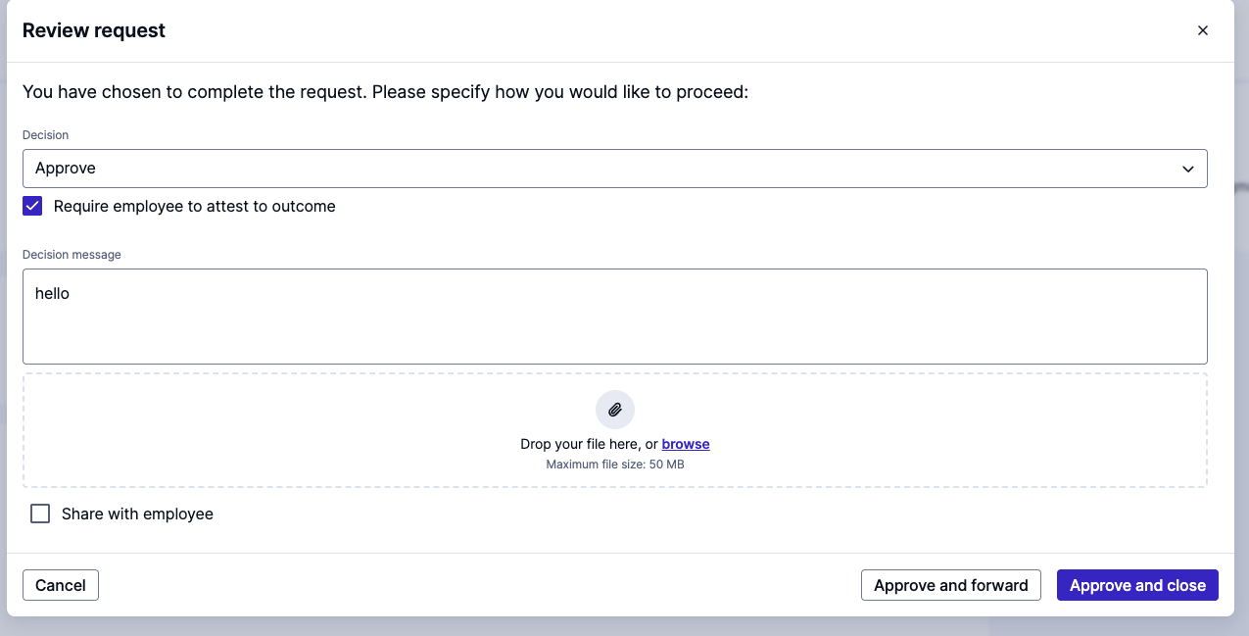
Request Conclusions
    Add any messages and attachments if needed
    Check Require employee to attest to outcome, if you require an attestation
    Check Share with employee in order to trigger an email to the requester.
    Click the Approve and close button in the lower right-hand corner

Slide 23
Approve and forward
    If you are needing other approvers to review your decision, click on the Approve and forward button.
    Other approvers will get an email and will be able to review the request and your decision.
    The requester will not be notified about this decision.
    Click the Approve and close button in the lower right-hand corner.

Slide 24
08
Cancelling a Request

Slide 25
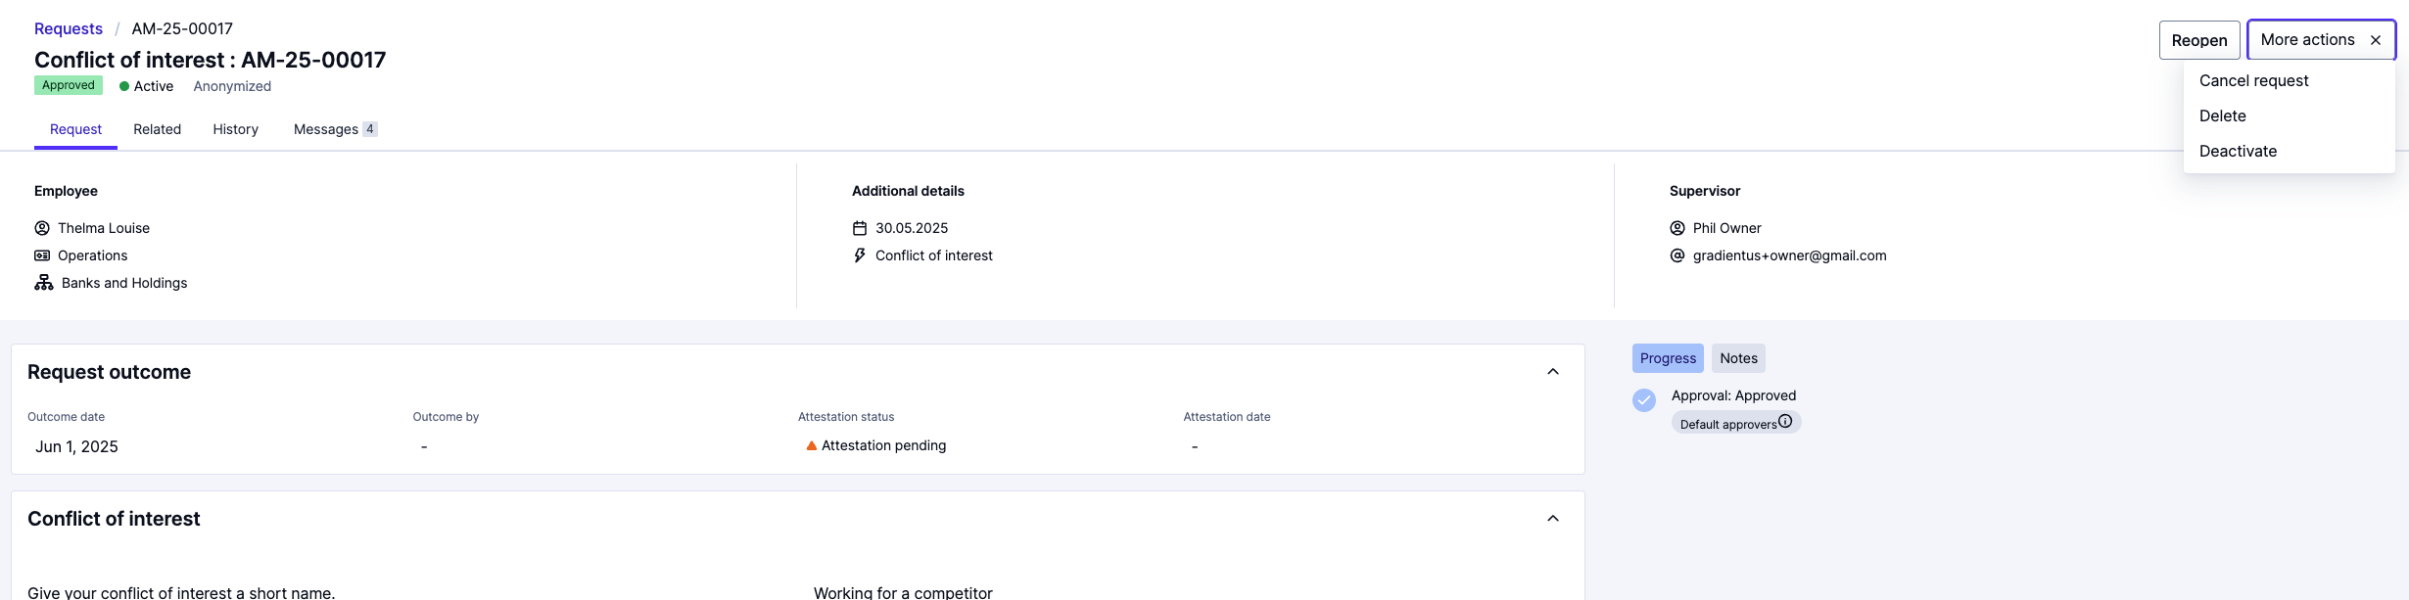
Cancelling a Request
    If you need to cancel a request, Click More actions, then choose Cancel request.
    Requests can be cancelled by employees while in Pending status or by Compliance Cockpit users at every stage.
      Cancelled means that the process or request is intentionally stopped or voided, often due to a change in circumstances. The record remains in the system, but no further actions will be taken.

Slide 26
09
Deleting a Request

Slide 27
Deleting a Request
    If you need to delete a request, Click More actions, then choose delete.
    Deletion is used when a request is raised by mistake (e.g., duplicate record or data entry error).
      Once deleted, the request is permanently removed and will not appear in reports or records.

Slide 28
10
Requesting Updates

Slide 29
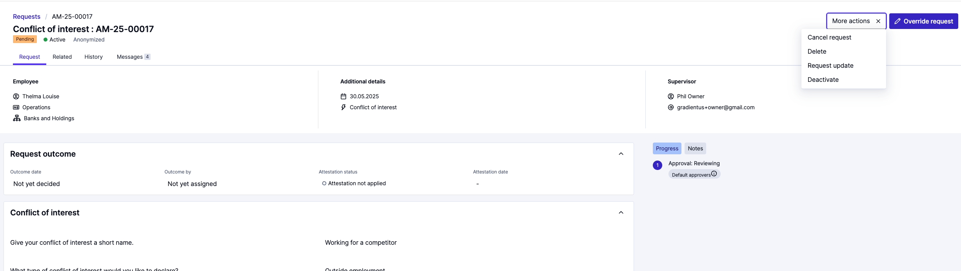
Requesting Updates
    If you need the requester to provide an update, click the More actions button, then choose Request update.
    This is used for clarification, additional details, or if the employee needs to edit the information in the request. This will set the status back to pending.

Slide 30

Thank you for your attention

