Slide 1
Recommendations for using this training presentation
Delete this slide before sharing this presentation
We recommend customizing this deck before using this presentation. The format (PPT) is editable so that you can add screenshots and notes about processes that are specific to your own organization
Intended audience: The people in your organization who will be reviewing, managing, and making decisions for submitted disclosures.
      This is likely to include members of your Ethics & Compliance team and/or supervisors around your organization.

Slide 2
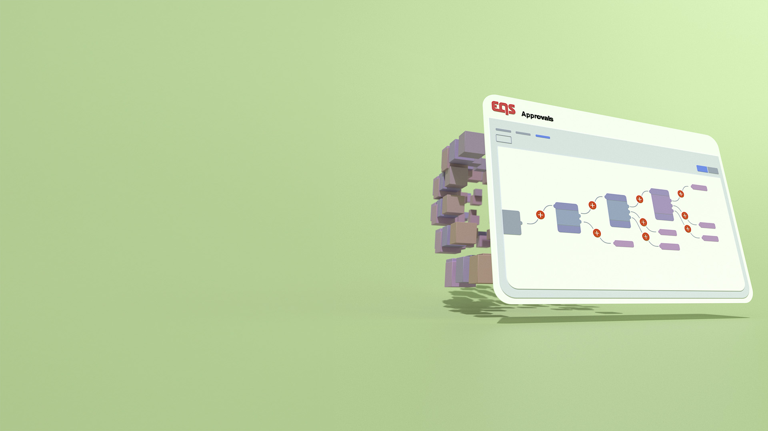
APPROVALS
Managing Disclosures
Training Deck

Slide 3
Agenda
Accessing the Approvals module and your assigned disclosures
What's in a disclosure
Notes in a disclosure
Activity history of a disclosure
Communicating with the employee
Disclosure Notes
Disclosure decisions
Cancelling a disclosure
Deleting a disclosure
Requesting updates

Slide 4
01
Accessing the Approvals module and your assigned disclosures

Slide 5
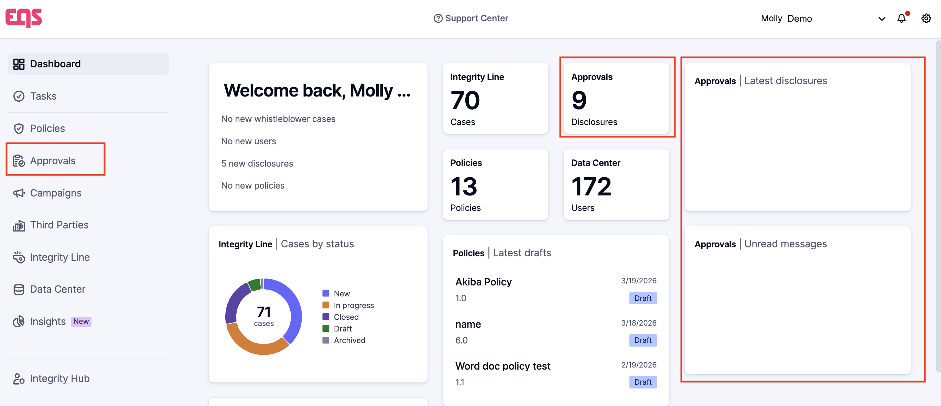
Terminology: Approvals and Disclosures
This image shows how to access the full Approvals module via the left-side menu and highlights the widgets that provide an overview of the disclosures that you have access to.
          The Approvals module includes functionality to manage disclosures, including the submitted disclosures themselves, the rules engine that governs how disclosures are routed for review, reporting, etc.
          This presentation is focused on submitted disclosures within the Approvals module.

Slide 6
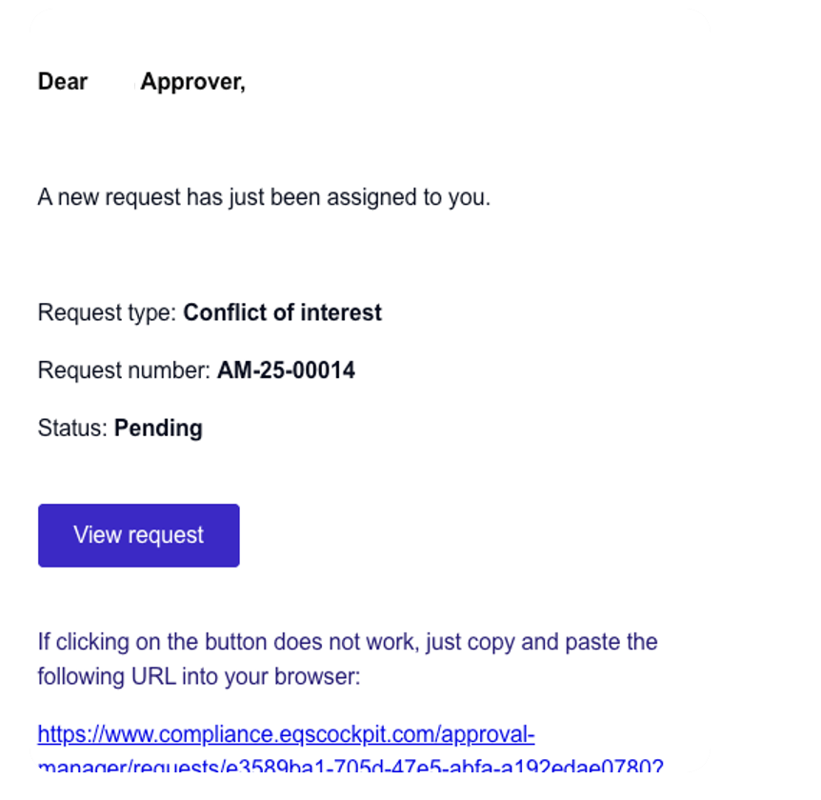
Accessing Your Assigned Disclosures
          When you are assigned to a disclosure, you will receive an email notification.
              Note: You can disable all Approval emails via the Notification settings page under your profile settings. This toggle is an all-or-nothing setting.
          The link in the email will take you straight you to the disclosure.

Slide 7
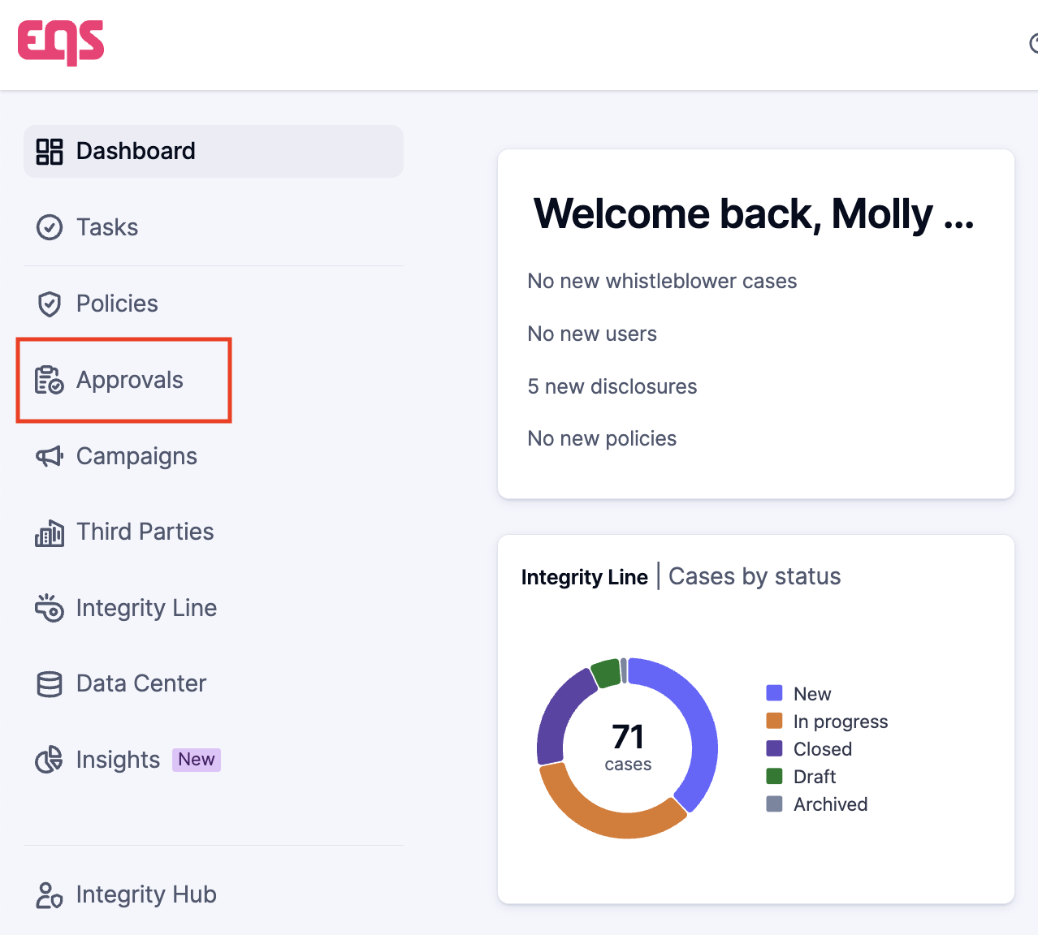
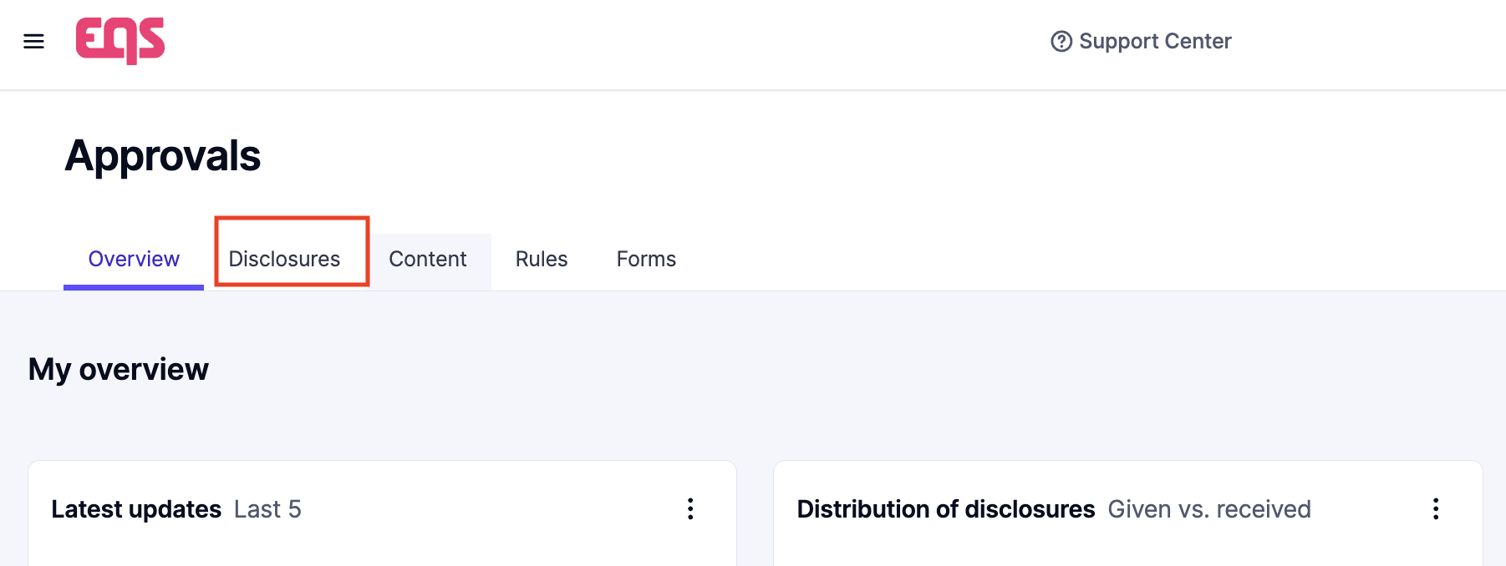
Accessing Your Assigned Disclosures
          You are also able to navigate to the disclosure in Compliance COCKPIT.
          From the home page, choose ‘Approvals’ from the left-side menu, then select the ‘Disclosures’ tab.

Slide 8
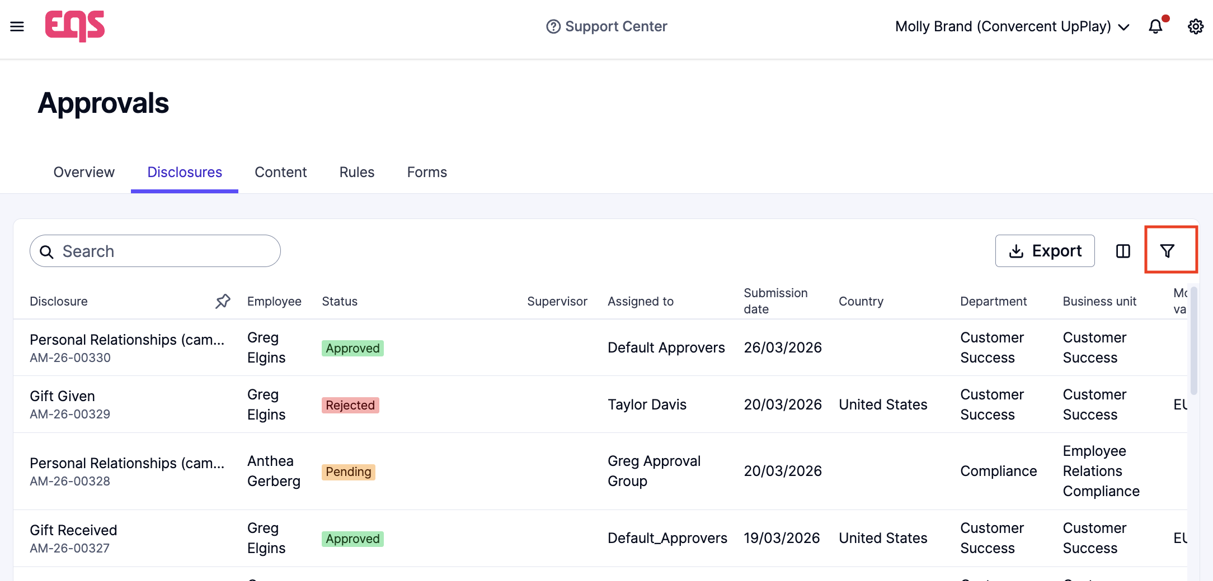
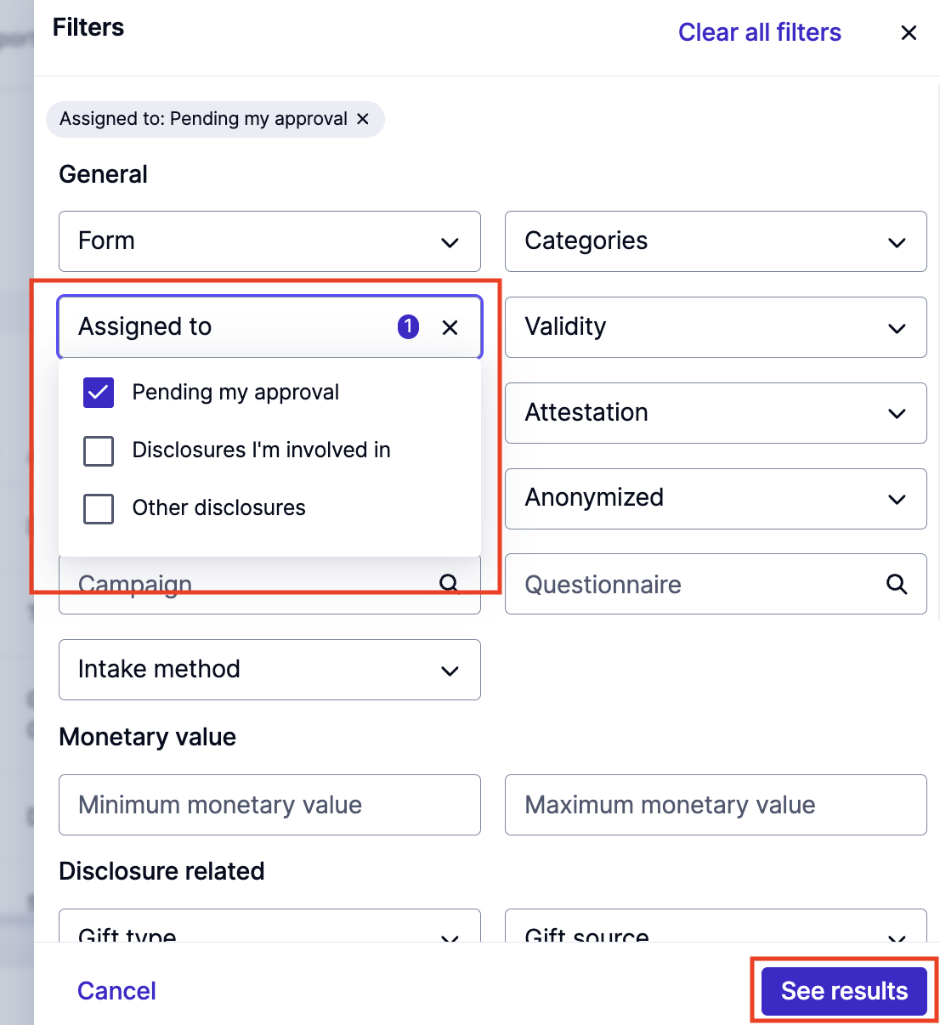
Accessing & Reviewing Disclosures
          You will see a list of disclosures that you have access to, along with details such as the Status and the name of the Employee who submitted the disclosure.
          Click the ‘filter icon’ in the top right to open the filter panel. We recommend using the ‘Pending my approval’ filter to quickly identify the disclosures that require your review. Click ‘See results’ to apply the filter.

Slide 9
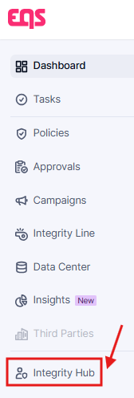
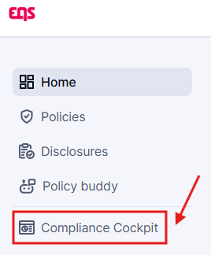
View Swapping from Compliance Cockpit to Integrity Hub
          For ease of navigation, you can swap to the Compliance Cockpit when you are logged in to Integrity Hub, or vice versa, via the buttons under your navigation menu in the top-left:
From Integrity Hub:
OR
From Compliance Cockpit:

Slide 10
02
What‘s in a disclosure

Slide 11


What‘s in a disclosure
  Disclosures contain information about activities, gifts, and/or potential conflicts of interest that an employee needs to disclose.
  The disclosure will contain the name of the employee, the type of disclosure, and the specific details, which may include attachments.

Slide 12
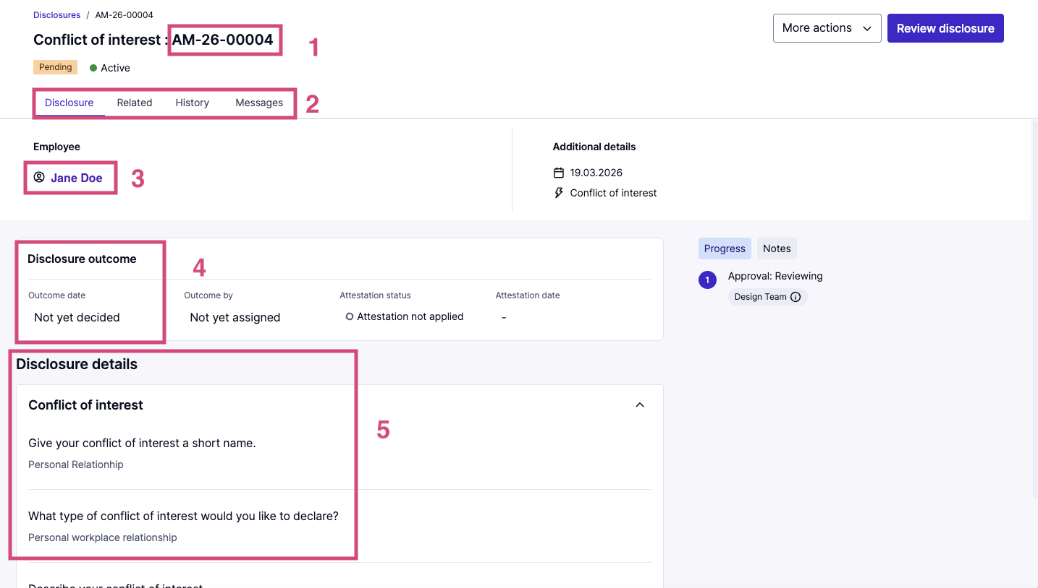
What‘s in a disclosure
The ID of the disclosure
Disclosure tab – all information about the disclosure
    Related tab – all disclosures from this employee
    History tab – activity history
    Messages tab – communication with the employee
The person who submitted the disclosure
The outcome or conclusion of the disclosure, along with attestation status
Disclosure details show the information submitted by the disclosing party

Slide 13
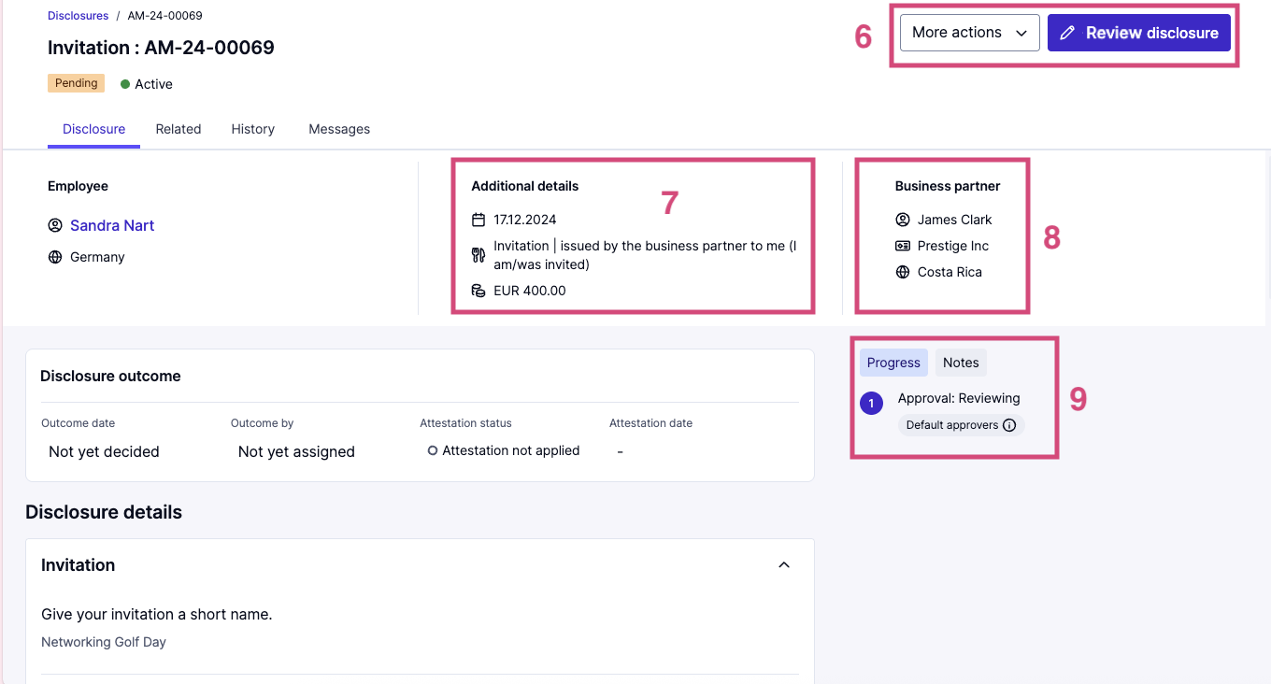
What‘s in a disclosure
    6. Actions such as cancelling a disclosure, deleting a disclosure, requesting an update, reactivating/deactivating a disclosure, review outcome of the disclosure
7. Additional details including type of disclosure and date of disclosure
8. Supervisor of the person who submitted the disclosure (may not be if not included in the employee's user profile)
9. Progress tab – approval rounds and current stage of the approval process.
Notes tab – Internal messaging

Slide 14
03
Reviewing related disclosures

Slide 15
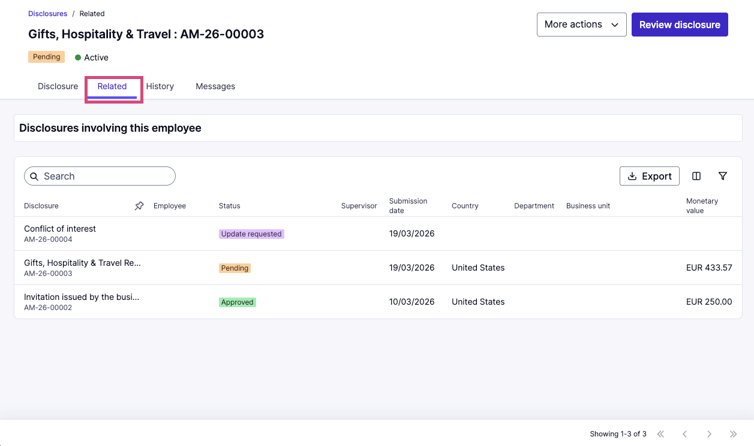

Reviewing Related Disclosures
    As you review the disclosure, you might want to review other disclosures that were submitted by the same employee.
    Click the ‘Related’ tab to review all other disclosures involving this employee.

Slide 16
04
Activity history

Slide 17
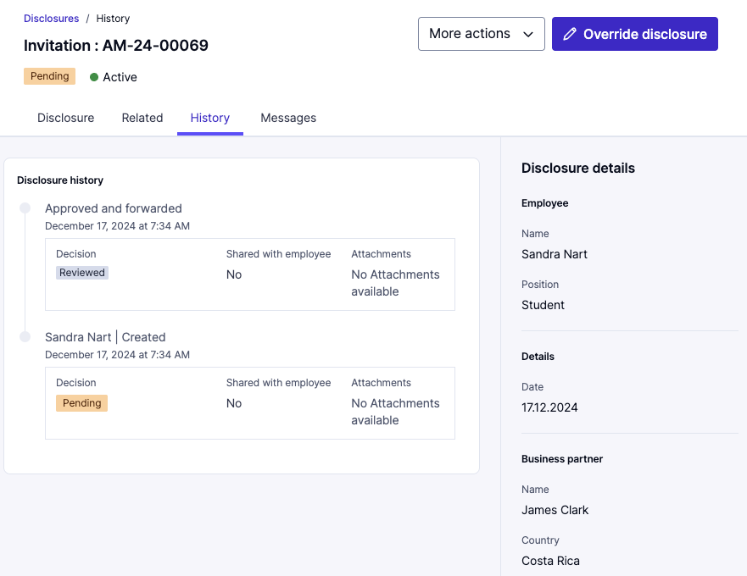
Reviewing Disclosure Activity History
    You can find the activity history under the ‘History’ tab.
    This includes information like:
      Disclosure history – types of decisions made throughout the approval process, whether those decisions were shared with the employee, and if there are any attachments included during each stage of the approval process

Slide 18
05
Communicating with the employee

Slide 19
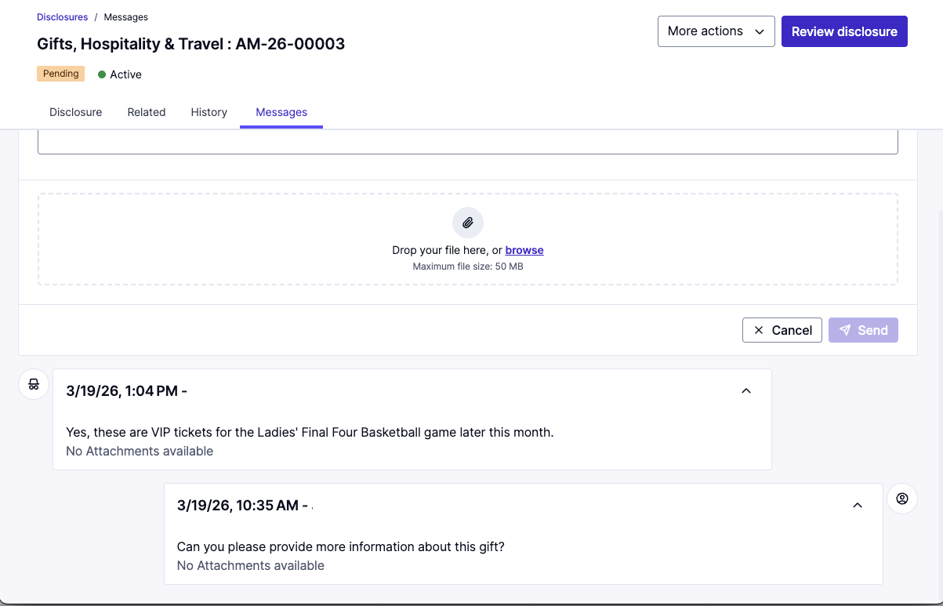
Communicating with the Employee
    As needed, you can communicate with the employee in the ‘Messages’ tab. You will also be able to review past communications with the employee here.
    To send a message to the employee, type in the message, add any attachments, then click the ‘Send’ button. The employee will get an email notification with a link straight to the ‘Messages’ tab.

Slide 20
06
Disclosure notes

Slide 21
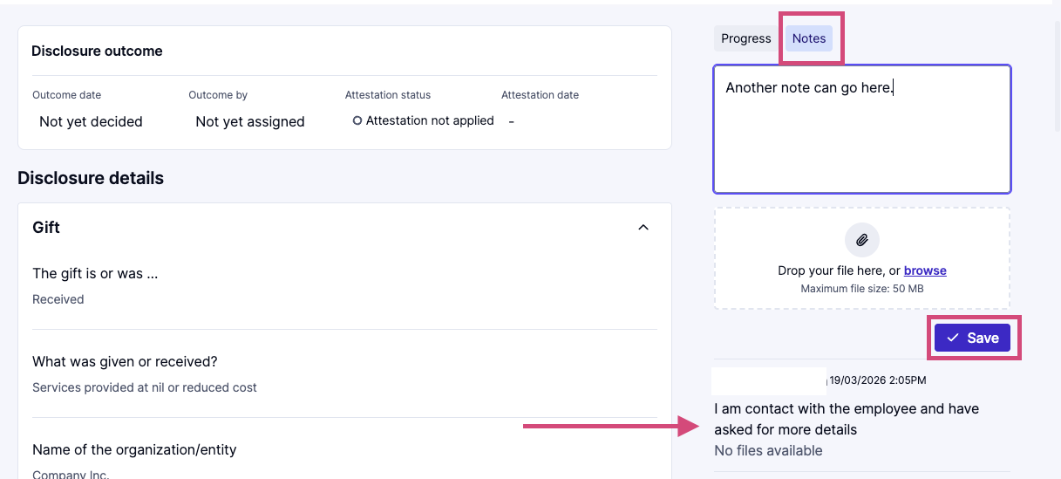
Disclosure Notes
    To add any notes to the disclosure such as internal communications, meeting/interview notes, or any supplemental attachments click the ‘Notes’ button on the right side of the screen in the disclosure tab.
      To make notes on the disclosure, type in your notes and add any needed attachments, then click the ‘Save’ button.
      Notes are only visible to admin users; the employee will not see any Notes.

Slide 22
07
Disclosure Decisions

Slide 23
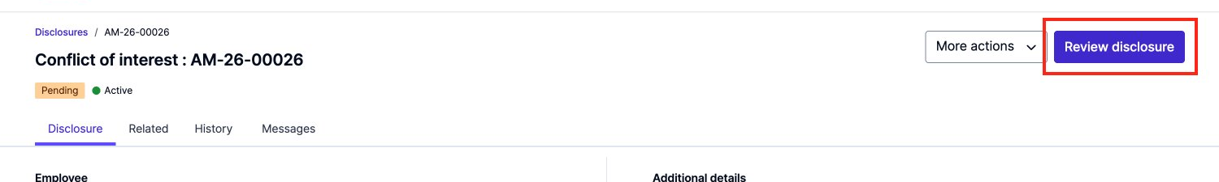
Disclosure Decisions
    To review and close out the disclosure and (optionally) share the decision with the employee, click on the ‘Review disclosure’ button on the right side of the screen.

Slide 24
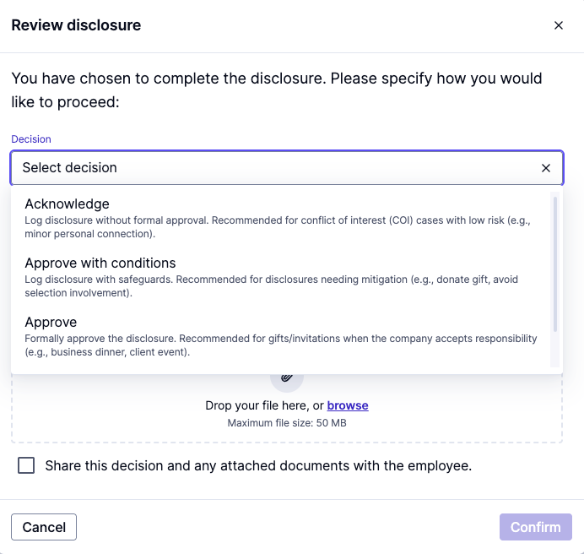
Disclosure Decisions
    Choose the decision:
Acknowledge - Log disclosure without formal approval. Recommended for conflict of interest (COI) cases with low risk (e.g., minor personal connection).
Approve with conditions - Approve disclosure with safeguards. Recommended for disclosures needing mitigation (e.g., donate gift, avoid selection involvement).
Approve - Formally approve the disclosures. Recommended for gifts/invitations when the company accepts responsibility (e.g., business dinner, client event).
Reject - Deny the disclosure. Recommended for high-risk or policy-violating cases (e.g., luxury gift, unmanaged COI).

Slide 25
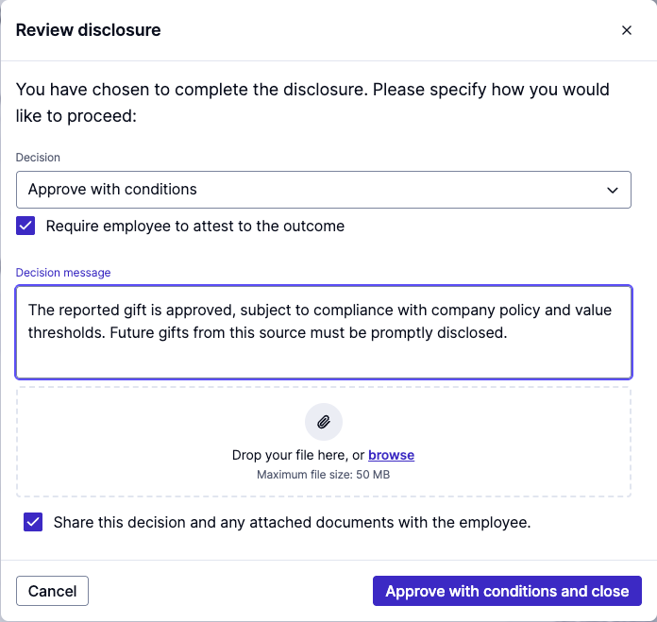
Disclosure Decisions
    Add any messages and attachments as needed
    Check ‘Require employee to attest to outcome,’ if you require an attestation
    Check ‘Share with employee’ in order to trigger an email to the employee. The decision message will be shared with the employee in Integrity Hub
    Click the ‘purple button’ in the lower right-hand corner to finalize the decision

Slide 26
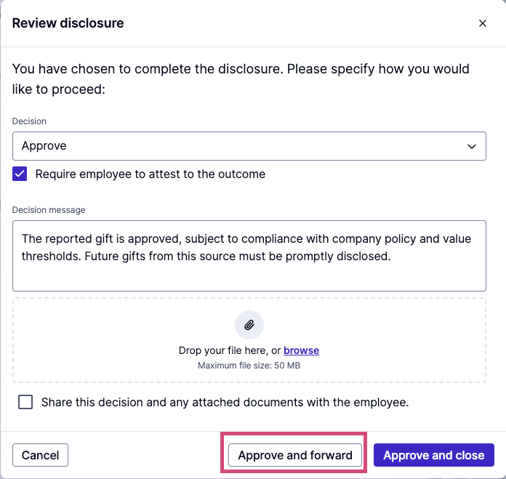
Approve and Forward or
Acknowledge and Forward
    For either the Approve or Acknowledge decision, there is an option to forward the disclosure for further review.
    The ‘Approve/Acknowledge and forward’ button will appear after selecting the decision.
    Other approvers will get an email notification and will be able to review the disclosure and your decision.
    The employee will not be notified at this stage.

Slide 27
08
Cancelling a disclosure

Slide 28
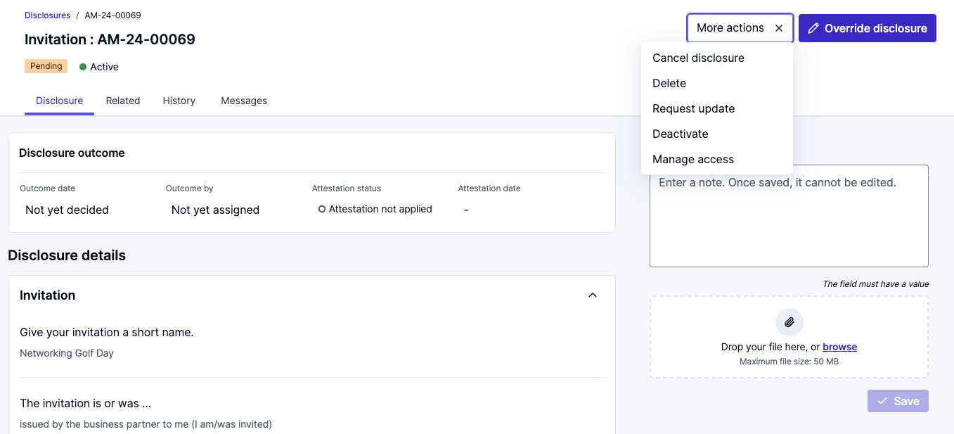
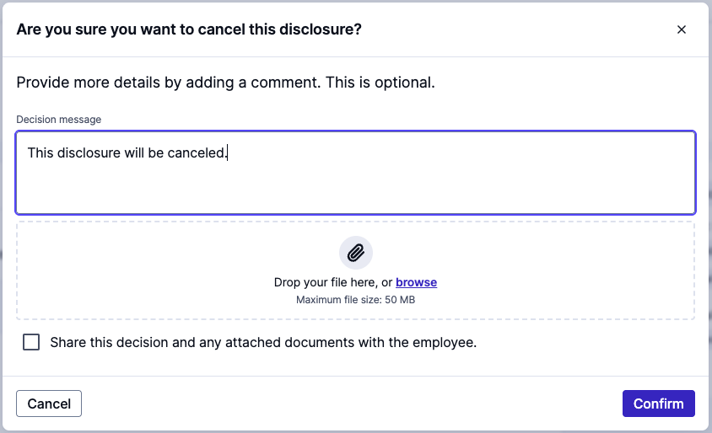
Cancelling a Disclosure
    If you need to cancel a disclosure, click ‘More actions,’ then choose ‘Cancel disclosure’.
    Disclosures can be cancelled by employees while in ’Pending’ status or by Compliance Cockpit users at any stage.
      ‘Cancelled’ means that the process or disclosure is intentionally stopped or voided, often due to a change in circumstances.
      The record remains in the system with a status of ‘Cancelled’, but no further actions will be taken.

Slide 29
09
Deleting a disclosure

Slide 30
Deleting a Disclosure
    If you need to delete a disclosure, click ‘More actions,’ then choose ‘Delete.’
    Deletion is used when a disclosure is raised by mistake (e.g., duplicate record, data entry error, or testing).
      Once deleted, the disclosure is permanently removed and will not appear in reports or records. The associated disclosure ID is retired and will not be reused, which may result in gaps in the sequential numbering of disclosure IDs.
      We recommend making a note of this detailing the reason for deletion for audit records.

Slide 31
10
Requesting updates

Slide 32
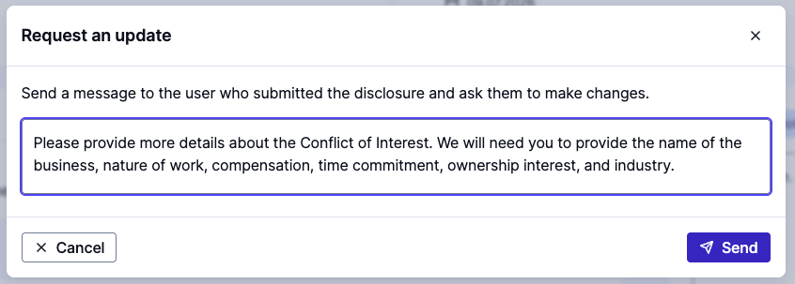
Requesting Updates
    If you need the employee to provide an update, click the ‘More actions’ button, then choose ‘Request update.’
    You should add a message to the employee to specify the action/information needed.
      The employee will receive a notification email and the message is visible to them in Integrity Hub.
    This is used for clarification, additional details, or if the employee needs to edit the information in the disclosure. This will set the status to ‘Update requested.’
    Once the employee makes updates and resubmits the disclosure, the status changes back to ‘Pending’

Slide 33

Thank you for your attention

