Slide 1
APPROVALS
Submitting an Ad Hoc Approval Request Training Deck

Slide 2
Agenda
Navigate to Integrity Hub
Starting a Request & Types of Requests
Completing the Request Form & Sending the Request
Cancelling a Request
Communicating with Approvers
Attestation
Glossary

Slide 3
01
Navigate to Integrity Hub

Slide 4
Navigate to Integrity Hub
Integrity Hub URL: https://www.integrityhub.net
Log in with your credentials
Note: Your company may have a slightly different URL. Update the URL above as needed.

Slide 5
02
Starting a Request & Types of Requests

Slide 6
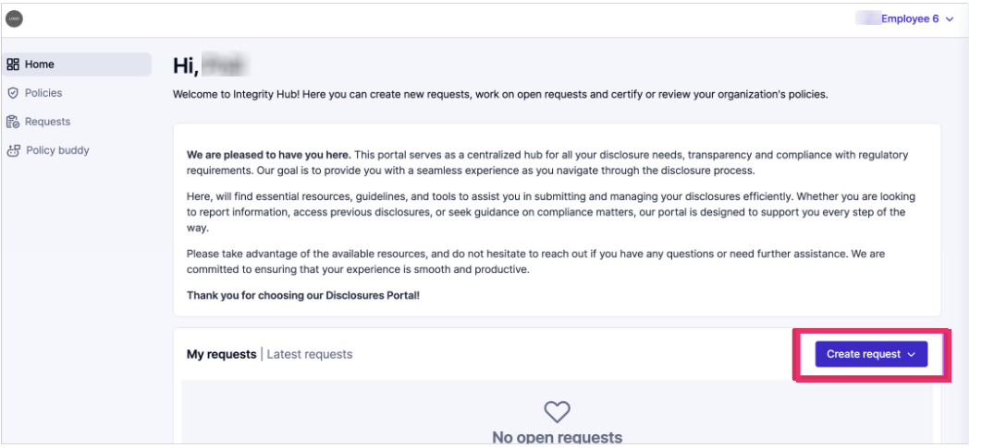
Starting a Request: Option 1
On the Home screen, click the Create request button.
Choose the type of request from the Create request dropdown button.
Note: Your organization may or may not have a welcome paragraph at the top of this screen

Slide 7
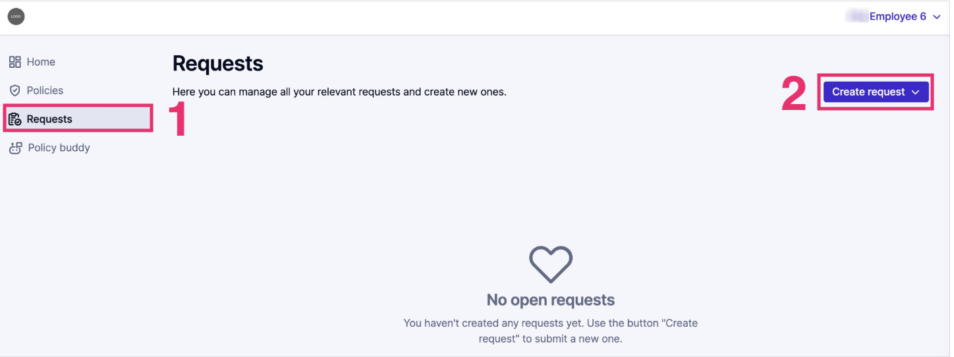
Starting a Request: Option 2
Click the Requests icon from the left menu, then click the Create request button.
Choose the type of request from the dropdown
Note: On this page, you will see any past Requests and can make updates when needed

Slide 8
Types of Requests
Conflict of Interest: Can refer to workplace relationships, outside engagements, outside employments, personal financial interests, or other types of conflicts of interest
Invitations: Invitations can refer to meals, conferences, travel, social, or other invitations issued by the company or business partners
Gifts: Gifts can refer to cash, donations, sponsorships, services, food/beverage, flowers, luxury items, or other items given or received
Note: There many be more types of requests, depending upon your organization

Slide 9
03
Completing the Request Form / Sending the Request

Slide 10
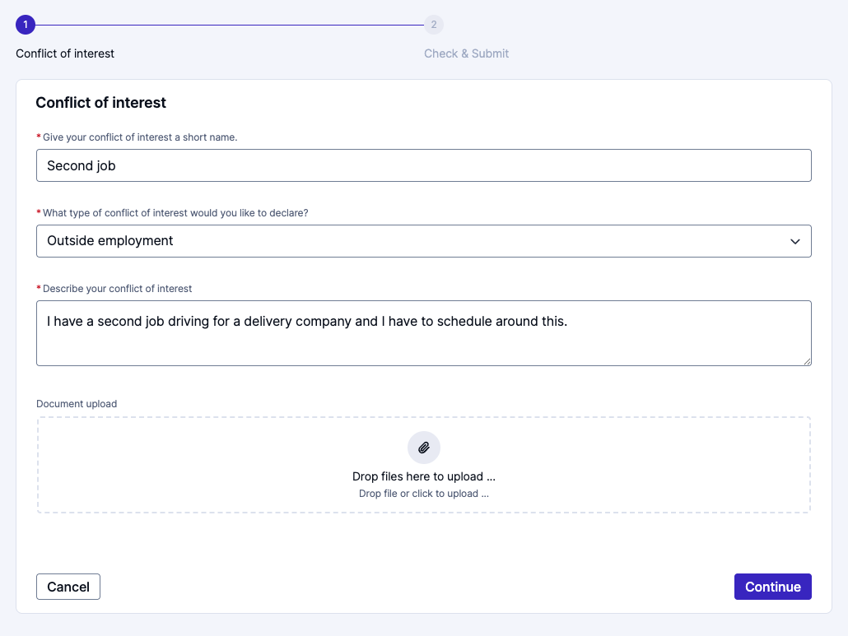
Complete the Form and Send Request
Gather all information, receipts, and attachments.
Complete the form entirely.
You may be prompted to add information about the business partner(s) or other people involved.
Click the Continue button.

Slide 11
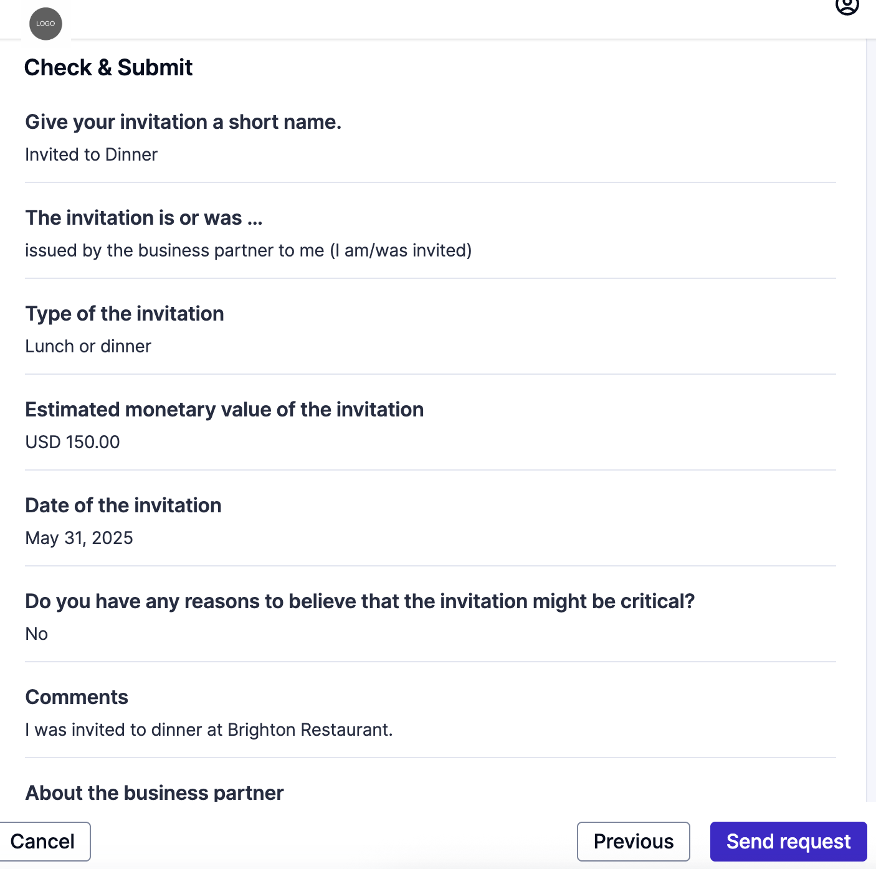
Complete the Form and Send Request
Review the request for accuracy.
Click the Send request button when you are ready to submit the request.

Slide 12
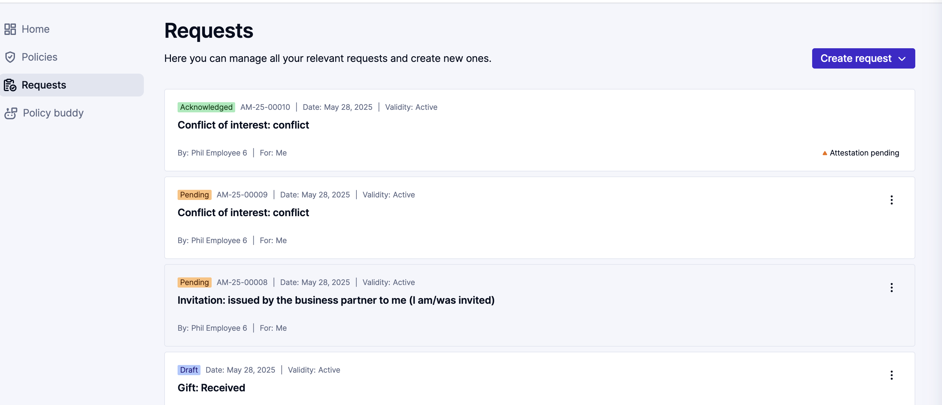
Complete the Form and Send Request
After submission, you will be directed to your list of requests.
You will see the request you just completed in that list. Its status will be Pending.

Slide 13
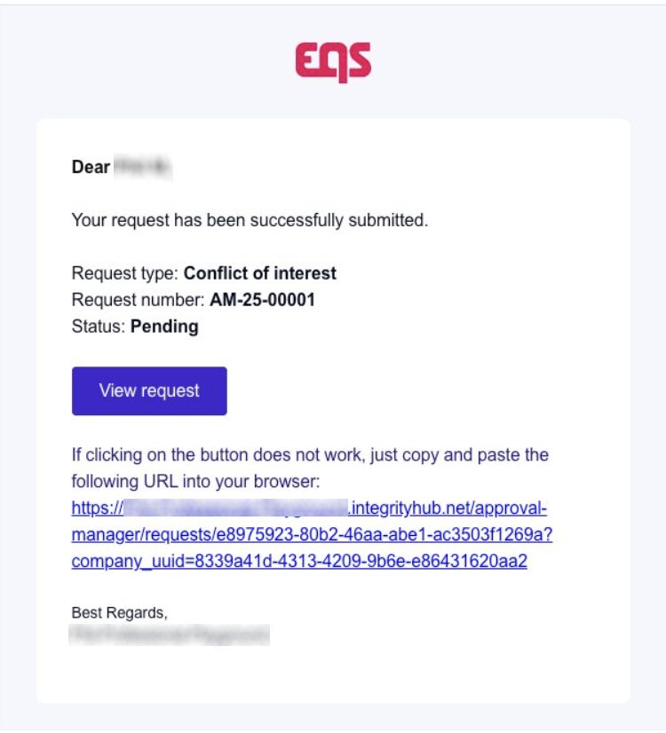
Complete the Form and Send Request
You will also receive an email confirmation with a link to your request.

Slide 14
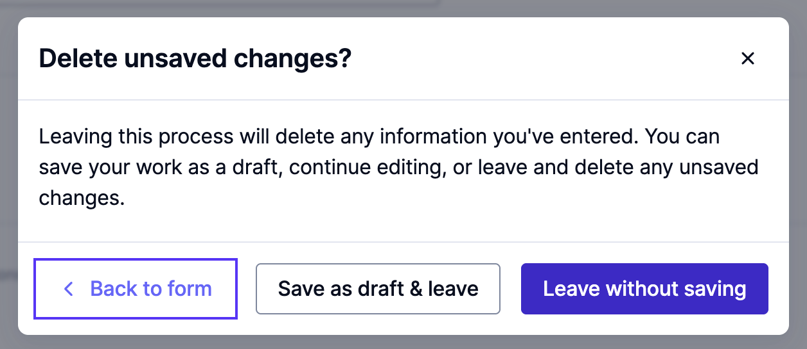
Saving the Request for Later
If you need to continue your work on the request later, click the cancel button instead of the Continue button.
You will see a pop-up message, and if want to save your progress, click Save as draft & leave.
Don’t forget to come back later to complete your request.

Slide 15
04
Communicating with Approvers

Slide 16
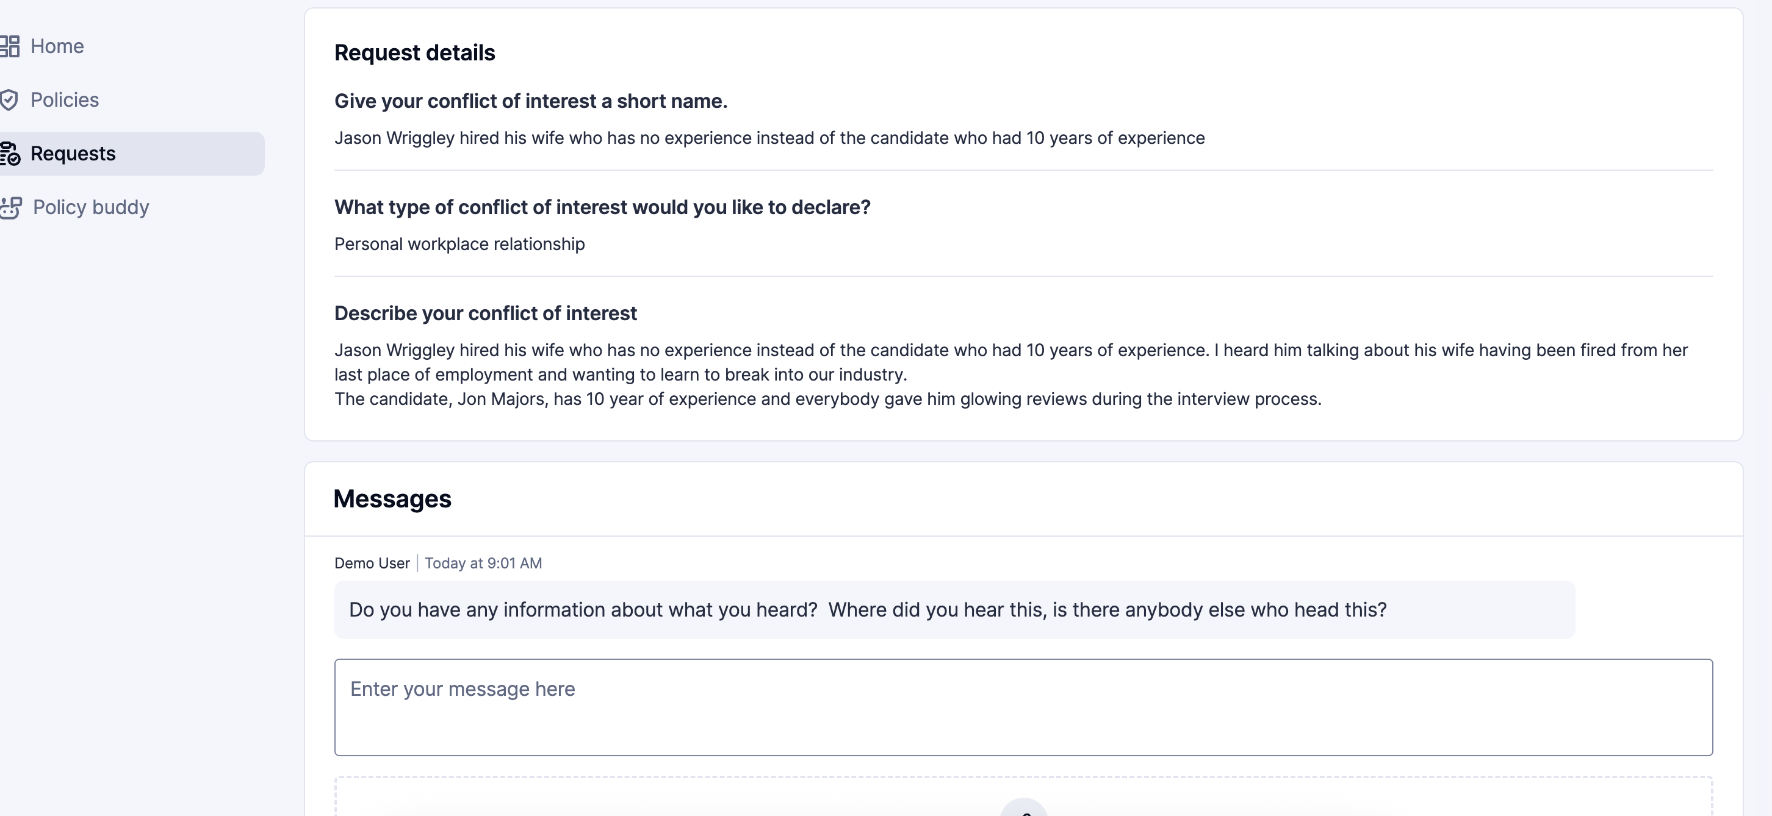
Communication from an Approver
If the approvers need more information, have questions, or need to communicate with you, you will receive an email. Click the link in the email to be directed to your request.
Open the request, then scroll to the bottom of the request. You will find the communication in the messages section of the request.

Slide 17
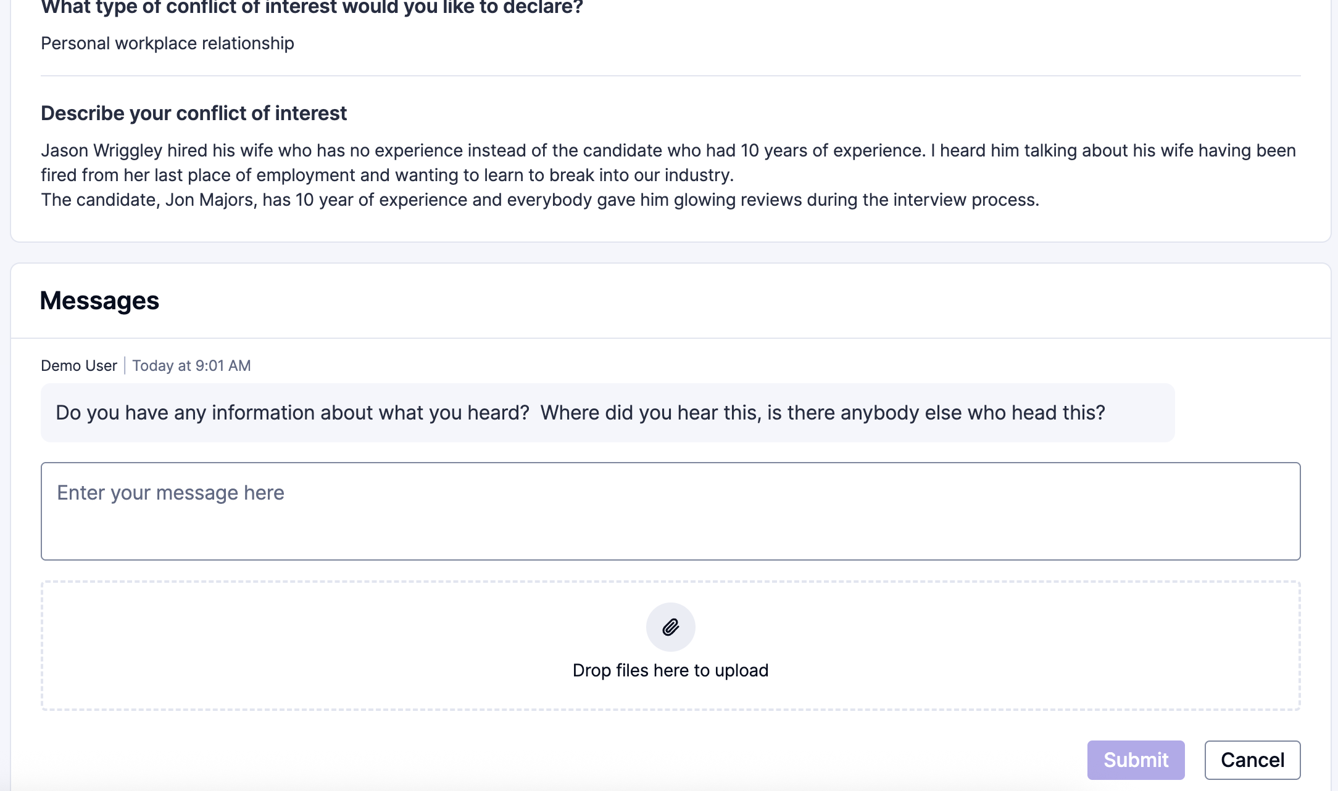
Communication to an Approver
To respond to an approver, respond in the box under the message in the Messages section.
You can add attachments to your response.
When you are finished with your response, click the Submit button.

Slide 18
05
Attestation

Slide 19
Attestation
You may be asked to attest to the result of the request.
You will receive an email requesting your review and attestation to the result of the request from the approvers. Click the link in the email. You will be directed to the request.
You will see that an attestation is required.

Slide 20
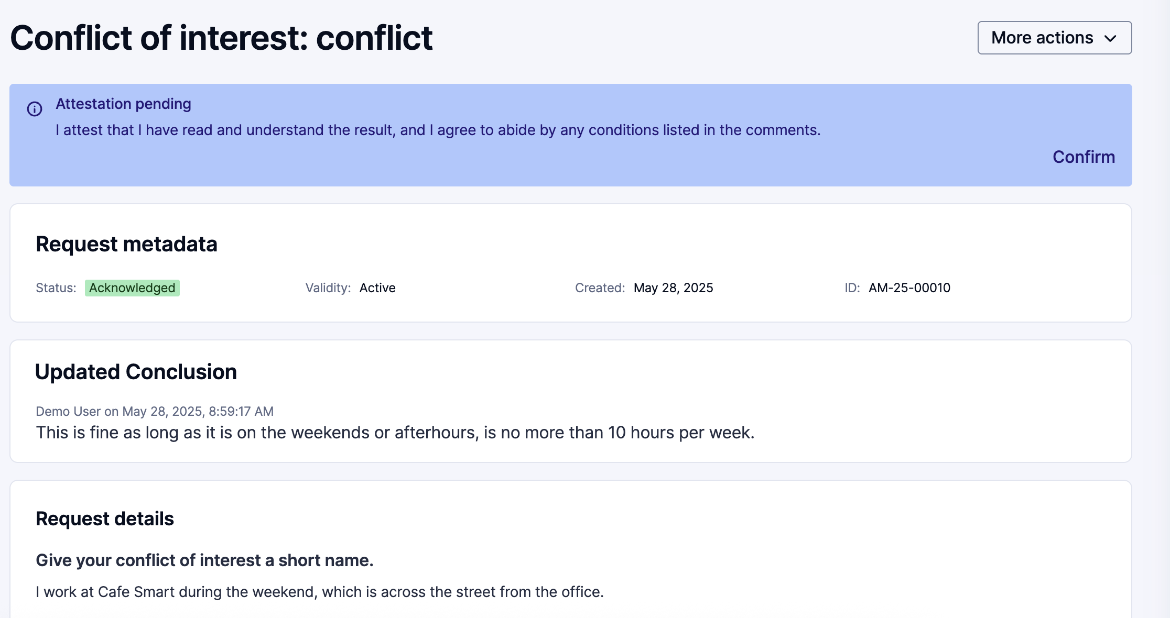
Attest to the Request Conclusion
At the top of the request, you will see there is an Attestation pending.
Click the Confirm button.

Slide 21
Attestation / Request is Completed
Once you complete the attestation, you will see this reflected in green. Your request is now fully complete.

Slide 22
06
Cancelling and Deleting a Request

Slide 23
Cancel a Request
There might be an instance when you need to cancel a request. For example, during the course of the request, the gift or invitation may have been taken back.
Navigate to Integrity Hub. Click on the request you need to cancel.
Inside this request, click on More actions, then choose Cancel request.

Slide 24
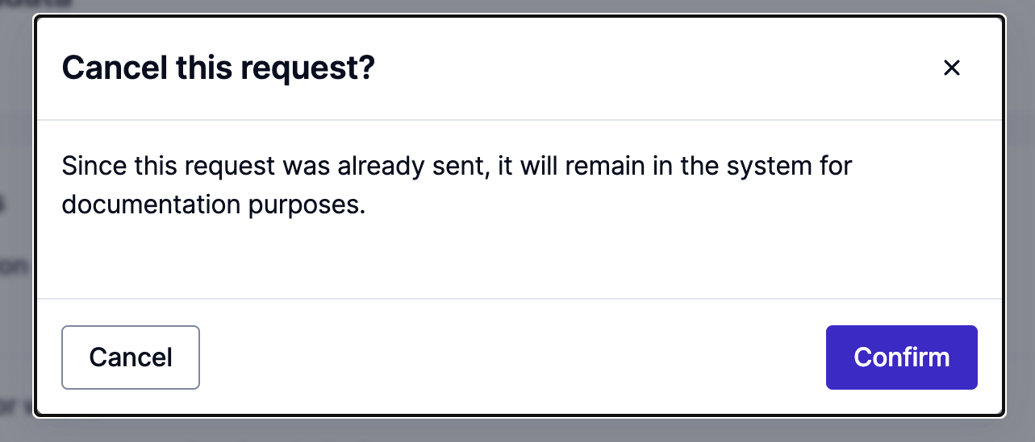
Cancel a Request
You will be prompted to Confirm you want to cancel the request.
The status of your request will then show as Cancelled.

Slide 25
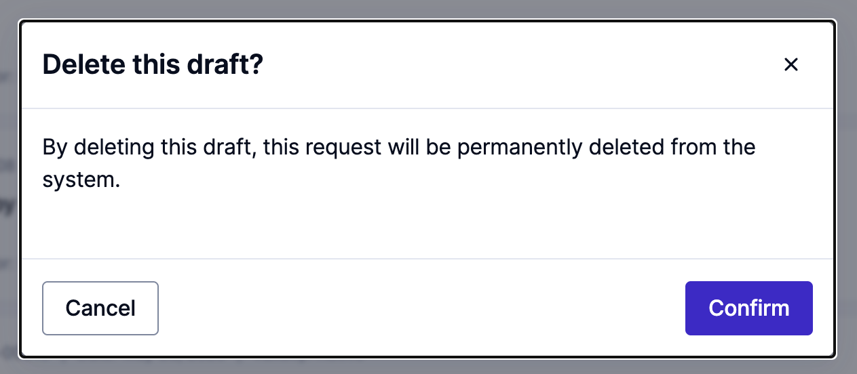
Delete a Draft Request
If you have started a request and it is in draft status, you can delete that draft. You might want to do this if the request no longer applies and you no longer need to send it.
Click the three dots on the right side of the request you want to delete. Click Delete draft.
You will be prompted to confirm you want to delete the draft. Click the Confirm button. This action is permanent.

Slide 26
07
Past Requests and Statuses

Slide 27
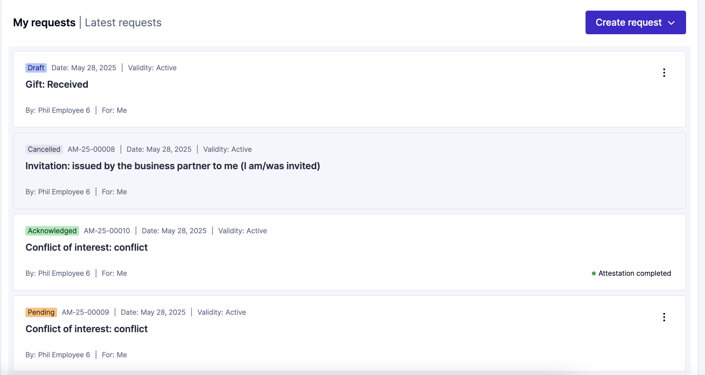
Past Requests
You may review any past requests that are in draft status, cancelled status, pending status, or any request in which a conclusion has been reached.
From the Home screen or Request screen you will see a list of all past requests.
If you need to view any past request, click on it to open the full details of the request.

Slide 28
Thank you for your attention

