Slide 1
INTEGRITY LINE
Case Management – Processing a Case Training Deck

Slide 2
Agenda
Overview & Cases
Reviewing a Case
Editing Case Details
Managing a Case
Additional Features
Closing a Case
Enterprise Features

Slide 3
Definitions
Terminology | Definition
Reporting Party | The person who submits the issue.
Case Manager | Individual assigned to an Issue. They are responsible for the documentation and maintenance of the Issue.
Secure Inbox | Where the reporter can receive messages regarding their case. If the reporter has provided contact information, they will also receive email notifications.
Notes | Repository for internal communication and questions as well as a summary of investigative activities. These messages can only be viewed by internal team members.
Involved Parties | Everyone named by the Reporting Party, as well as all others identified during the investigation as having information relating to the Issue.
Case | A claim or question around misconduct (e.g., unethical or illegal conduct) by the Company or its employees. Each case has its own unique ID and one primary classification.

Slide 4
Definitions
Terminology | Definition
Classification | Categories that describe the alleged misconduct involved in the Issue, (e.g., Unprofessional Behavior, Bullying).
Manual | A method of intake in which a person reports an Issue on behalf of someone else.
Link Cases | Other Issues that relate to the same incident (e.g. two separate Reporting Parties submit a complaint about the same incident).
Status | Current stage of the case - New, In Review, or Closed.
Reminders | An issue-related activity that can be assigned by an Administrator/ Case Manager to themselves or to another team member to complete. Reminders are only viewed by team members with access to the Issue (not the Reporting Party). Reminders can be entered/assigned even after an Issue is closed.
Anonymization | Deleting /replacing confidential information present in the case.

Slide 5
01
Overview & Cases

Slide 6
Overview tab
You will see an overview of all the cases you have access to
You can filter by ‘Time Range’ or ‘Reporting Channel’
For each of the different sectors, you can download the graphic by clicking on the download icon
Select the desired file type to download

Slide 7
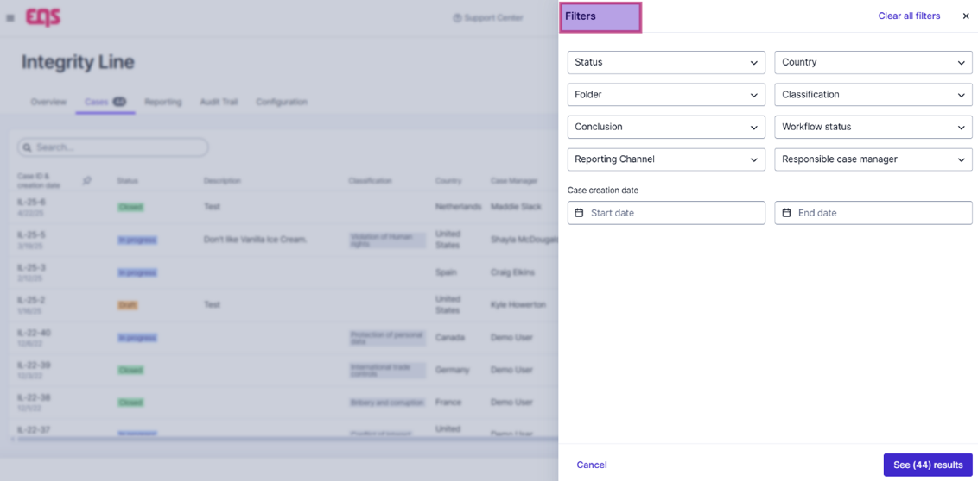
Cases tab
The Cases tab is a more customizable view. You can search for specific keywords to pull up specific cases.
By clicking on the Filter funnel icon (located on the right-hand side), you can edit the filers to your preference.

Slide 8
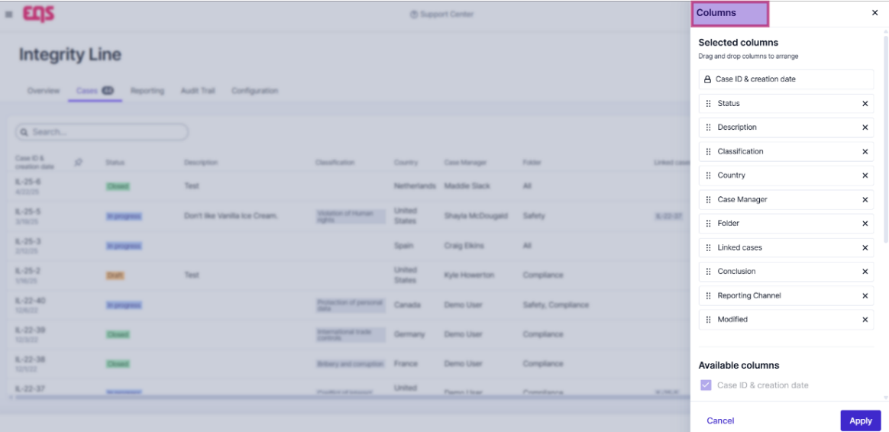
Cases tab
You can customize the columns, i.e. rearranging / removing, to further tailor your view. (Click the Column icon, next to the filter icon).
Your Column preferences are auto saved, so the next time you log in, your customized column layout will be preserved.

Slide 9
02
Reviewing a Case

Slide 10
Reviewing a Case
Find and review all information provided by the reporter
To open the case, click the Issue ID located in the left of the Dashboard pane.
The Case Manager will receive an email once assigned to case.
A link to the Issue will be included in the email, or you can also log in to view your dashboard.
Note: The Issue ID for new cases in integrity line will be in the following format
“IL– [Calendar year the case was submitted]-[sequentially assigned based on year submitted]”

Slide 11
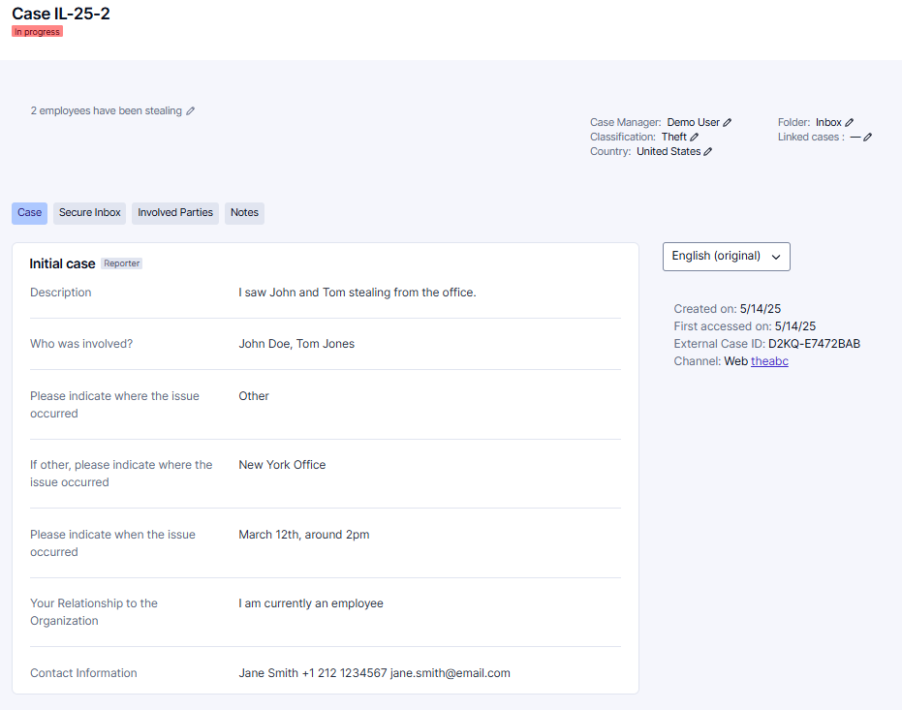
Reviewing a Case
Once you click into the case, you will be able to review the information provided by the reporting party, such as Location, Description, and more.
At the end of the report, you can see whether the Reporting Party has provided ‘Contact Information’. If not provided, it will say ‘Anonymous

Slide 12
03
Editing Case Details

Slide 13
Editing Case Details
Update and add key case investigation details
At the top of the report is where you can edit the case details. Click on the pencil icon next to the desired feature to edit it. You can select the relevant option from the list of available options configured on your system.

Slide 14
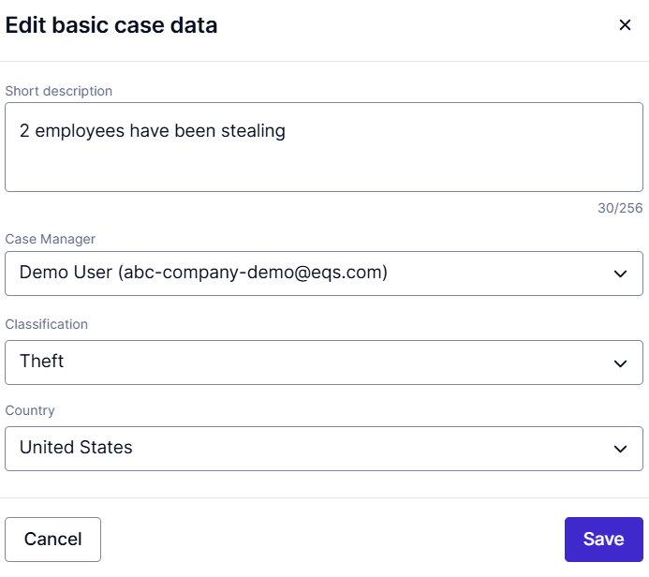
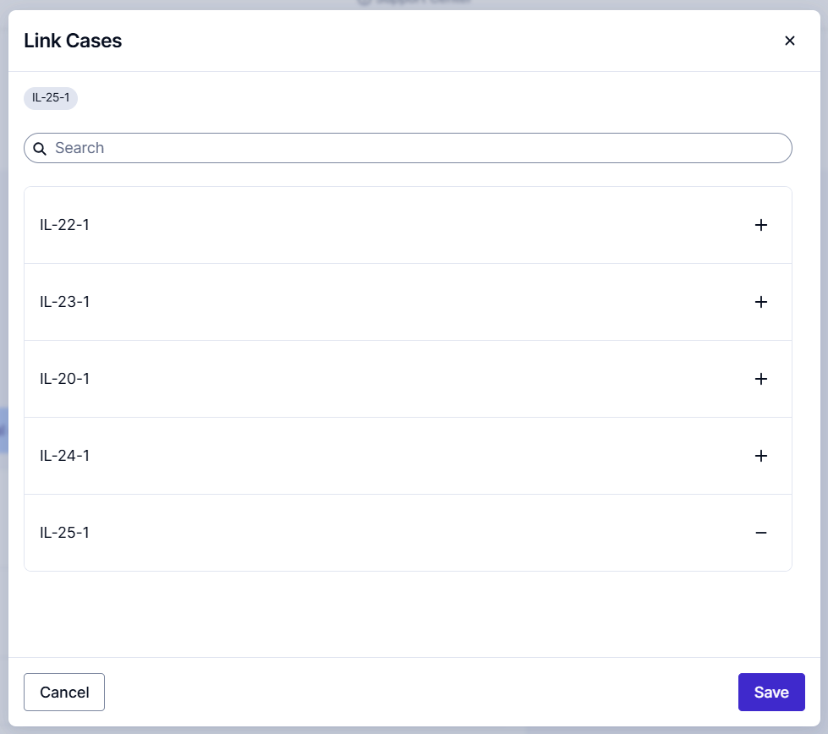
Editing Case Details
Case Manager: This should be assigned to the lead Investigator; an email notification will be sent to that user regarding the new case assignment.
Classifications: You can select the main Issue type category for the case.
Folders: You can select the relevant folder for the case.
Linked Cases: Related cases can be linked to one another to allow the Case managers to manage these issues together or to be aware that there are multiple reports. You can use the ‘+’ icon to link any relevant cases.

Slide 15
Editing Case Details
On the right-hand panel, you will also see additional information pertaining to the case, i.e. the reporting method, creation date, and more.
There is also an in-app machine translation feature, which you can use to translate the case, secure inbox content, etc. into any required language.

Slide 16
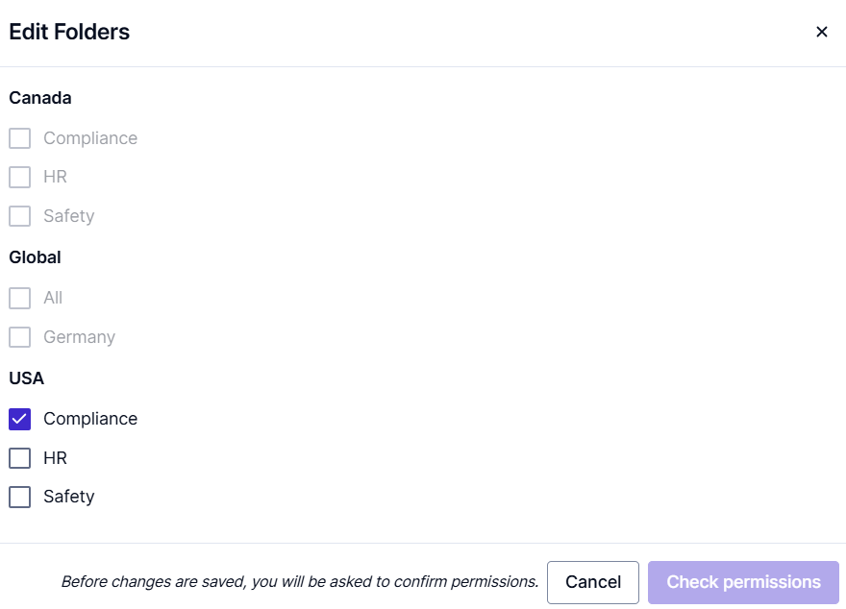
Editing Case Details - Folders
You can assign cases to different folders
Depending on your individual setup, case access permissions may depend on the folder a case has been assigned.
Select all folders the case should be assigned to, from the list of available folders.
The bold headlines reflect folder groups. A case can only be assigned to one or multiple folders of the same group.
Additionally, you can only move cases into another folder group, if you have permission to access at least one folder of that type or have a specific permission to overrule that restriction.

Slide 17
04
Managing a Case

Slide 18
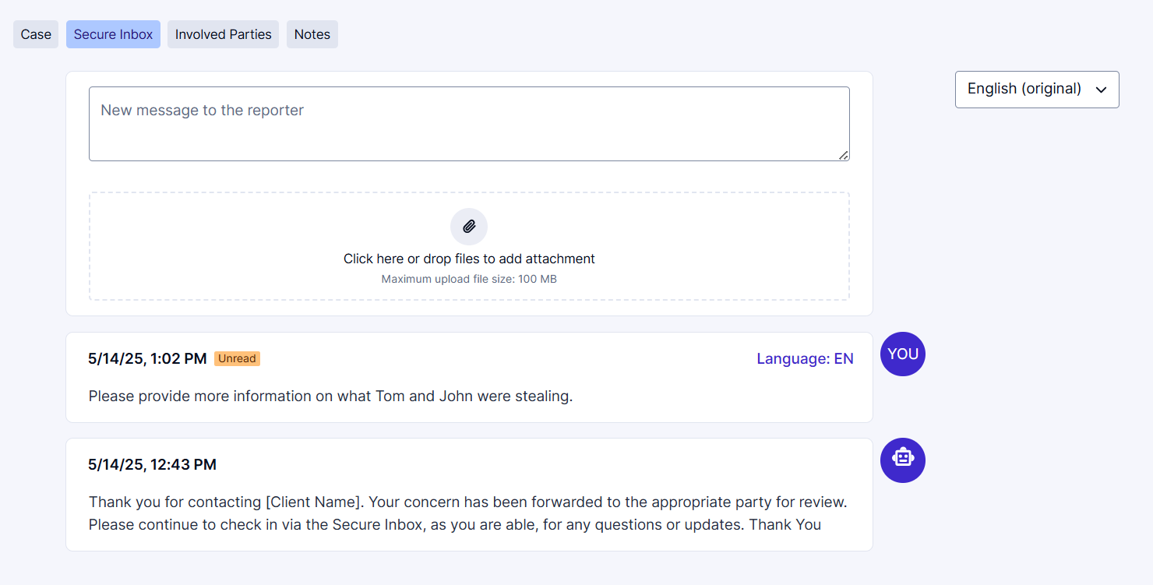
Managing a Case
Secure Inbox – Reporter Communication
To communicate with the Reporting Party, click on ‘Secure Inbox’ tab to send a message, and any other relevant supporting documents.
If the reporter has provided contact information, they will receive email notifications. If not, it will be up to them to continue checking in on their case. You can keep track of whether the message has been seen by the reporter using the ‘Unread/Read’ tags.
Note: Messages can’t be deleted once sent to the reporter.

Slide 19
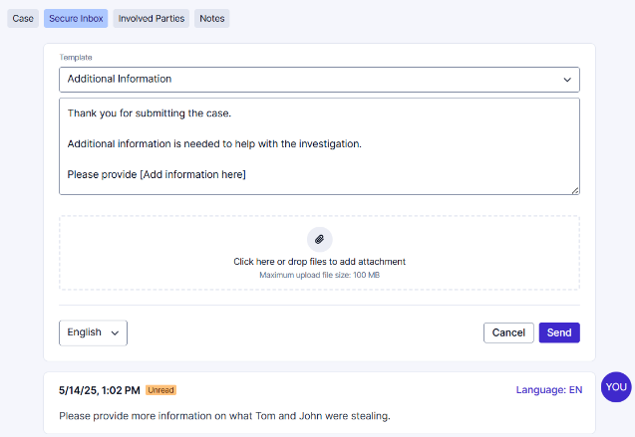
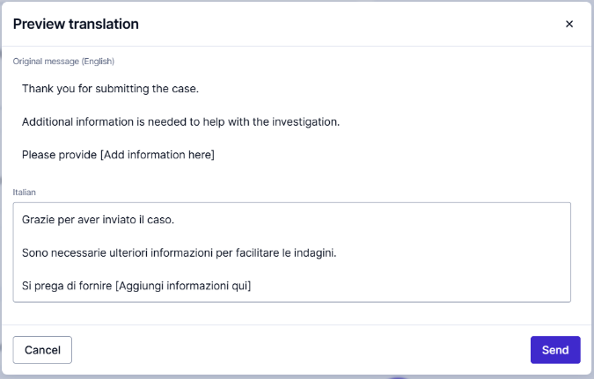
Managing a Case
Secure Inbox – Reporter Communication
If ’Messages templates’ have been configured, you can also send these to the reporter.
You can still edit the message template as needed.
You are also able to translate the message using the in-app machine translations.

Slide 20
Managing a Case
Notes – Communicating Internally
‘Notes’ can be used to document case activity such as interview summaries, case updates, and to communicate with other case managers working on the case.
You can add links, documents, and images.
You can create multiple threads, and reply to messages
You are also able to delete or edit these messages by clicking on the 3 dots ‘…’ at the right-hand corner of the message.

Slide 21
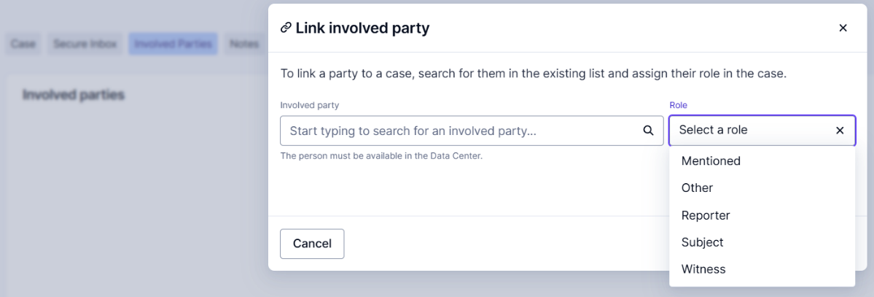
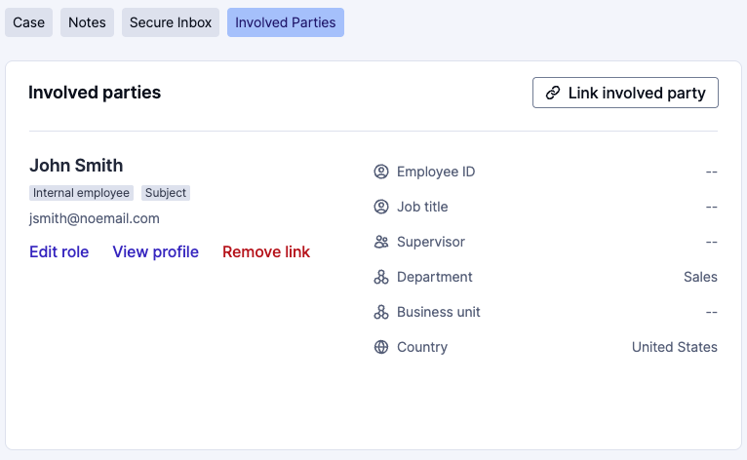
Managing a Case
Involved Parties – HR Tagging
In the ‘Involved Parties’ tab, if you have added your employee data to the system, you will be able to link users to cases and specify the role they played.

Slide 22
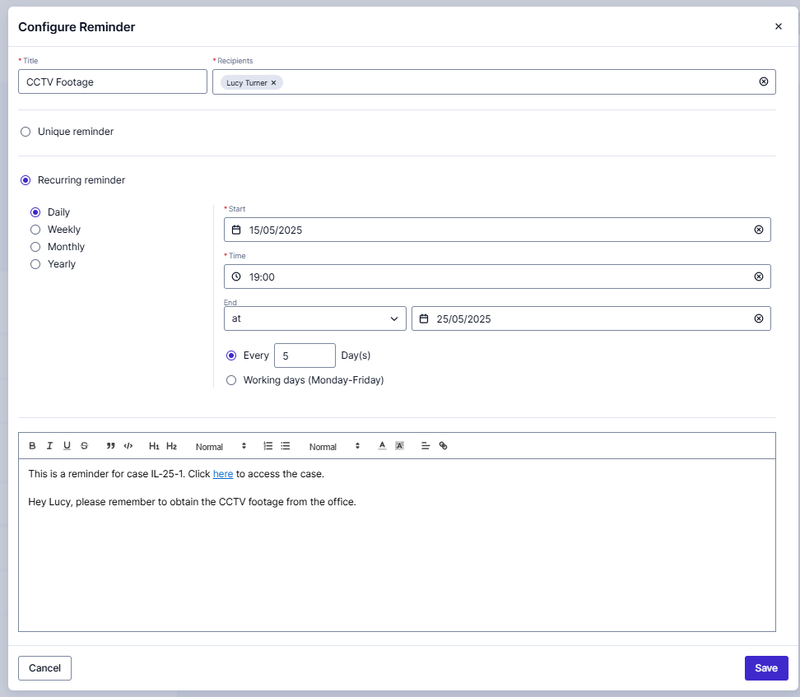
Managing a Case
Reminders
Reminders can be assigned by Case Managers to themselves or other team members to help facilitate tasks to complete.
Reminders are only viewed by team members with access to the case (not the Reporting Party). The assignee will receive an email notification.
Reminders can be created/assigned even after the case is closed.
You can set a one-time reminder ‘Unique Reminder’ or a ‘Recurring Reminder’.
Reminders can be edited or deleted.

Slide 23
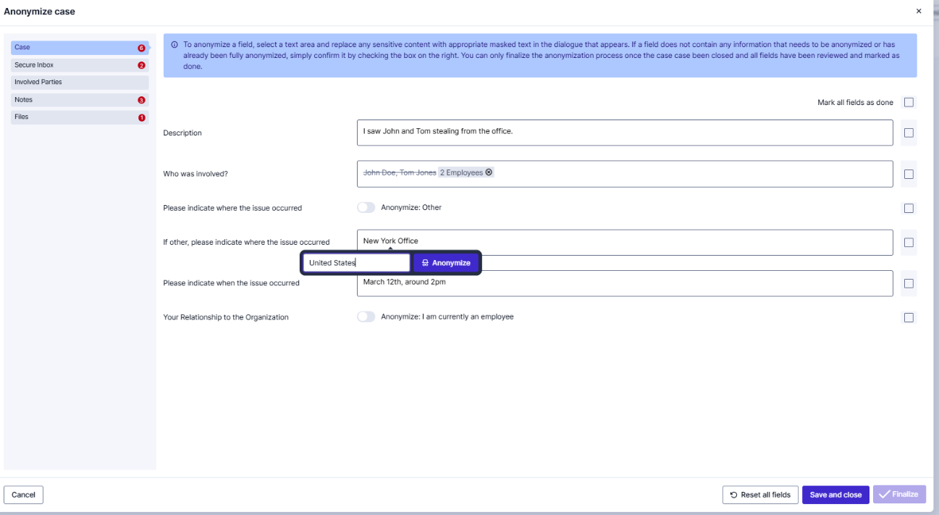
Managing a Case
Anonymization
The case can be anonymized by clicking on the Anonymize button, this allows you to delete/replace confidential information.
A final anonymization of a case is only possible when the case status is set to Closed.
When the case status is in Progress, anonymizations can be saved/edited but cannot be finalized. The original case as well as the redacted version are kept.

Slide 24
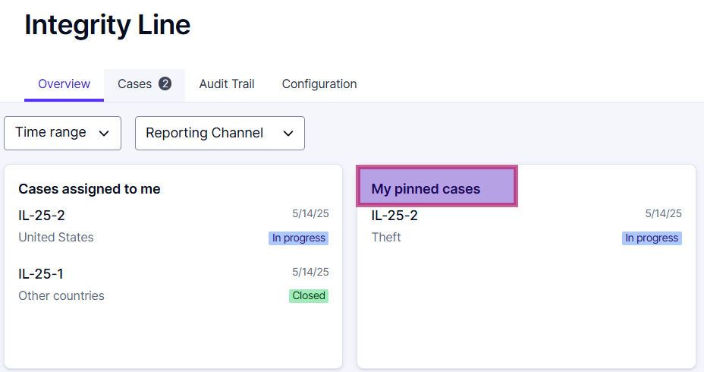
Managing a Case
Pin Cases
For easier access to your most relevant cases, you can pin a case so that it appears in your Dashboard. (Click on the thumbtack icon to pin the case)

Slide 25
05
Additional Features

Slide 26
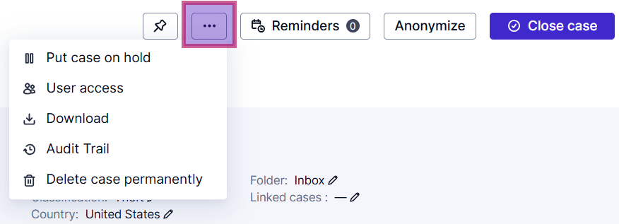
Additional Features
In the top right panel of the case, in the ‘...’ icon, there are some additional key features

Slide 27
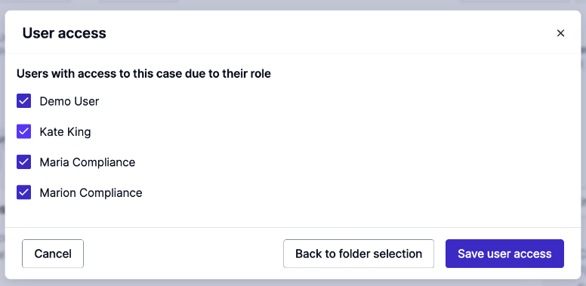
Additional Features
User Access
You can determine and manage who has access to the case.
The list will show which users currently have/ have no access. Only users with the correct role permissions will show.
Access restrictions can be applied to case managers for a specific case, by unticking the box next to their name and removing their access.
Additionally, access can be granted ad hoc by ticking the box next to the user’s name.
The designated case manager will always have access to a case and cannot be removed through user access.

Slide 28
Additional Features
Put a case on hold
This feature allows you to temporarily pause case processing while awaiting additional information or external investigations. This ensures that important cases remain visible without progressing prematurely. While on hold:
All case details stay intact
You can still add case notes and read secure inbox messages
You will not be able to send messages to the reporter
To continue working on the case, it must first be resumed

Slide 29
Additional Features
Delete case permanently
Use this option to permanently remove a case and all related data from the system.
Note: This action is final and cannot be undone. It’s typically used for test cases.

Slide 30
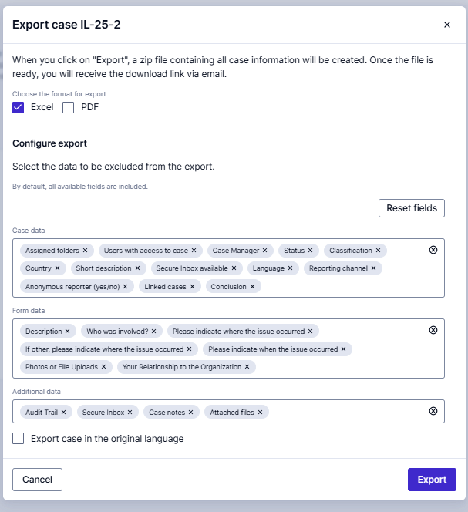
Additional Features
Download
Cases can be downloaded for further analysis and reporting. Click the Download option to export a case. The export is customizable, so you can choose what will be included in the export.
You can exclude specific data to minimize unneeded content or omit sensitive information not required for your report

Slide 31
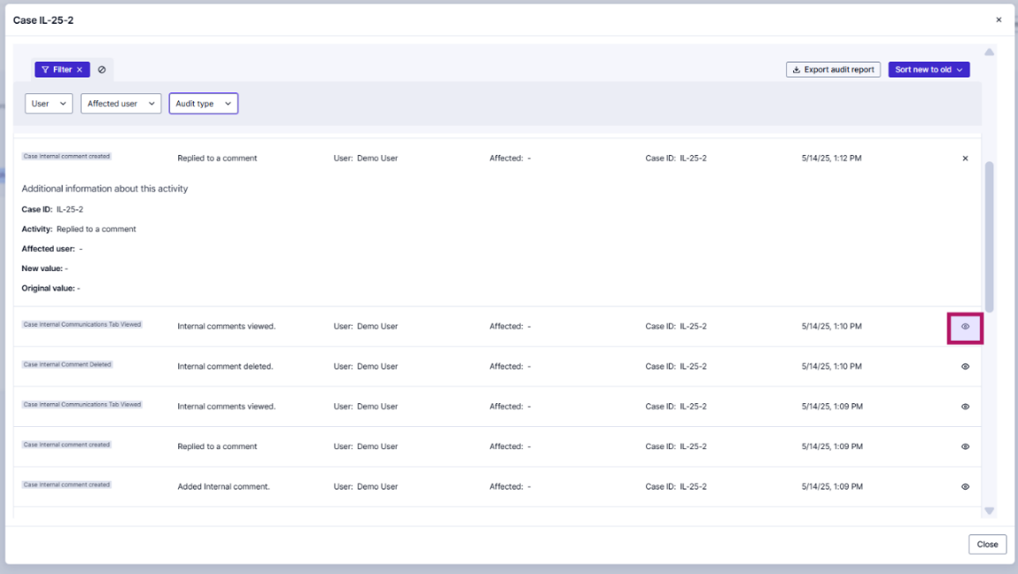
Additional Features
Audit Trail
Here you can see all the activity for the case. If you click on the eye icon in the corner, you can expand the activity to see more information.
The audit report can be downloaded and filtered.

Slide 32
06
Closing a Case

Slide 33
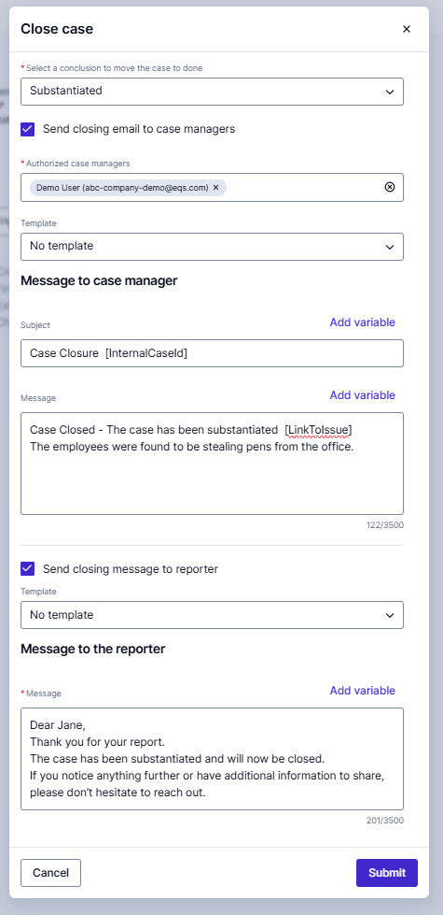
Closing a Case
When you are ready to close out the case, click on the ‘Close case’ button in the top right corner. Then you will be able to select a Conclusion, and optionally, by ticking the boxes, you can send out a closing email to the other case managers, or to the reporter.
If you have ‘Message Templates’ setup, then you will be able to use them
Notes:
Level 3 = Bullet 1 (Barlow 20 PT)

Slide 34
Reopening a Case
Cases can also be re-opened if needed. Simply click the ‘Reopen case' button, and then you can make any additional amendments and updates as needed.
Notes:
Level 3 = Bullet 1 (Barlow 20 PT)

Slide 35
07
Enterprise Features

Slide 36
Enterprise Features
Integrity Line offers more advanced features designed to enhance your case management experience. With the Enterprise package, there are some additional features.
If you do not have the Enterprise package and are interested, please speak with your Account Executive or Customer Success Manager.

Slide 37
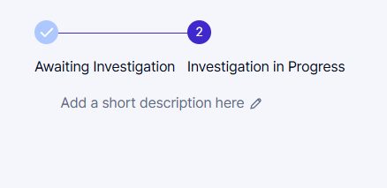
Enterprise Features
Workflows
Workflow statuses can be used to further specify the status and progress of a case. The workflow statuses are configurable.
When a case is moved to in progress, the Workflow Statuses will show up above the Short Description. The case can then be moved through the workflow.
Workflow statuses can be linked to custom case tabs to define requirements to progress the case to the next status.
Notes:
Level 3 = Bullet 1 (Barlow 20 PT)

Slide 38
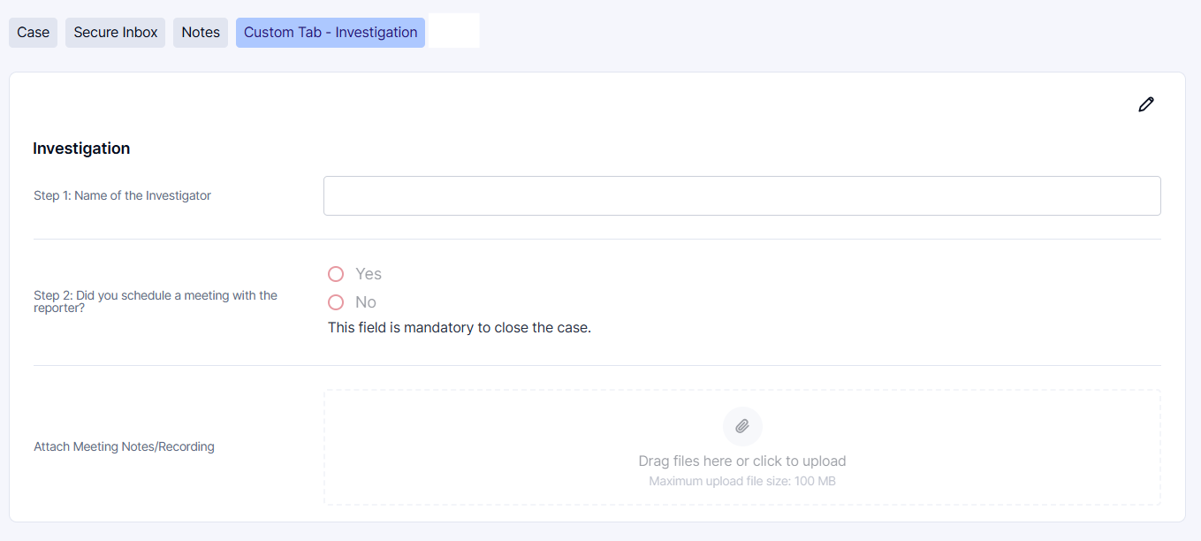
Enterprise Features
Custom Case Tabs
You can have custom case tabs which can include additional questions and sections, where you can obtain any further required information during the case management process.
You can have multiple custom case tabs and each of the questions within the custom tabs can be utilized in reporting.
Notes:
Level 3 = Bullet 1 (Barlow 20 PT)

Slide 39
Thank you for your attention

