Slide 1
Reporting Party
Submitting a Case Training Deck

Slide 2
Contents
Making a Report
Creating a Password
Obtaining Case ID
Accessing a Case
Call Us

Slide 3
01
Making a Report

Slide 4
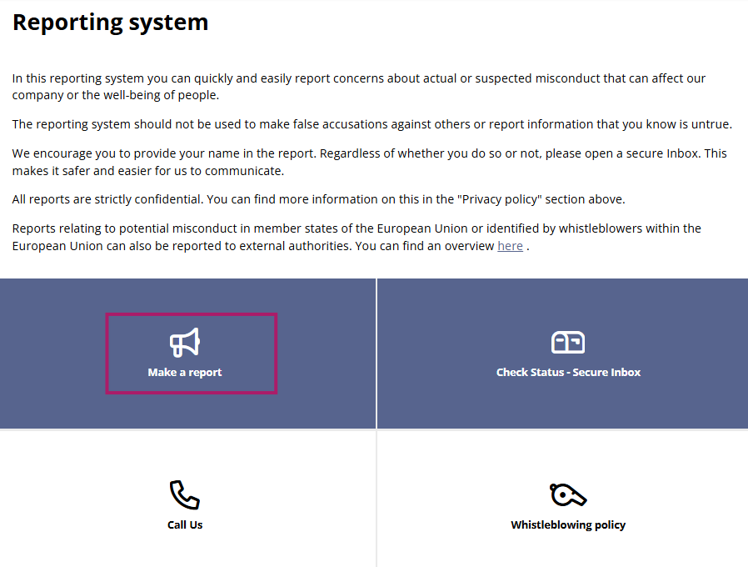
Making a Report
Once your organization has published a branded Integrity Line, users can use the portal’s intake form to submit the details of their alleged ethics violation. This training deck outlines the submission workflow reporting parties would follow to submit their case, obtain a case ID, and create a case password.
Completing the Intake Form
When users first access the Integrity Line, they will be greeted by the portal’s welcome screen. New users can make a report by clicking into the “Make a report” tile.

Slide 5
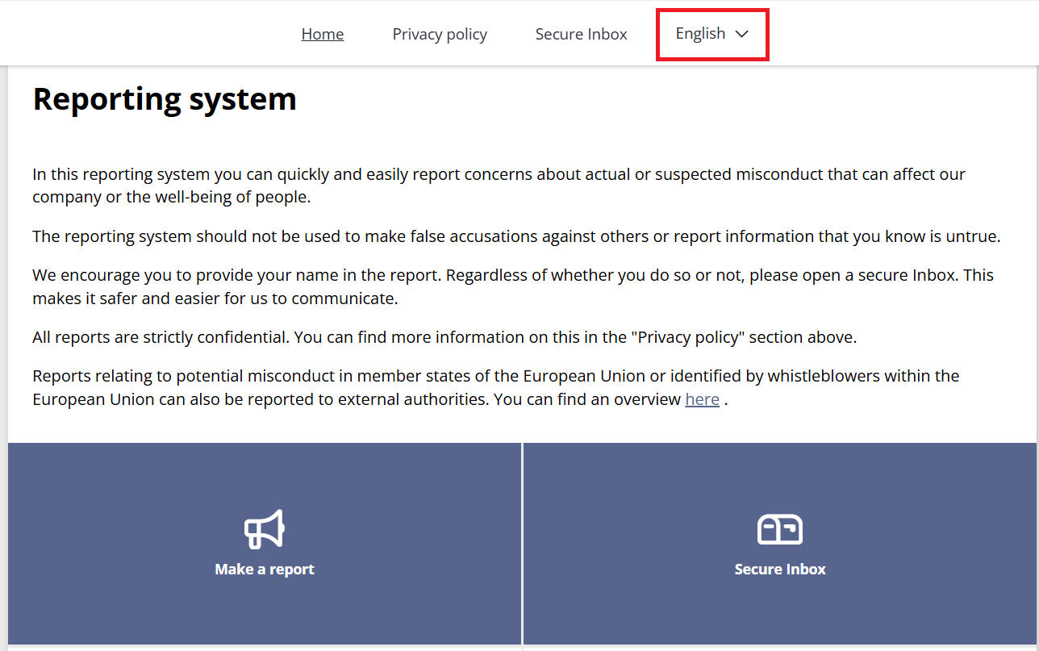
Making a Report
Language Selection
Please note, on the welcome screen, the user can also select the language they wish to report in. The language drop down will only appear if there is more than one intake language enabled.

Slide 6
Making a Report
If your organization's Integrity Line is configured to ask for country, you will see this question. If not, you will go straight to describing the incident (see next slide) .

Slide 7
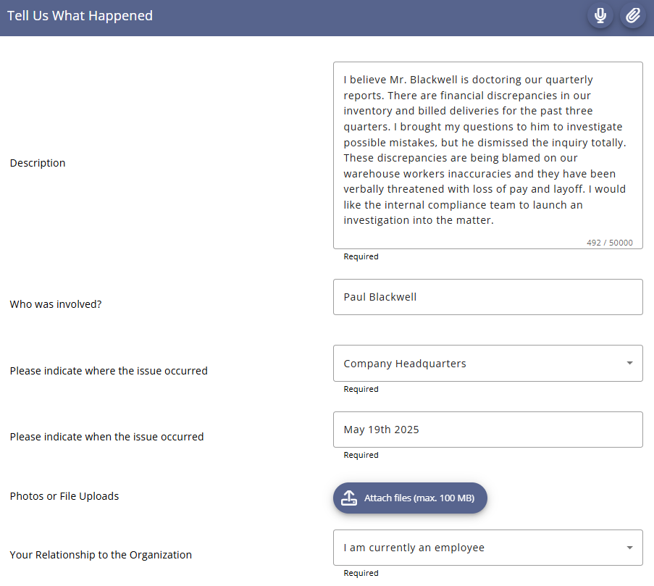
Making a Report
The reporting party will enter the details of their alleged ethics violation. The table below describes the fields and options that might be available by default on the intake form.

Slide 8
Making a Report
Field | Description
Please describe the details of the incident | Reporting party will describe the incident. These details will be viewed by the internal compliance team and appear in the Case Management screen. Clicking the microphone button enables you to record what happen in a voice note. Your voice will be automatically distorted to safeguard your anonymity throughout the process.
Who was involved | Reporting party will list the individuals who were involved in the incident i.e.: Subject Witness Victim
Please indicate where the issue occurred | Reporting party will select one of the following i.e.: Company Location City Country Other
Please indicate when the issue occurred | Reporting party will be able to provide specific date and time or a general timeframe.
Photos or File Uploads | Reporting party will be able to attach files.
Your Relationship to the Organization | Reporting party will select one of the following: I am currently an employee I am a former employee Non employee (this includes contractor, student, supplier, partner, member, etc.)

Slide 9
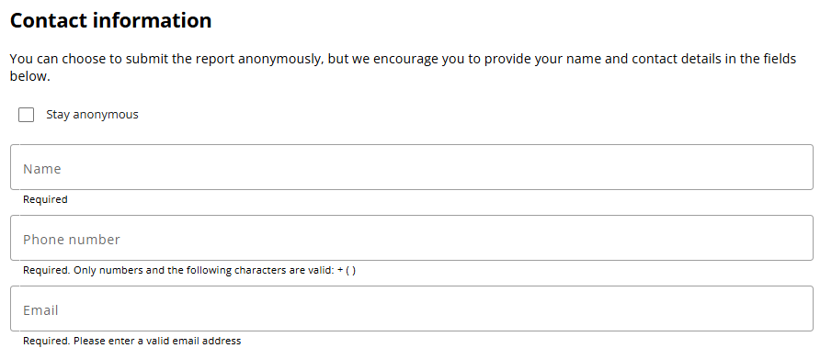
Making a Report
In the contact information section, you can choose to stay anonymous or provide your name, phone number and email. If you provide your email address, you will receive email notifications once a new message is waiting for you in the Secure Inbox. If you do not want to provide the email address, please log in regularly to check for any new messages.

Slide 10
02
Creating a Password

Slide 11
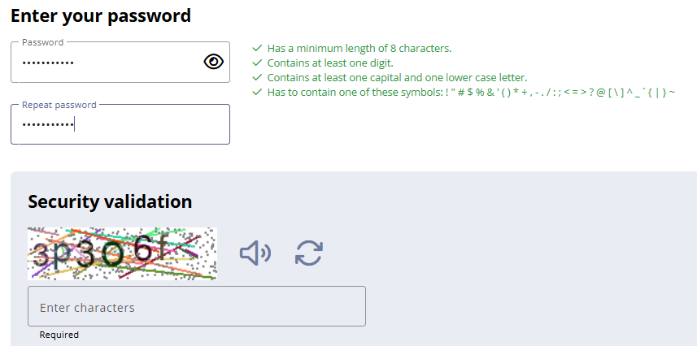
Creating a Password
The reporting party will be asked to create a custom password that can be used to access their case through the Secure Inbox. A security validation (captcha) is shown. Please enter characters (letters and numbers) shown. If you’re having difficulties in reading the captcha, you can click on the speaker icon to have it read out loud to you or click on the arrows to generate a new one.

Slide 12
Password Creation Details
Users who lose or forget their case ID or password will not be able to access their case and you have to submit a new case to open a new Secure Inbox.
Password Strength Requirements
Should be at least 8 characters long
Should contain at least one digit
Should contain at least one uppercase and one lowercase letter
Should contain a special character

Slide 13
03
Obtaining Case ID

Slide 14
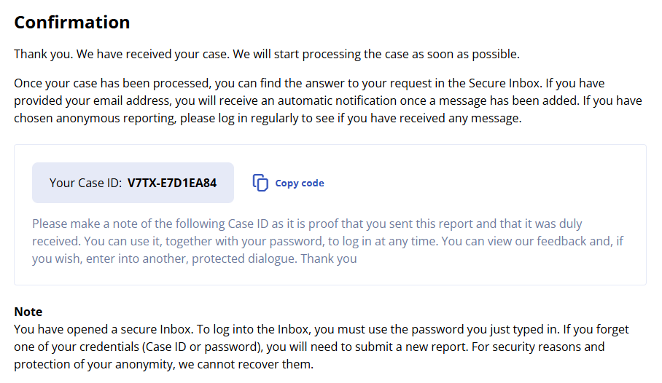
Obtaining the Case ID
Once the reporter clicks the Next button, a confirmation screen will appear with their associated case ID. This number should be documented in order to access the case from the Secure Inbox.

Slide 15
04
Accessing a Case

Slide 16
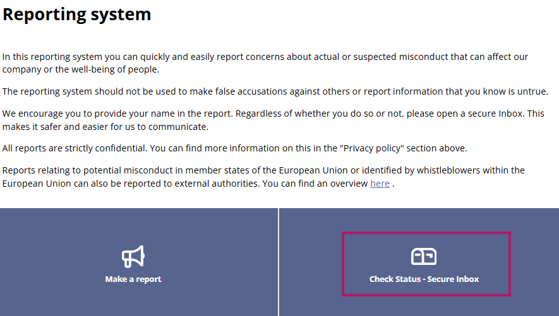
Accessing a Case
The reporting party can access the Secure Inbox by providing their case ID and custom password on your organization’s Integrity Line welcome screen.

Slide 17
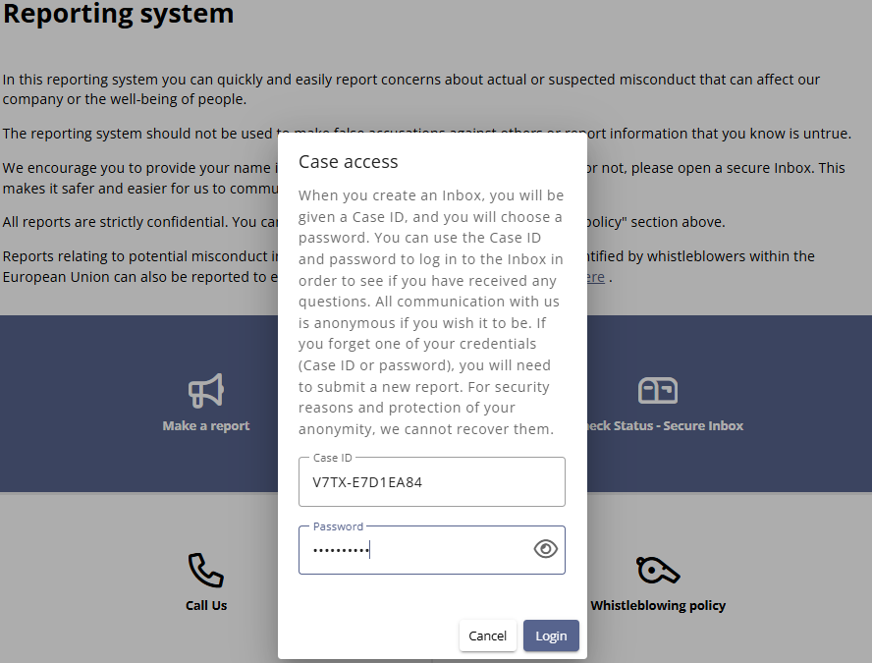
Accessing the Case
The reporter must enter the Case ID and password and click on Login.

Slide 18
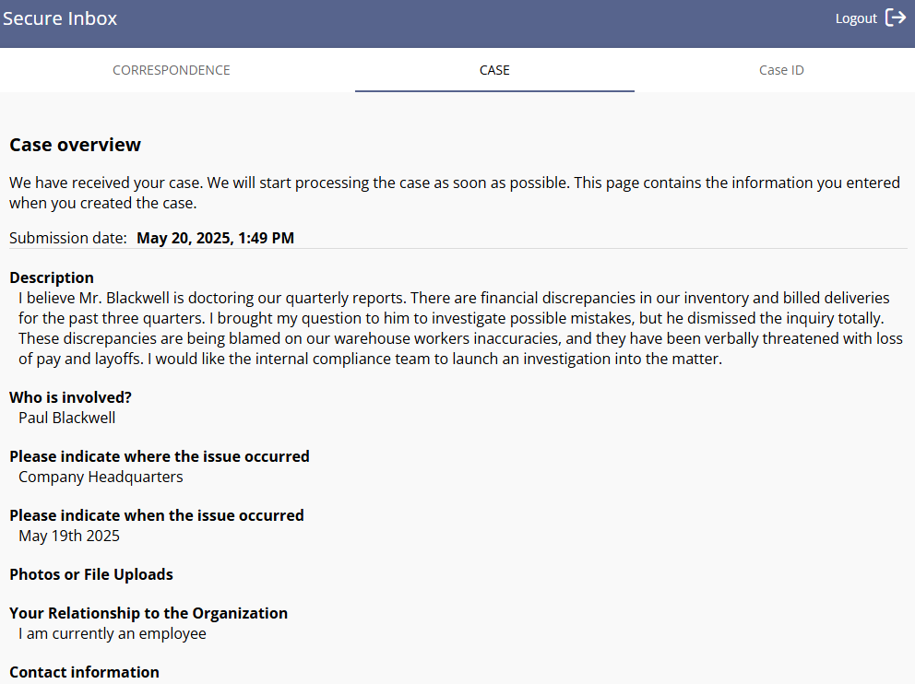
Accessing the Case
The Secure Inbox will display all of the user’s submitted details and the messages that have been added to the case by the compliance team. The user can respond to the message on the Correspondence tab.

Slide 19
05
Call Us

Slide 20
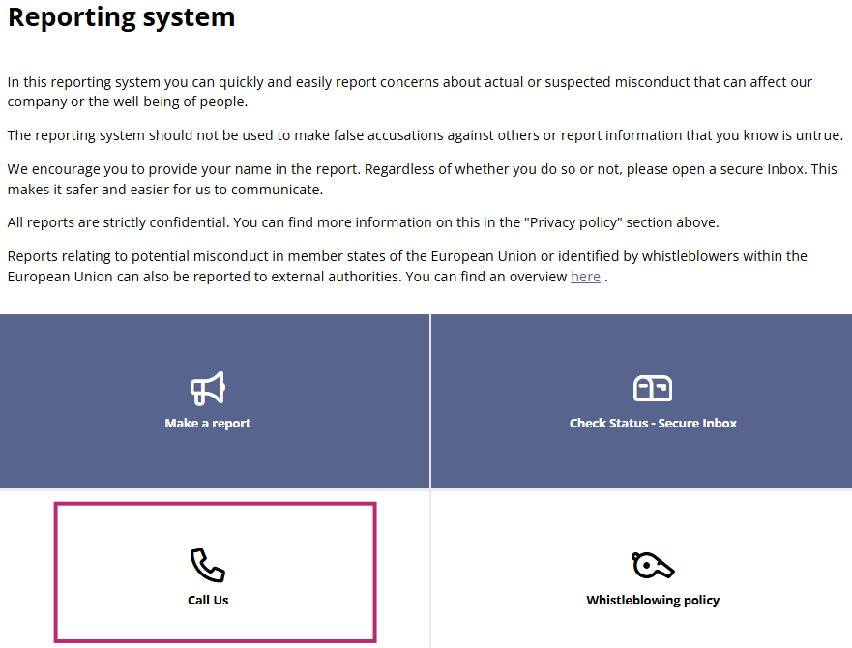
Call Us
There is also the option to make the report via the Call Us tile. Your organization will have provided you with a number – international numbers are provided as well, which will direct you to the EQS call center. The call center agent will allow you to make a report completely confidentially and they will be taking you through the exact same options that are available in the web report, just over the phone.

