Slide 1
Policies
Reviewing and Versioning a Policy

Slide 2
Agenda
Overview and Policies
Reviewing a Policy
Editing a Published Policy
Creating a New Version of a Published Policy

Slide 3
01
Overview & Policies

Slide 4
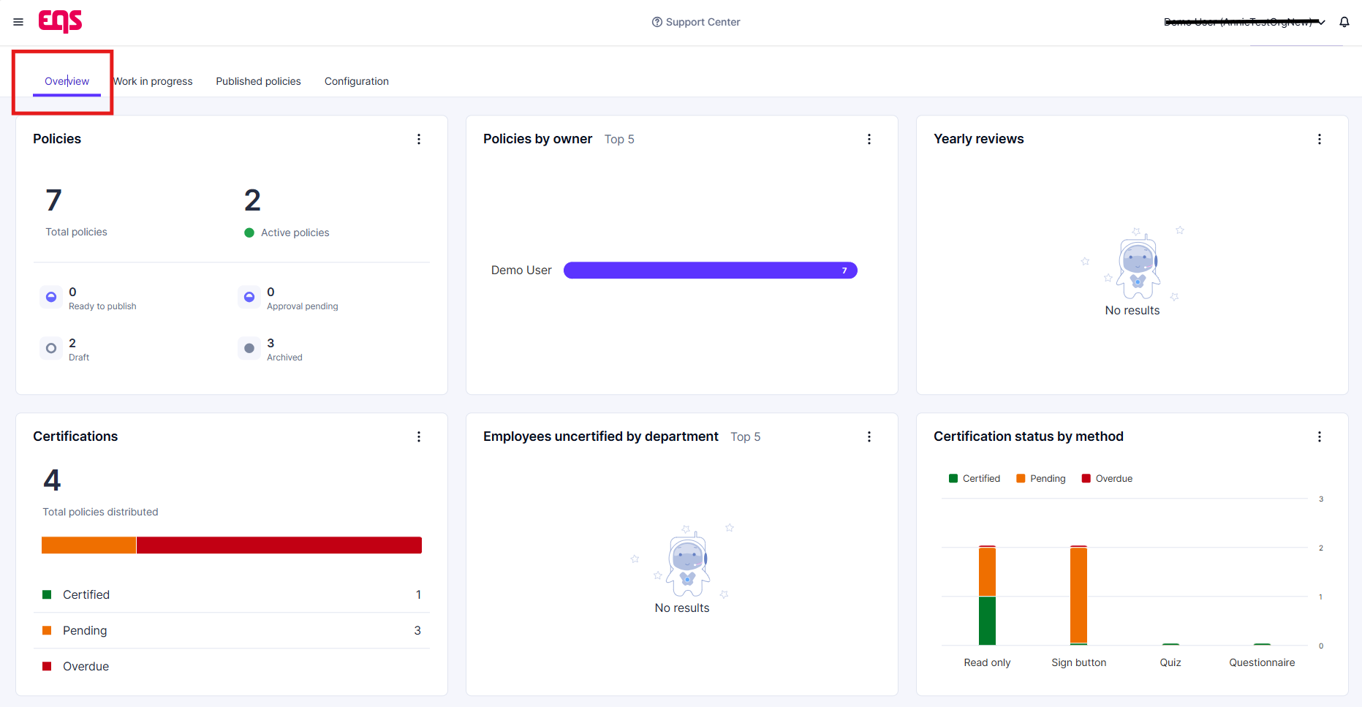
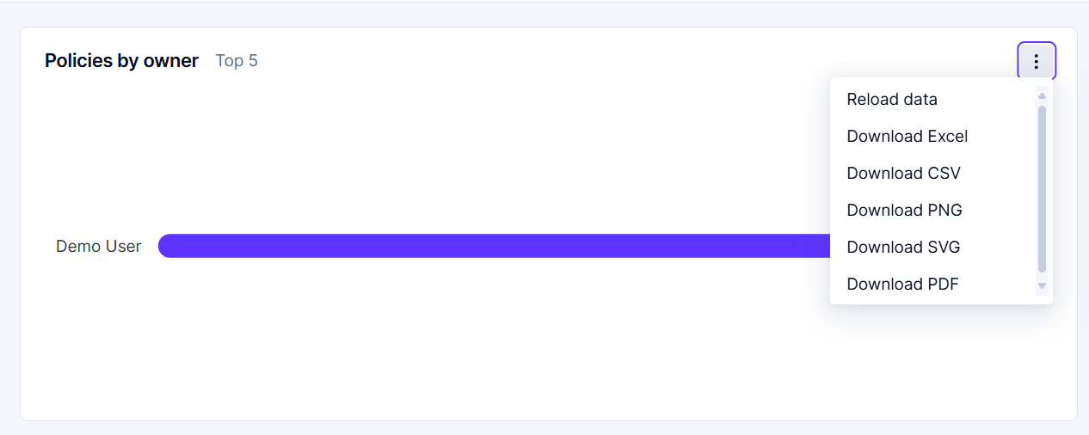
Overview tab
You will see an overview of all the policies and statistics related to those policies
For each of the different sections, you can download the graphic by clicking on the download icon
Select the desired file type to download

Slide 5
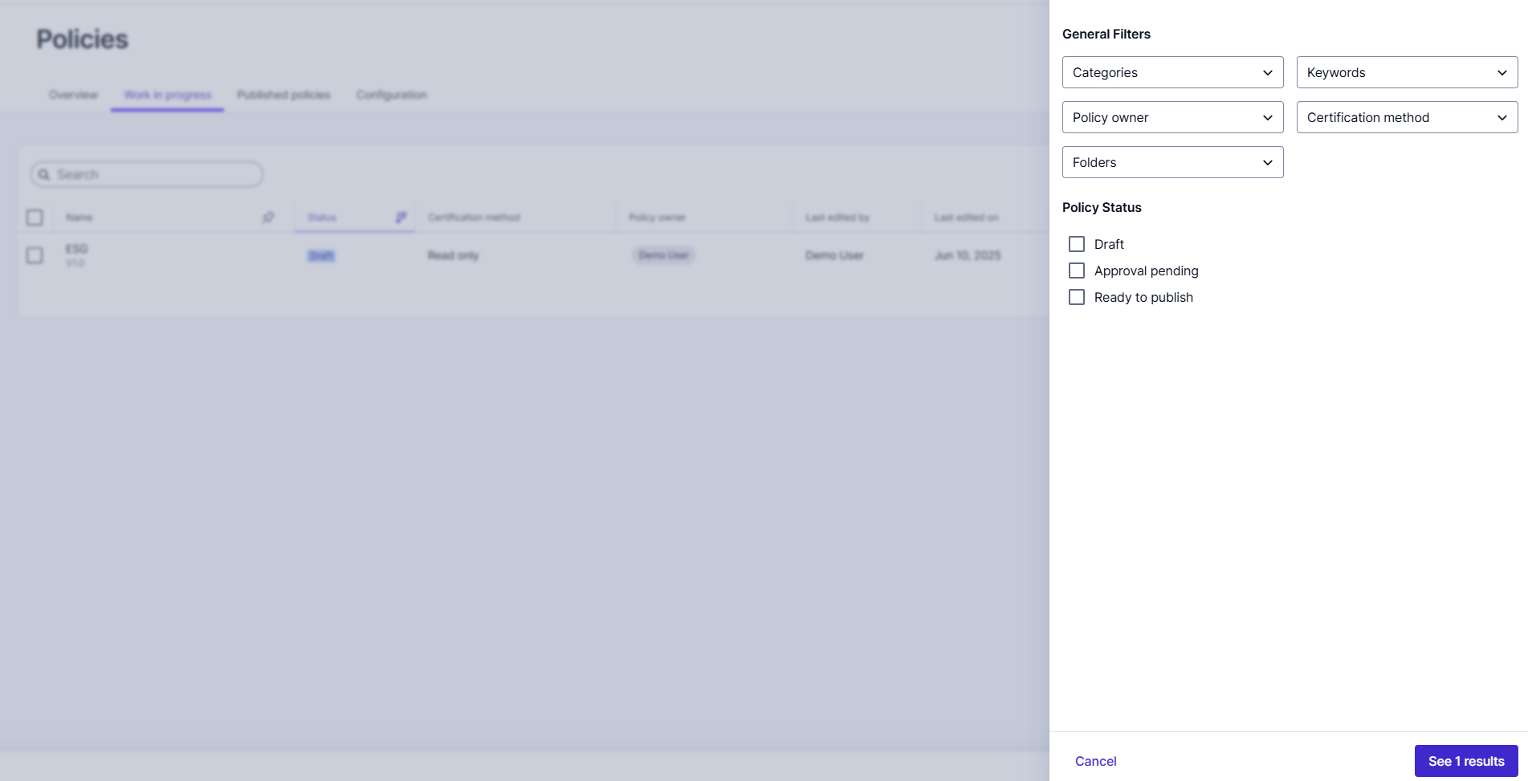
Work in Progress tab
The work in progress tab will show policies that are in draft status, approval pending, or ready to publish.
By clicking on the icons located on the right-hand side of each policy, you can sort, add columns, and filter your view as needed

Slide 6
Published Policies tab
On this page you can view your Active and Archived policies. When a policy is Active, that means it has been assigned, and it is viewable to employees in Integrity Hub.
Each line will give an overview of the Policy Name, status, certification method, certification rate, audience, and date published.
Here you can also use the buttons on the top right to send a reminder and download meta data for all published policies
Note: The "remind pending users" button will send an email reminder to ALL users who have not yet certified any of the Active, Published policies.

Slide 7
02
Reviewing a Policy

Slide 8
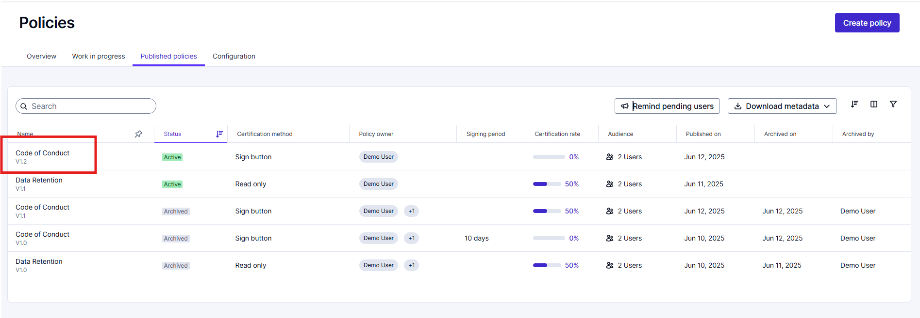
Reviewing a Policy
To open the Policy (either In Progress or Published), click the Policy Name located in the left of the Dashboard pane.

Slide 9
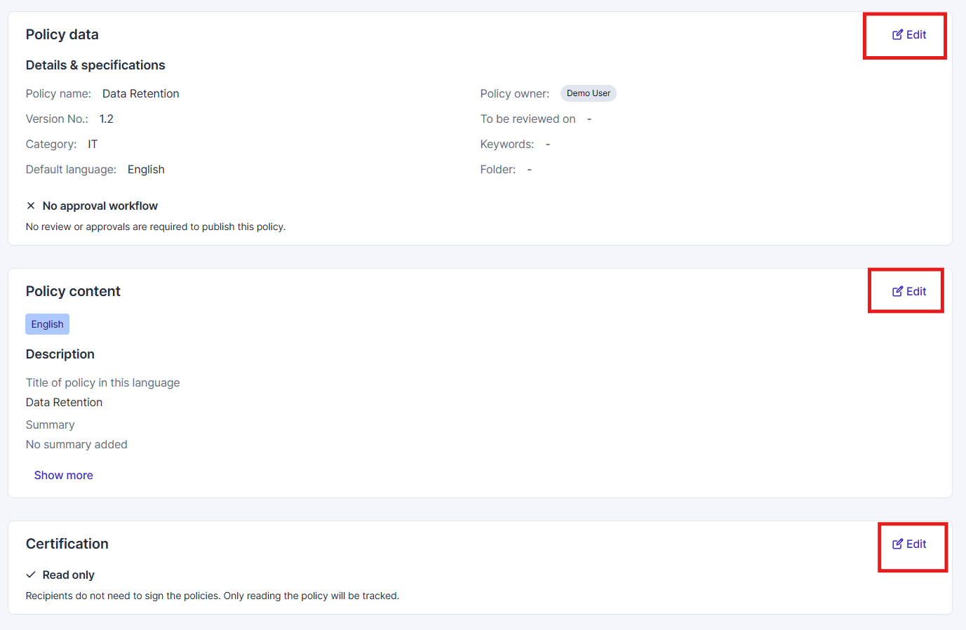
Reviewing a Policy
Once in the Policy you can view the content, details, certification and audience.
For "draft" policies you can use the edit button next to each section to make changes.
For policies "Pending approval" see the next slides for how to review and approve.
For changes to "Active" policies, see sections 3 & 4.

Slide 10
Reviewing a Policy
To view the full policy content you will need to click "See More" under the policy Content section

Slide 11
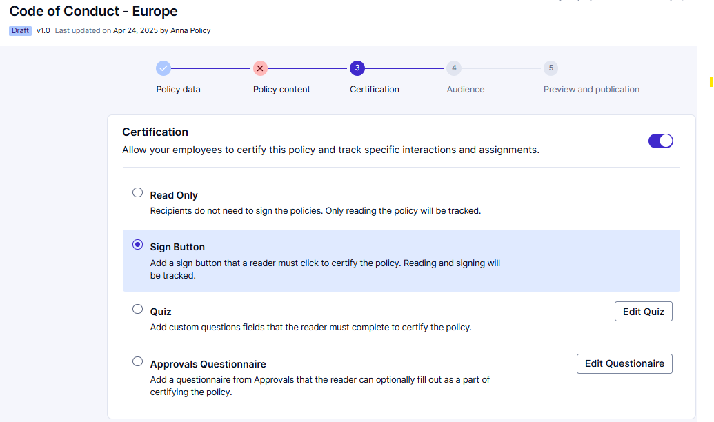
Reviewing a Policy
One of the following Certification Methods will be selected within each policy

Slide 12
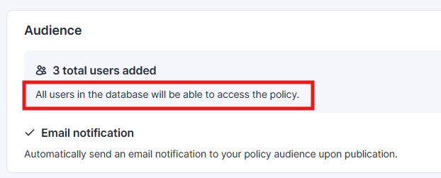
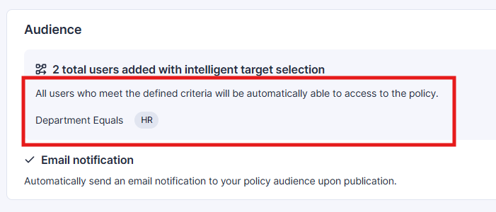
Reviewing a Policy
The audience outlines the users or employees who have been assigned the policy. These users have either previously certified the policy or can view and certify the policy in Integrity Hub
There are two ways in which the audience of a policy can be defined.
Either all users in the data base will be assigned the policy
OR the policy can be assigned based on user criteria

Slide 13
Reviewing a Policy
Policies pending approval will be flagged with the appropriate status on the work in progress screen
To begin your review, click into the policy, review all appropriate fields, then click "Start Review" in the upper right hand corner

Slide 14
Reviewing a Policy
After clicking "Start Review" you will see a pop up on the right hand side to Approve or Deny and add Comments as needed.
Then click "Submit"
This process will need to be completed for all rounds of approval

Slide 15
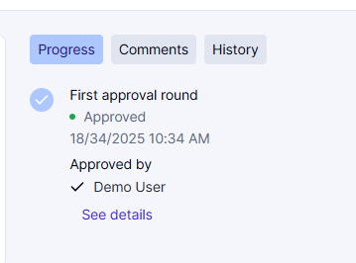
Reviewing a Policy
Once Approved by all necessary users the Policy will be marked as "Ready to Publish" and the approval process will be outlined on the right side of the screen.
The appropriate user can then access the policy and click "Publish". This will assign the policy to all applicable employees and move it to the "Published Policy" tab

Slide 16
Reviewing a Policy
Within each Published Policy you will again see the "Remind Pending Users" and "Download Metadata" buttons
You can use these buttons to send an email reminder to all employees who have not yet certified that specific policy or download meta data for that specific policy

Slide 17
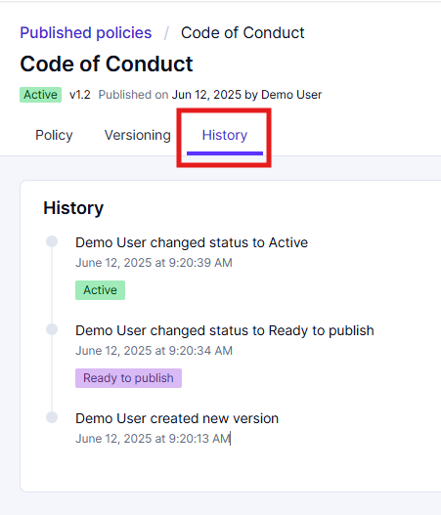
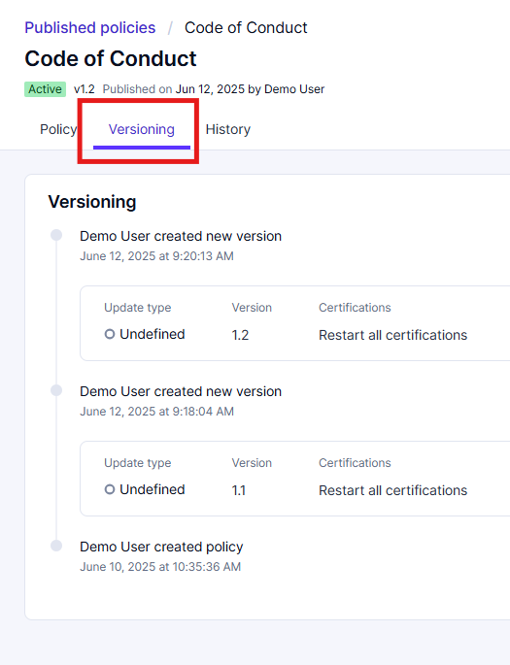
Reviewing a Policy
On the history tab you can view when that version of the policy was moved through each previous stage prior to publication.
On the Versioning tab you can view the previous versions of that policy, the updates that were made, and if recertification was required.

Slide 18
03
Editing a Published Policy

Slide 19
Editing A Published Policy
Making small changes to a policy
Once in a policy you can use the ellipses in the upper right hand corner and select “Edit a Policy”. Here you can correct mistakes or make small changes without creating a new version or restarting certification. No notifications will be sent out. All changes will be logged in the policy history.

Slide 20
Editing A Published Policy
Once in edit mode, click “Edit” to the right of “Policy data” to step through and make small edits.

Slide 21
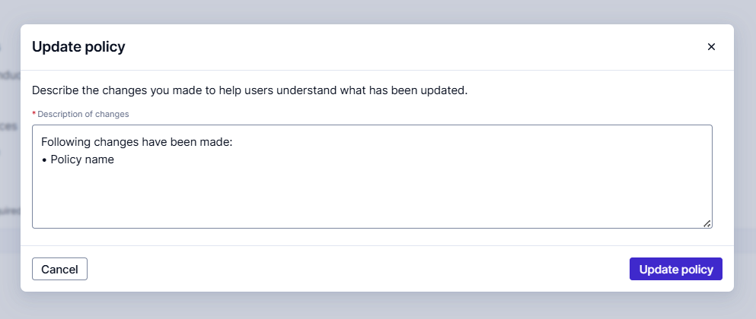
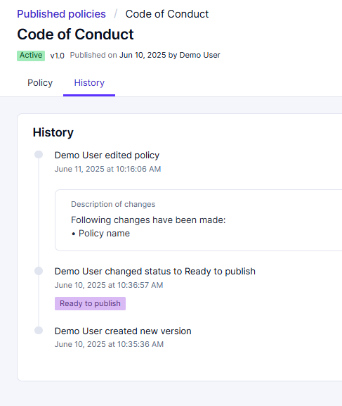
Editing A Published Policy
After updates are made, a pop-up window will summarize the changes that have been made. You can edit this text as needed. Then click update policy.
The summary of changes will then be displayed in the policy history

Slide 22
04
Creating a New Version of a Published Policy

Slide 23
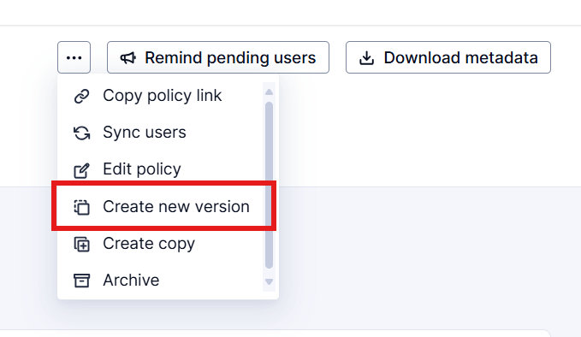
Creating a New Version of a Published Policy
For significant updates that require recertification
Using the same ellipses menu, you can “Create a new version” of a policy.
When creating a new version, you can make major edits to the policy.

Slide 24
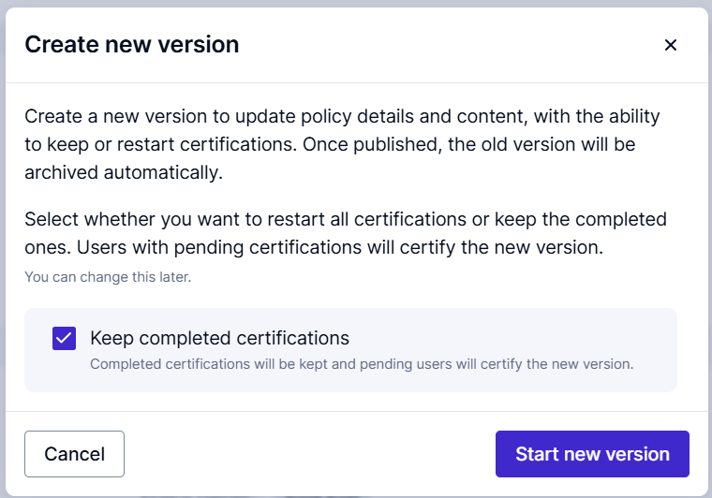
Creating a New Version of a Published Policy
When you click create a new version you will see a pop up that asks if you would like to keep completed certifications.
If you would like all employees who have already certified (or attested to) this policy to re-certify uncheck this box.
Otherwise, leave as is and the policy will be updated for all future certifications.

Slide 25
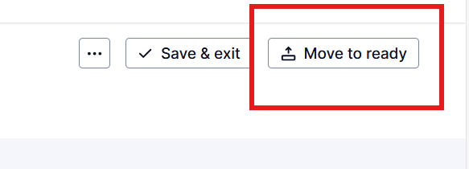
Creating a New Version of a Policy
Once the new version has been created, it will be found in the “Work in progress” tab with the applicable version number.
You can edit each section as needed.
Once edits are complete, select "Request Approval" or “Move to Ready”. This will move the new version of the policy through the appropriate approval flow.

Slide 26
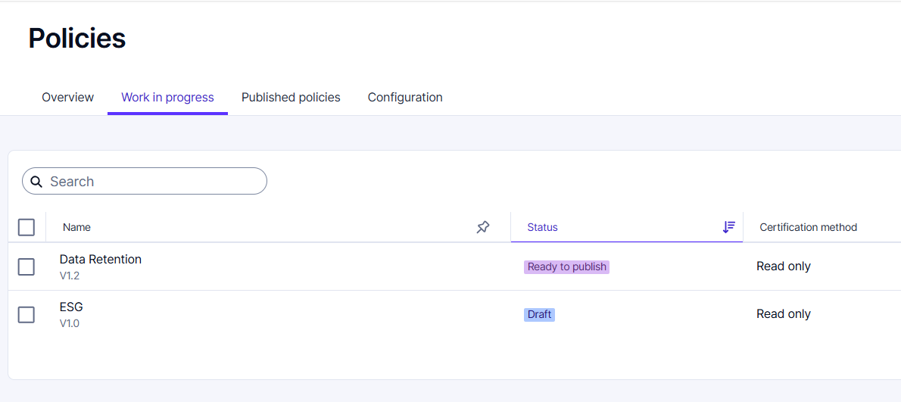
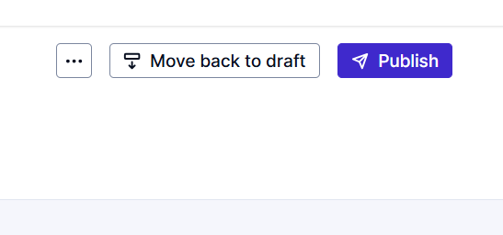
Creating a New Version of a Policy
Publishing the new version
Once all approvals are complete the policy will be marked as “Ready to publish.
The appropriate admin user can open the policy and click “Publish” in the upper right hand corner.
This new version of the policy will then be "Active" and displayed in the "Published" tab

Slide 27
Thank you for your attention

