Slide 1
Recommendations for using this training presentation
Delete this slide before sharing this presentation
Customization of this deck is necessary before using this presentation. The format (PPT) is editable so that you can remove content, add screenshots and add notes about processes that are specific to your own organization
  Note: Customization is necessary as there are two alternative use cases for managing allegations. Review the Section 4 slide titled: Invovled Party – Allegations and either delete the slide or delete the warning box depending on your use case.
Intended audience: The people in your organization who will be reviewing, managing, and making updated for submitted cases.

Slide 2

INTEGRITY LINE
Case Management – Processing a Case Training Deck

Slide 3
Agenda
Overview & Cases
Reviewing a Case
Editing Case Details
Managing a Case
Additional Features
Closing a Case
Enterprise Features

Slide 4
Definitions
Terminology | Definition
Reporting Party | The person who submits the case.
Case | An issue or question around compliance and ethics (e.g., unethical or illegal conduct) by the Company or its employees. Each case has its own unique ID and one primary classification.
Case Manager | Individual assigned to a Case. They are responsible for the documentation and maintenance of the Case. Typically, the person who is responsible for the investigation.
Secure Inbox | Where the reporting party and case manager(s) communicate about the case, and where thereporting party can check on the status. If the reporting party has provided contact information, they will also receive email notifications.
Notes | Repository for internal communication and questions as well as a summary of investigative activities. These messages can only be viewed by internal team members.
Involved Parties | Designated involved parties, as identified and added to the case during the investigation.

Slide 5
Definitions
Terminology | Definition
Classification and Allegations | Categories that describe the alleged misconduct involved in the Case, (e.g., Unprofessional Behavior, Bullying). Multiple allegations can be added to the case along with the associated involved party, and the primary allegation is designated in the Classification field.
Manual Intake | A method of intake in which a person reports a Case on behalf of someone else.
Link Cases | Other Cases that relate to the same incident (e.g., two separate Reporting Parties submit a complaint about the same incident).
Status | Current stage of the case - New, In Review, or Closed.
Reminders | A Case - related activity or notification that can be assigned by an Administrator/ Case Manager to themselves or to another team member to complete. Reminders are only viewed by team members with access to the Case (not the Reporting Party). Reminders can be entered/assigned even after a case is closed.
Anonymization | Deleting /replacing confidential information present in the case. Prior to case closure, users can see anonymized and original versions of the case based on their permissions. After case closure, anonymized data can be finalized to fully redact the information.

Slide 6
01
Overview & Cases

Slide 7
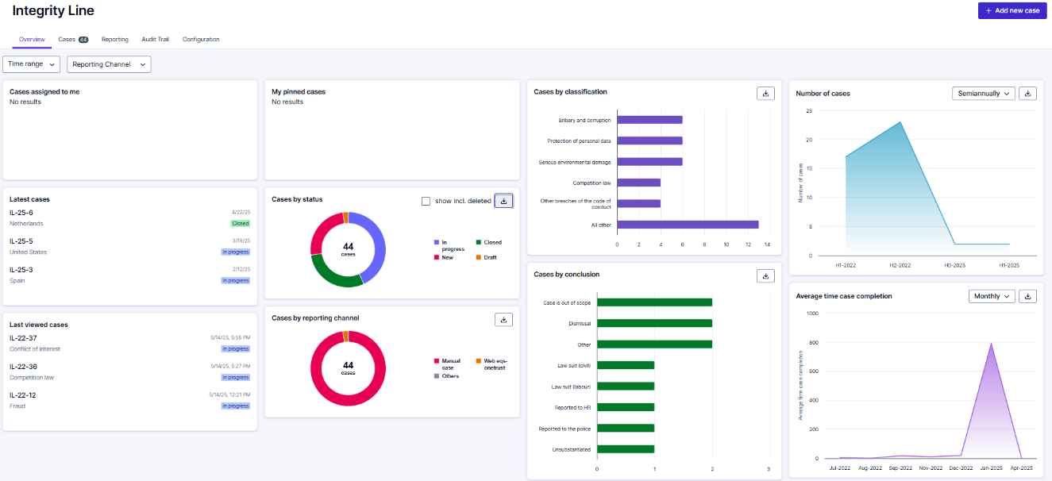
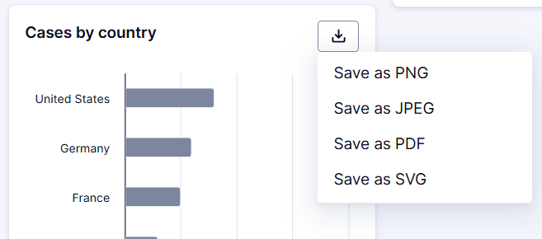

Overview tab
    You will see an overview of all the cases you have access to
    You can filter by ‘Time Range’ or ‘Reporting Channel’
    For each of the different sectors, you can download the graphic by clicking on the download icon
    Select the desired file type to download

Slide 8
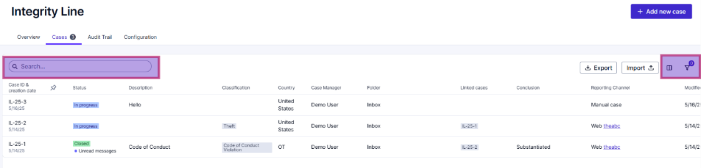
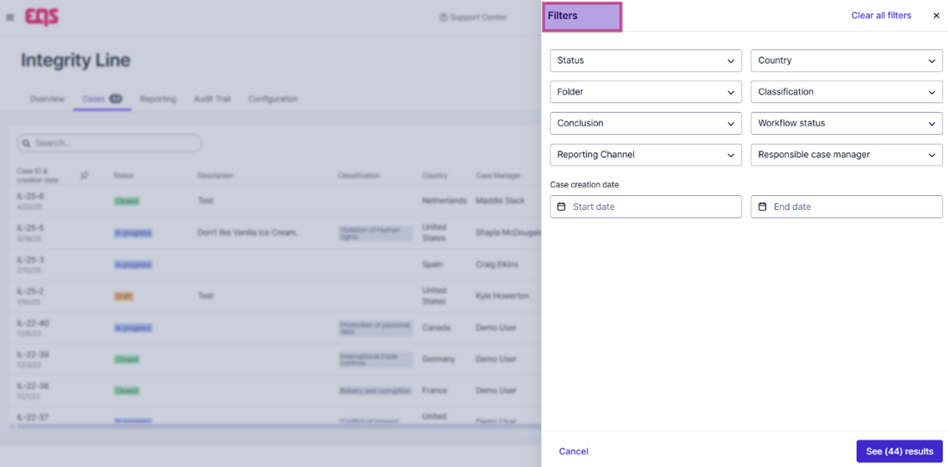
Cases tab
    The Cases tab is a more customizable view. You can search for specific keywords to pull up specific cases.
    By clicking on the Filter funnel icon (located on the right-hand side), you can edit the filers to your preference.

Slide 9
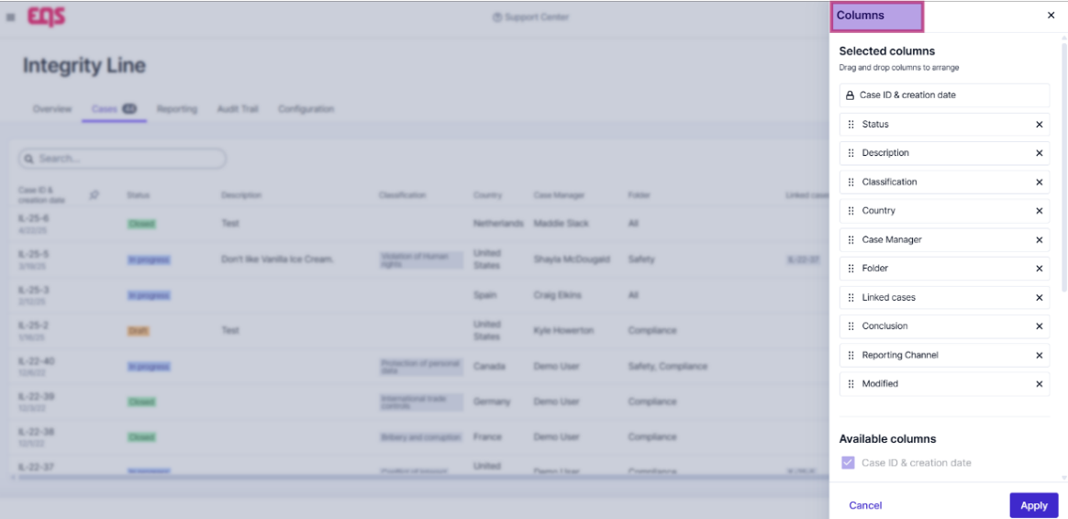
Cases tab
    You can customize the columns, i.e., rearranging / removing, to further tailor your view. (Click the Column icon, next to the filter icon).
    Your Column preferences are auto saved, so the next time you log in, your customized column layout will be preserved.

Slide 10
02
Reviewing a Case

Slide 11
Reviewing a Case
Find and review all information provided by the reporting party
To open the case, click the Case ID located in the left of the Dashboard pane.
    The Case Manager will receive an email once assigned to case.
    A link to the Case will be included in the email, or you can also log in to view your dashboard.
Note: The Case ID for new cases in integrity line will be in the following format
“IL– [Calendar year the case was submitted]-[sequentially assigned based on year submitted]”

Slide 12
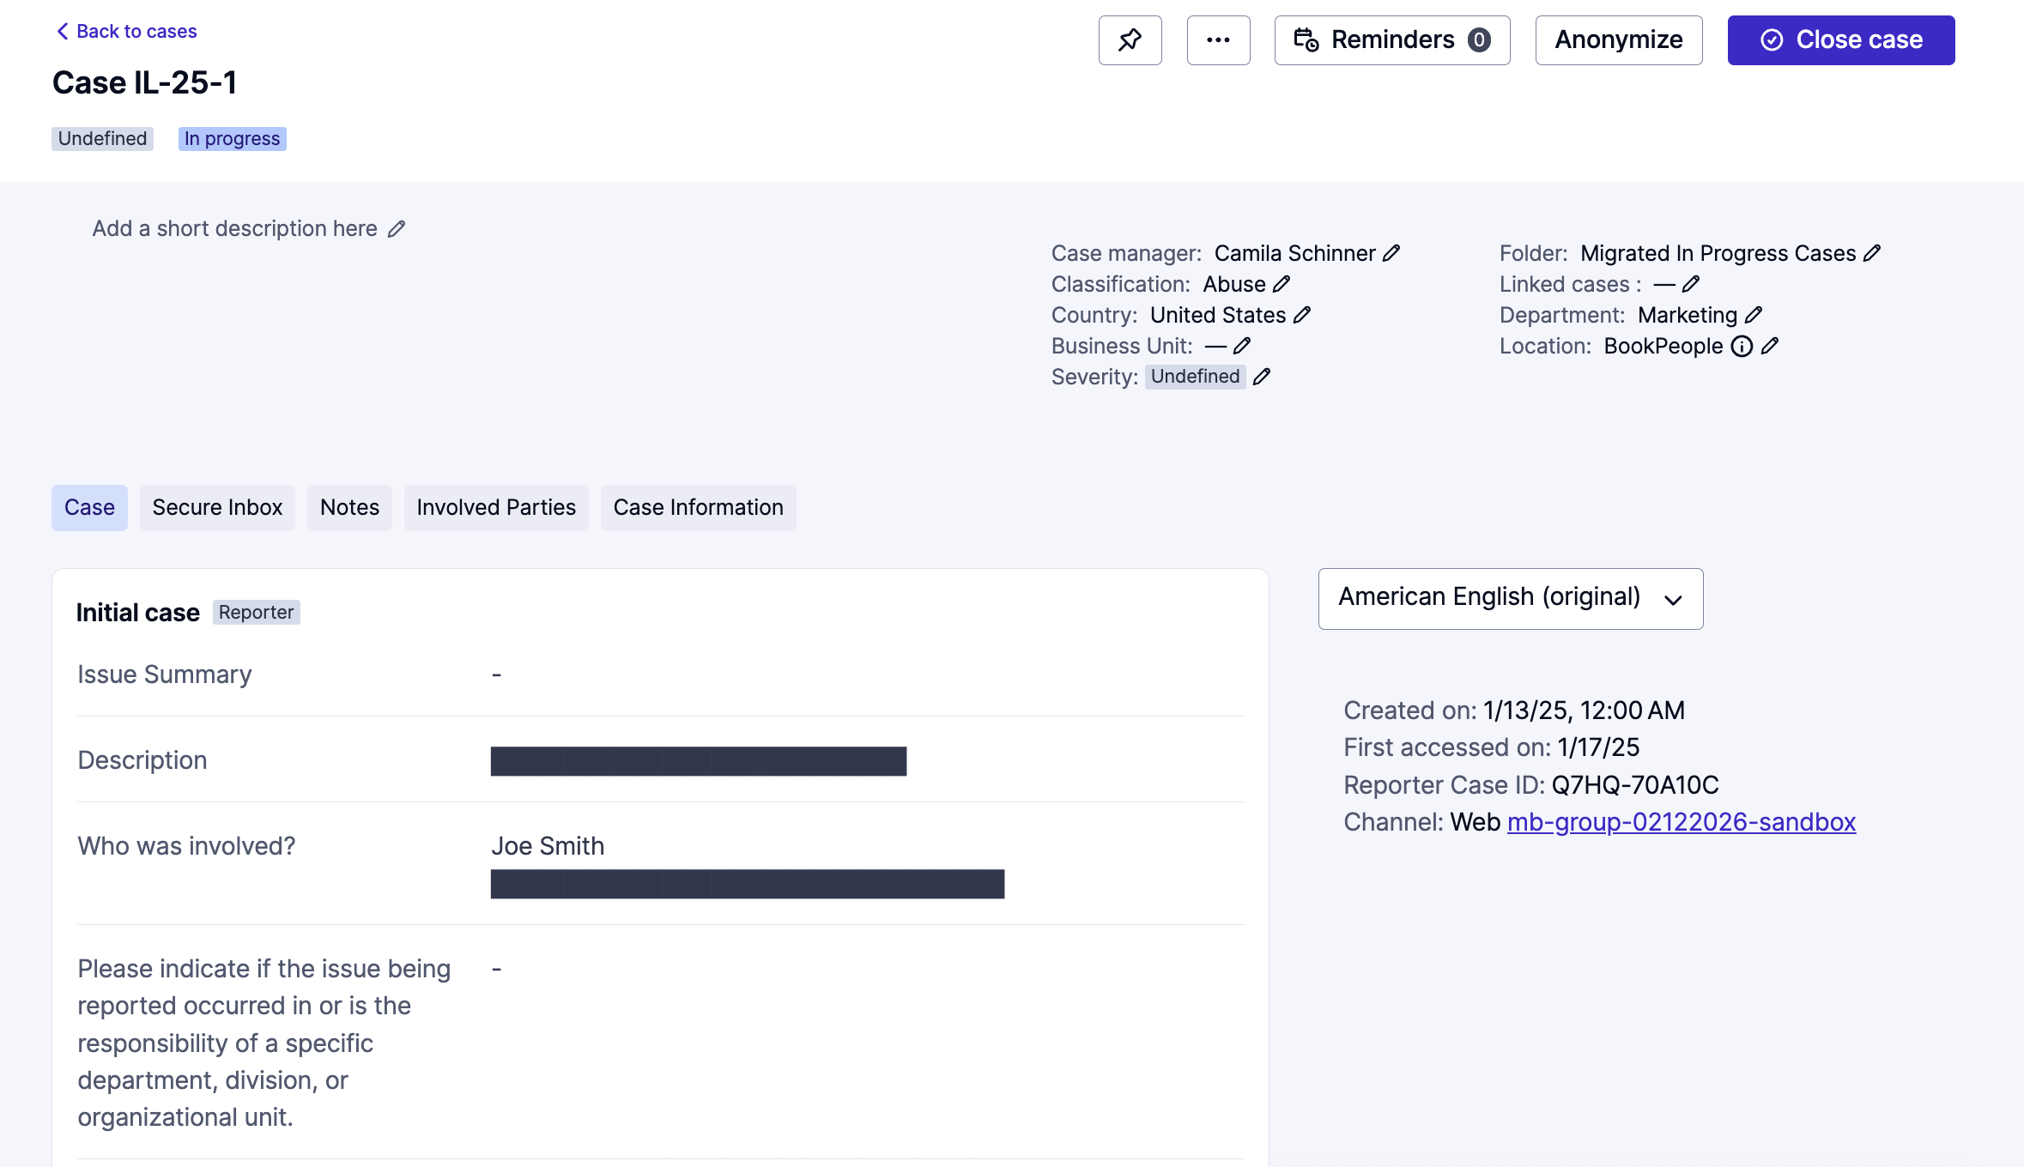
Reviewing a Case
    Once you click into the case, you will be able to review the information provided by the reporting party, such as Location, Description, and more in the Case Tab.
    At the end of the report, you can see whether the Reporting Party has provided ‘Contact Information’. If not provided, it will say ‘Anonymous

Slide 13
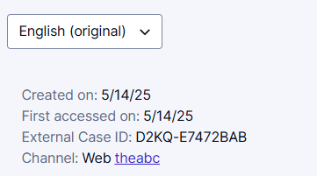
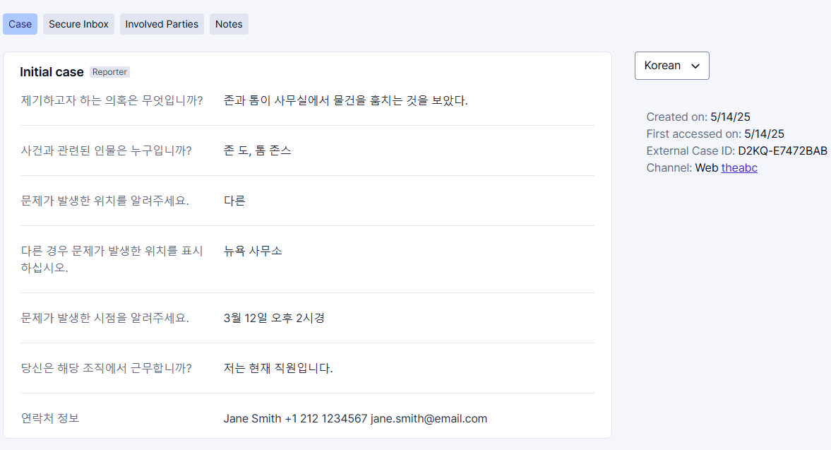
Reviewing a Case
    On the right-hand panel, you will also see additional information pertaining to the case, i.e., the reporting method, creation date, and more.
    There is also an in-app machine translation feature, which you can use to translate the case, secure inbox content, etc. into any required language.

Slide 14
03
Editing Case Details

Slide 15
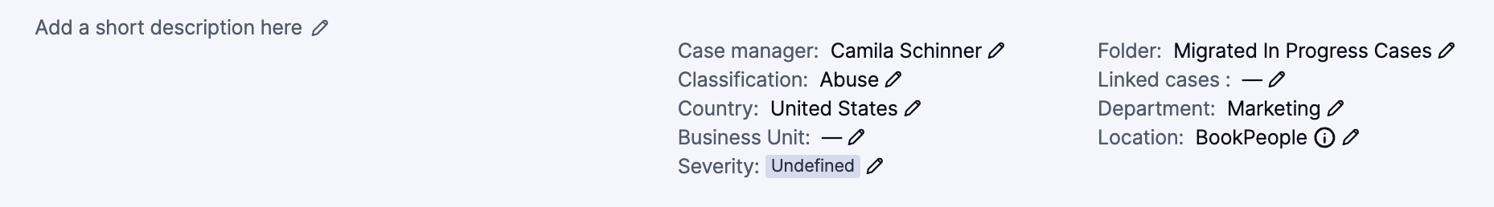
Editing Case Details
Update and add key case investigation details
At the top of the report is where you can edit the case details. Click on the pencil icon next to the desired feature to edit it. You can select the relevant option from the list of available options configured on your system.

Slide 16
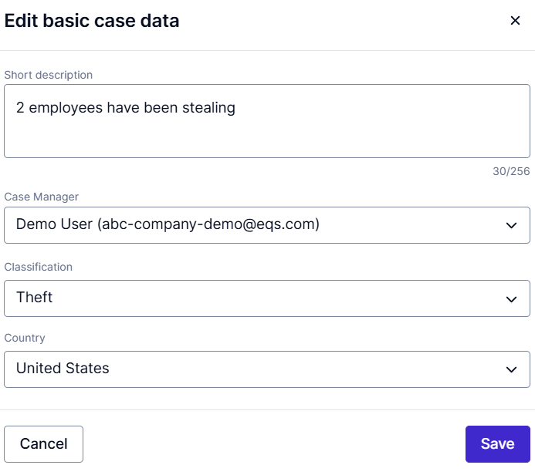
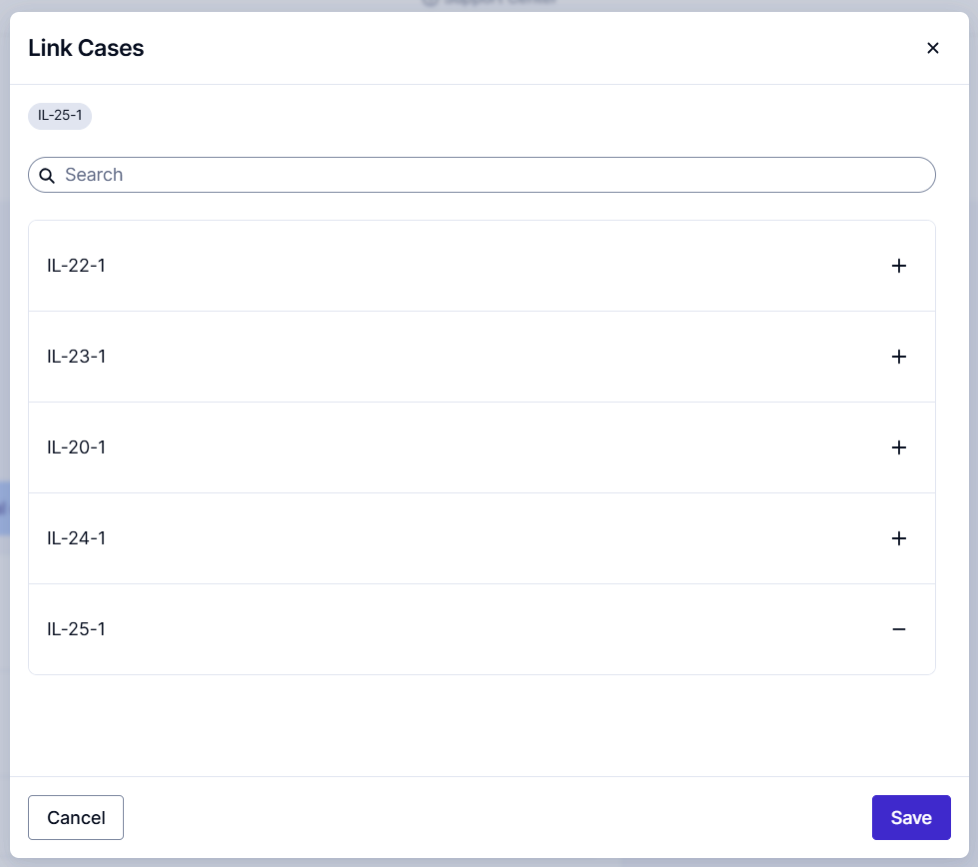
Editing Case Details
    Case Manager: This should be assigned to the lead Investigator; an email notification will be sent to that user regarding the new case assignment.
    Classifications: You can select the main Issue type category for the case.
    Folders: You can select the relevant folder for the case (if applicable see next slide).
    Linked Cases: Related cases can be linked to one another to allow the Case managers to manage these cases together or to be aware that there are multiple reports. You can use the ‘+’ icon to link any relevant cases.
    Severity: You can select the relevant severity for the case.

Slide 17
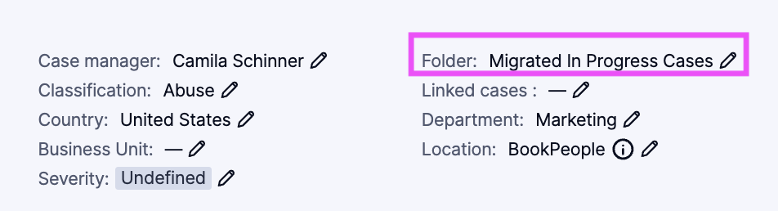
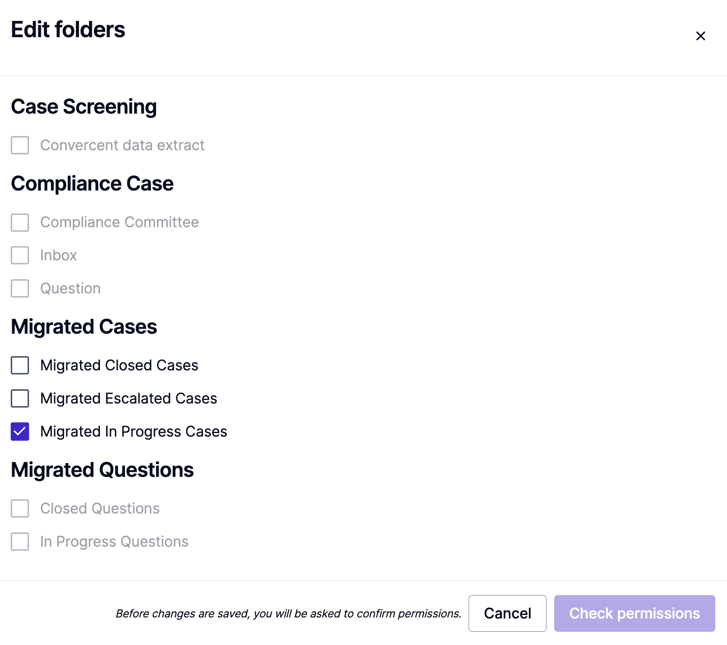
Editing Case Details - Folders
    You can assign cases to different folders
      Depending on your individual setup, case access permissions may depend on the folder a case has been assigned (along with location/department/business unit/classification, depending on your configuration).
    Select all folders the case should be assigned to, from the list of available folders.
      The bold headlines reflect folder groups. A case can only be assigned to one or multiple folders of the same group.
      Additionally, you can only move cases into another folder group, if you have permission to access at least one folder of that type or have a specific permission to overrule that restriction.

Slide 18
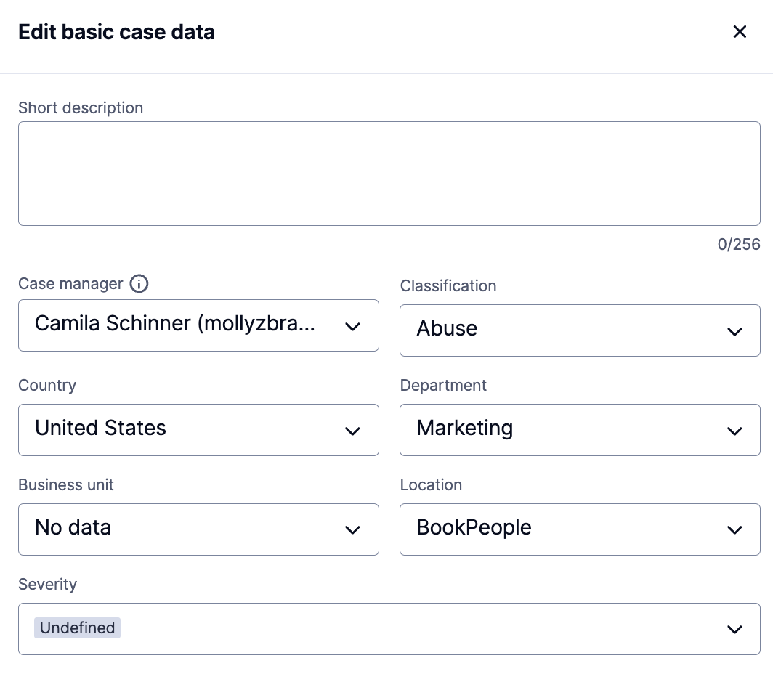
Editing Case Details
    Business Unit, Department, Location: These optional fields are used to indicate which Business Unit/Department/Location applies to this case.
      While the reporting party may provide information in their report about these data points, they may not know the exact term to use or how to determine which entity is the most appropriate to designate. In these case detail fields, you can indicate the exact value that needs to pull through into reporting.

Slide 19
04
Managing a Case

Slide 20
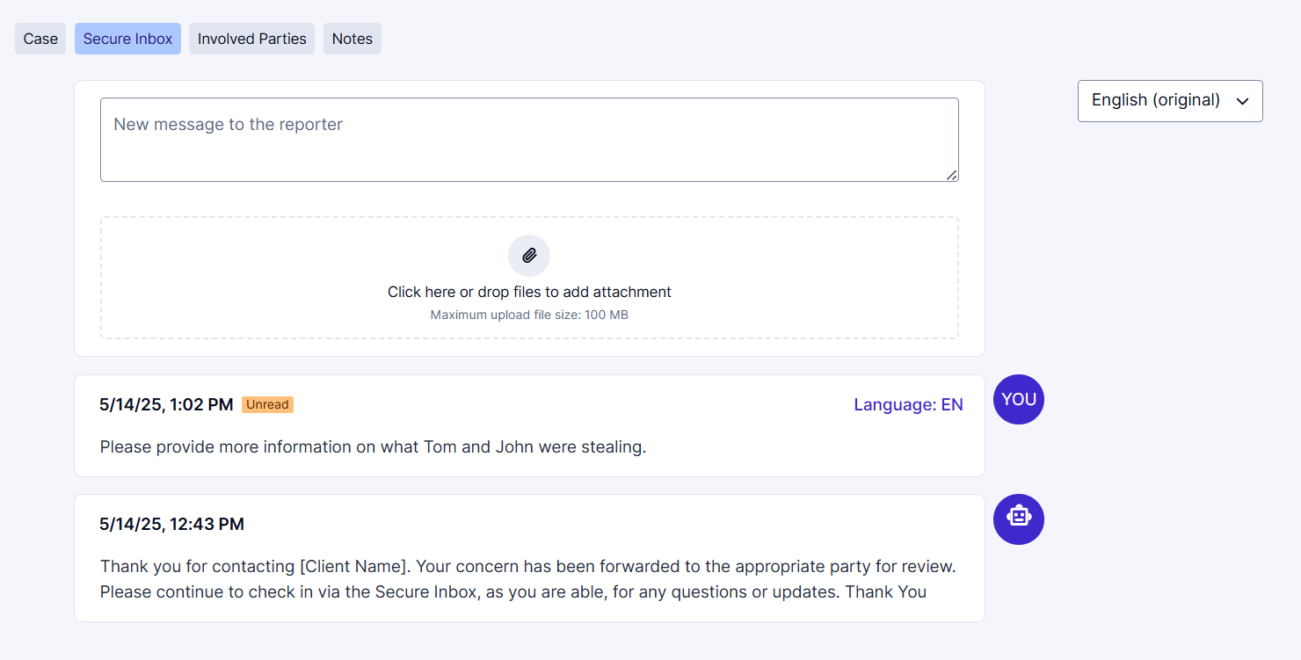
Managing a Case
Secure Inbox – Reporter Communication
    To communicate with the Reporting Party, click on ‘Secure Inbox’ tab to send a message, and any other relevant supporting documents.
    If the reporting party has provided their email in their contact information, they will receive email notifications. If not, it will be up to them to continue checking in on their case. You can keep track of whether the message has been seen by the reporting party using the ‘Unread/Read’ tags.
      Note: Messages can’t be deleted once sent to the reporting party .

Slide 21
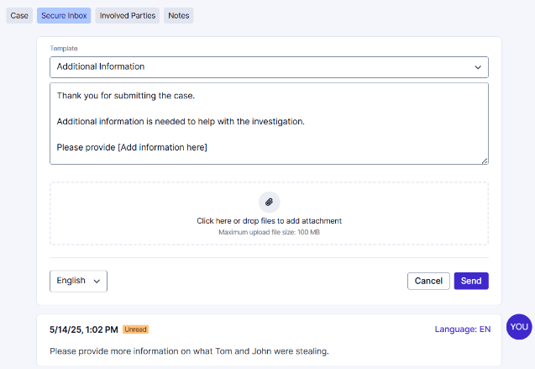
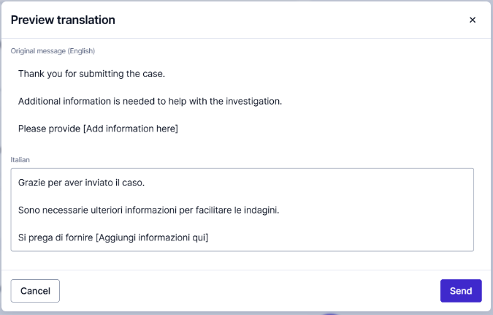
Managing a Case
Secure Inbox – Reporter Communication
    If ’Messages templates’ have been configured, you can also send these to the reporting party.
    You can still edit the message template as needed.
    You are also able to translate the message using the in-app machine translations.

Slide 22
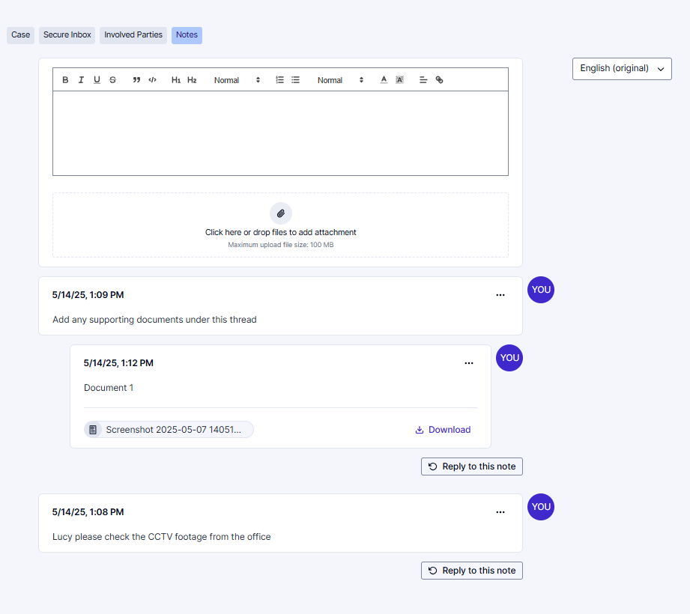
Managing a Case
Notes – Communicating Internally
    ‘Notes’ can be used to document case activity such as interview summaries, case updates, and to communicate with other case managers working on the case.
    You can add links, documents, and images.
    You can create multiple threads, and reply to messages
    You are also able to delete or edit these messages by clicking on the 3 dots ‘…’ at the right-hand corner of the message.

Slide 23
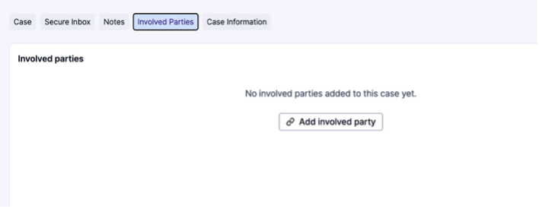
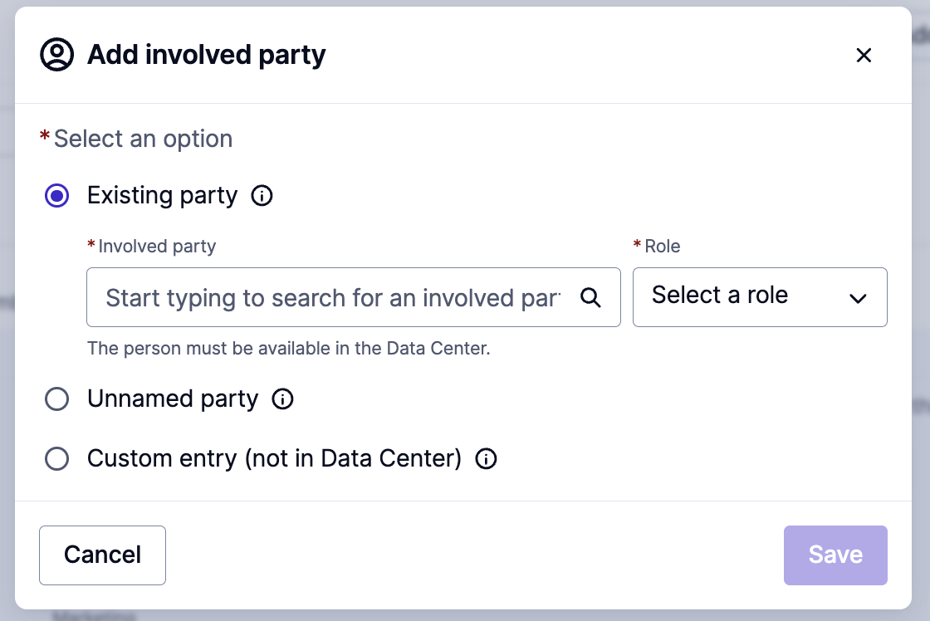
Managing a Case
Involved Parties
Navigate to the In the ‘Involved Parties’ tab and click add involved party. You can add three distinct types of Involved Parties.

Slide 24
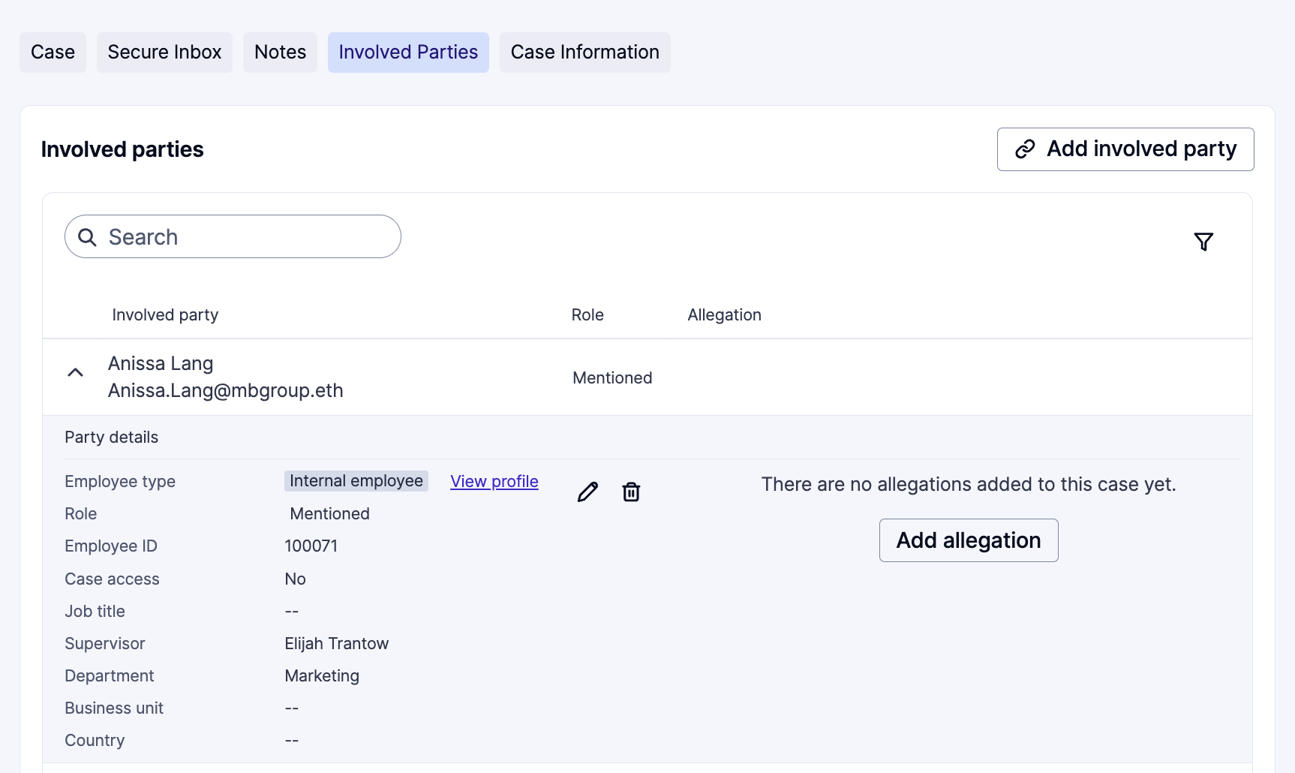
Managing a Case
Involved Parties – HR Tagging
If you have added your employee data to the system, you will be able to link users to cases and specify the role they played.
Once users are added, the Party details section will show basic user details, including employee ID and Supervisor name. The added user will also no longer have access to that case if applicable.

Slide 25
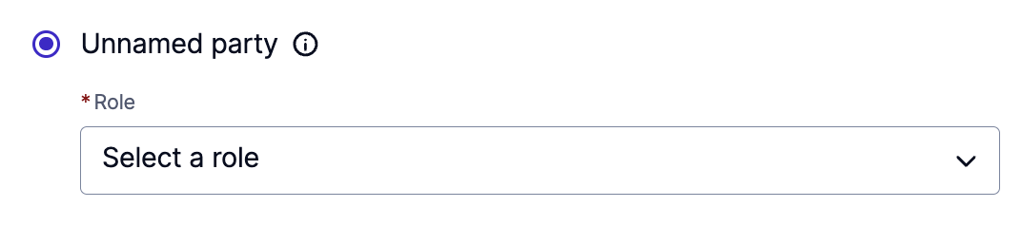
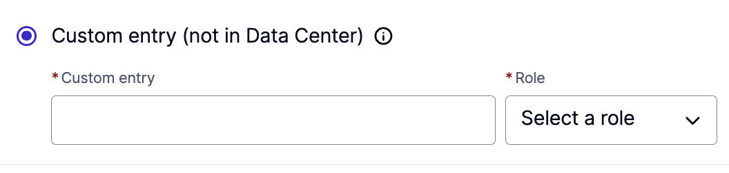
Managing a Case
Involved Parties – Unnamed party and free text
While managing a case, you may find that involved parties are people outside of your organization, or that you need to designate an organization, department or some other entity as an involved party.
Integrity Line allows you to add an involved party as an “Unnamed party” or as a custom entry (free text field).

Slide 26
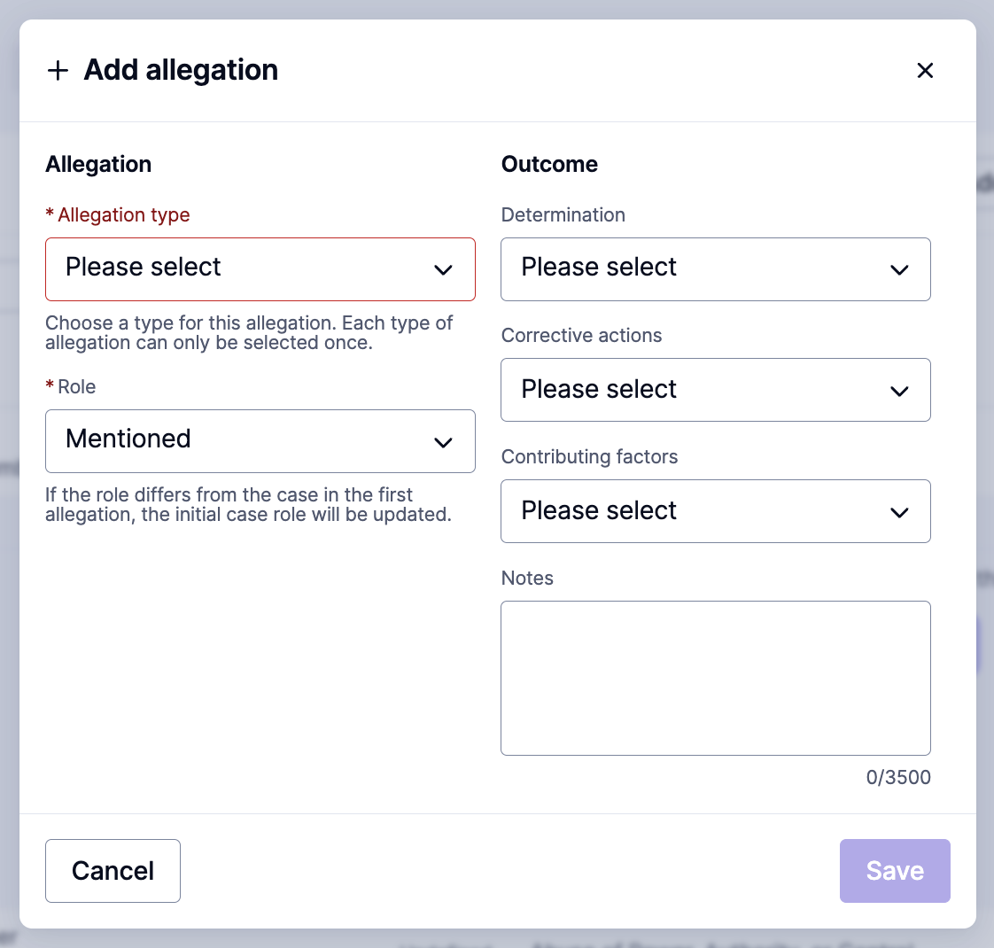
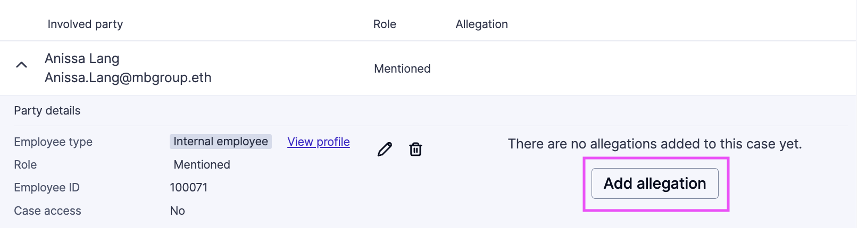
Managing a Case
Delete this slide if your organization is not using allegations related to each involved party.
If you only document one issue type and one outcome per case, you don't need to use Allegations. You can use the classification field and closure fields at the case level for necessary documentation.
Involved Parties – Allegations
After adding an Involved Party, you can add an Allegation. Along with the allegation, you can update the role and document involved party-level outcomes: Determination, Corrective actions, and/or Contributing factors. The Notes field is only visible to admins.
While multiple allegations can be added to each Involved Party the primary allegation for the case should be documented in the Classifications field at the top of the case and the primary outcome/substantiation for the case will be documented at case closure.

Slide 27
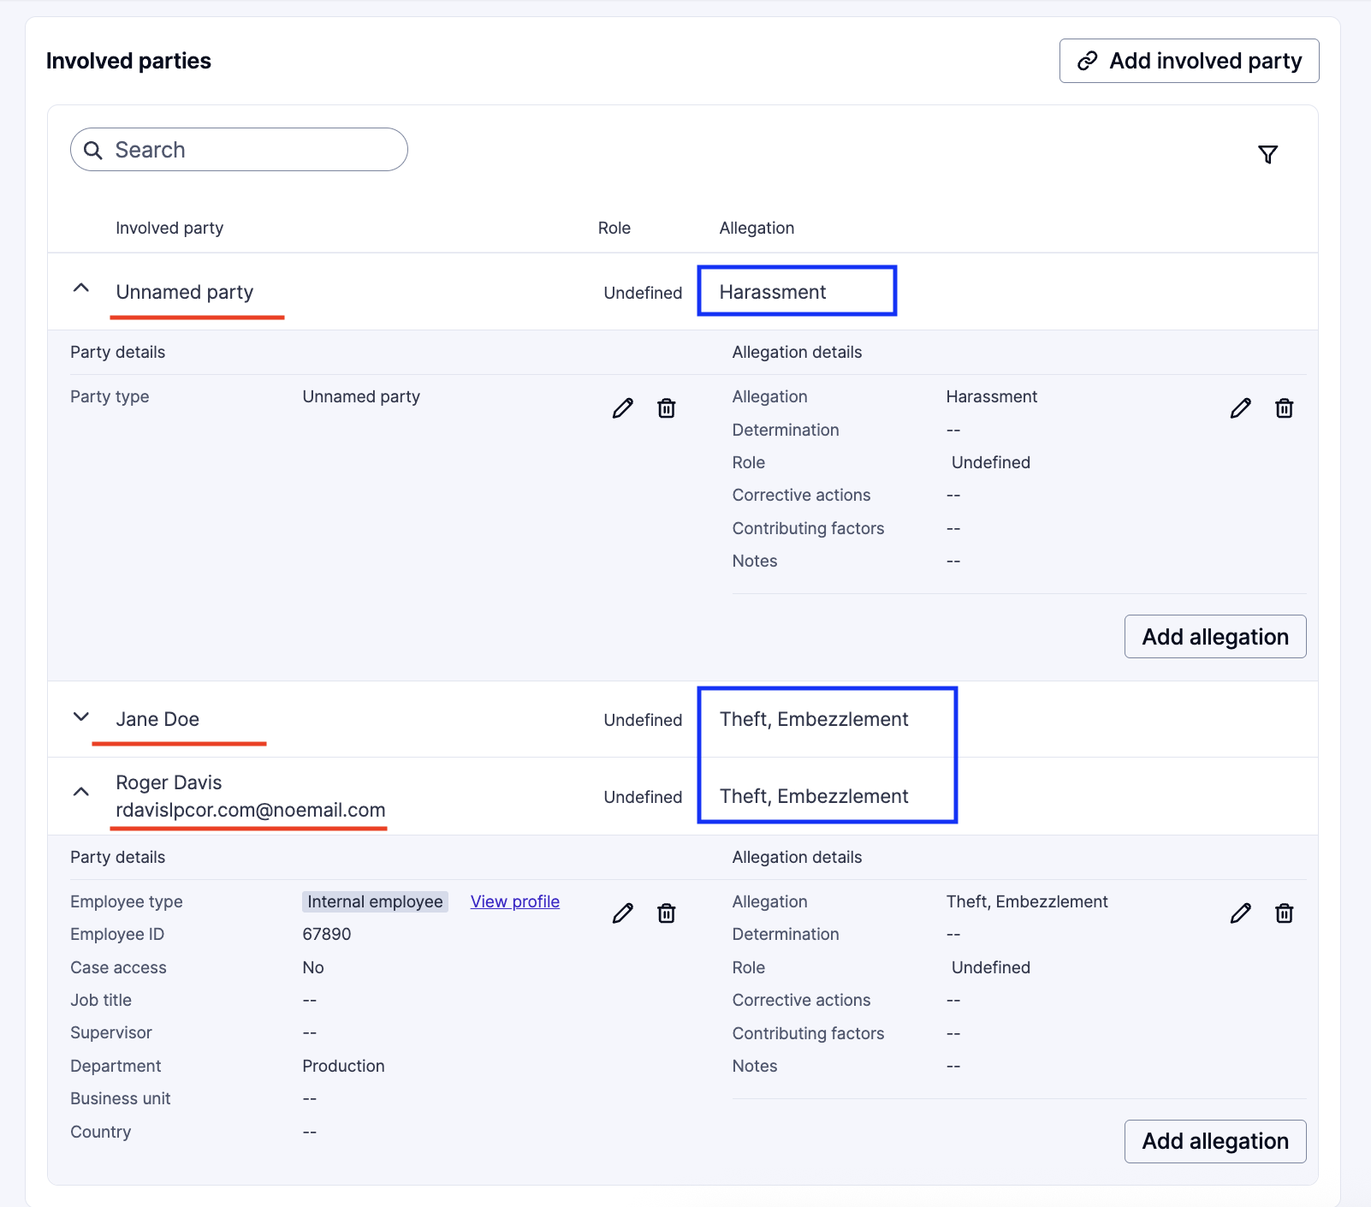
Managing a Case
Delete this slide if your organization is not using allegations related to each involved party.
If you only document one issue type and one outcome per case, you don't need to use Allegations. You can use the classification field and closure fields at the case level for necessary documentation.
Involved Parties – Allegations
A case with multiple allegations will look like the one to the right. There are two types of allegations, marked in blue: "Harassment" and "Theft, Embezzlement."
For the "Theft, Embezzlement" allegation, there are two persons involved: Jane Doe and Roger Davis.
    Note: In reporting, this case will show as having one instance of "Harassment" and one instance of "Theft, Embezzlement," in which two people were involved.

Slide 28
05
Additional Features

Slide 29
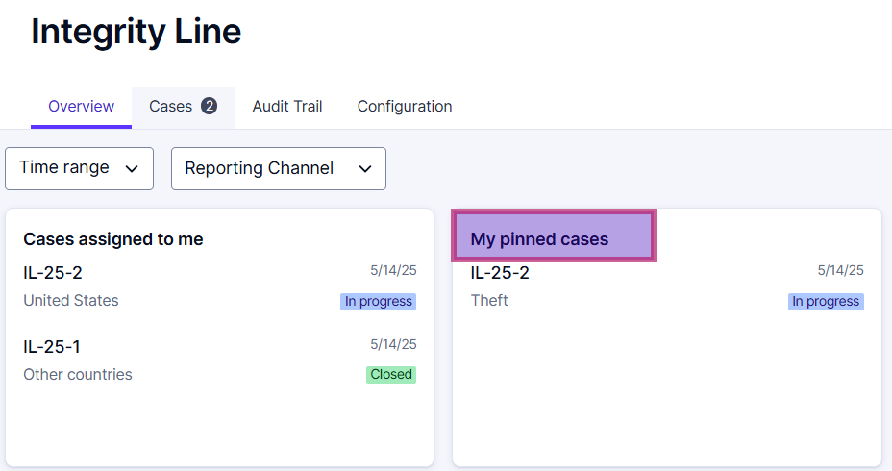

Additional Features
Pin Cases
    For easier access to your most relevant cases, you can pin a case so that it appears in your Dashboard. (Click on the thumbtack icon to pin the case)

Slide 30
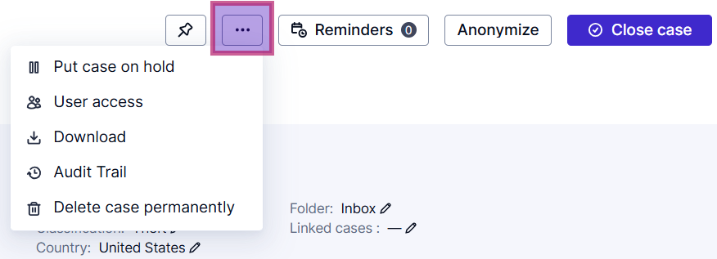
Additional Features
    In the top right panel of the case, in the ‘...’ icon, there are some additional key features

Slide 31
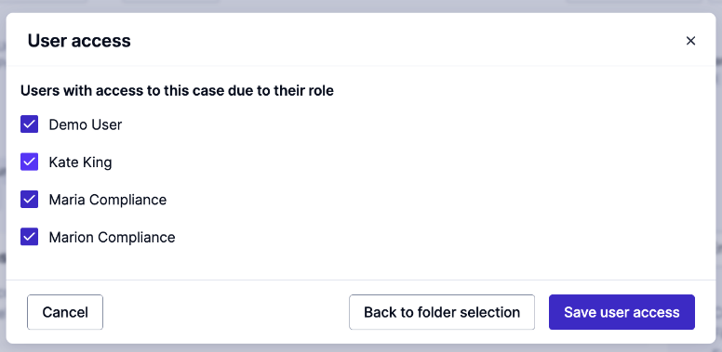
Additional Features
User Access
    You can determine and manage who has access to the case.
    The list will show which users currently have/ have no access. Only users with the correct role permissions will show.
    Access restrictions can be applied to case managers for a specific case, by unticking the box next to their name and removing their access.
    Additionally, access can be granted ad hoc by ticking the box next to the user’s name.
    The designated case manager will always have access to a case and cannot be removed through user access.

Slide 32
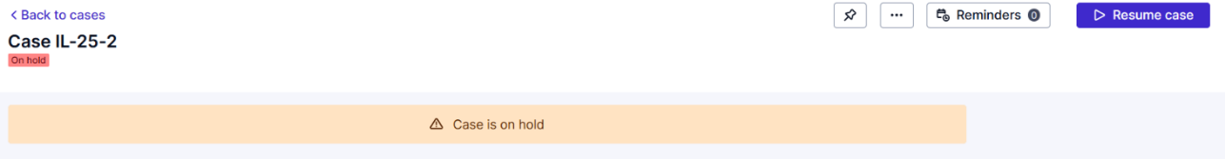
Additional Features
Put a case on hold
    This feature allows you to temporarily pause case processing while awaiting additional information or external investigations. This ensures that important cases remain visible without progressing prematurely. While on hold:
      All case details stay intact
      You can still add case notes and read secure inbox messages
      You will not be able to send messages to the reporting party
      To continue working on the case, it must first be resumed

Slide 33
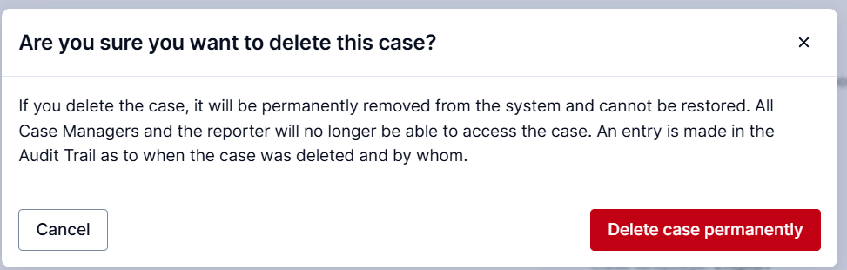
Additional Features
Delete case permanently
    Use this option to permanently remove a case and all related data from the system.
      Note: This action is final and cannot be undone. It’s typically used for test cases.

Slide 34
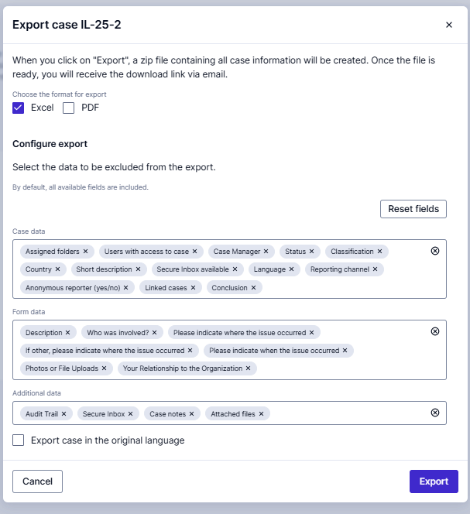
Additional Features
Download
    Cases can be downloaded for further analysis and reporting. Click the Download option to export a case. The export is customizable, so you can choose what will be included in the export.
    You can exclude specific data to minimize unneeded content or omit sensitive information not required for your report

Slide 35
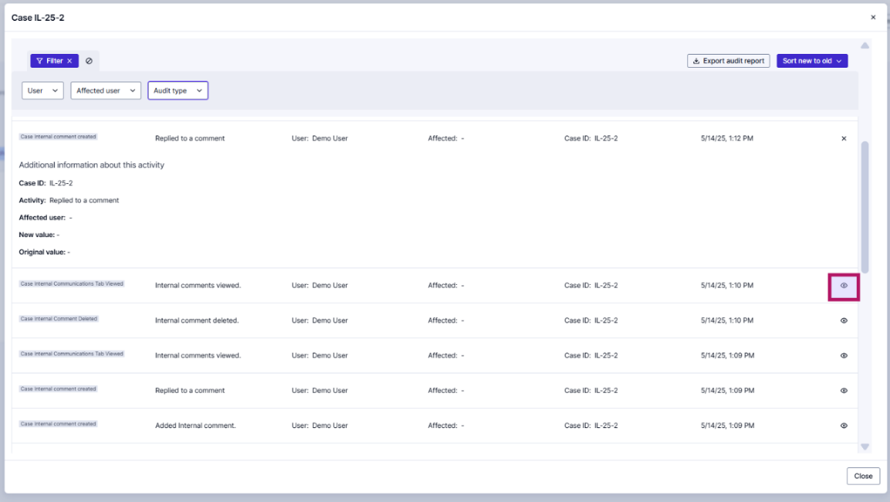
Additional Features
Audit Trail
    Here you can see all the activity for the case. If you click on the eye icon in the corner, you can expand the activity to see more information.
    The audit report can be downloaded and filtered.

Slide 36
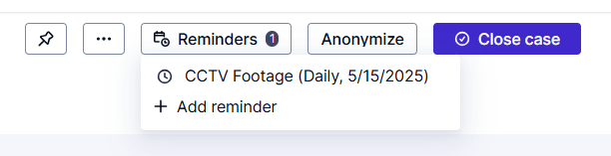
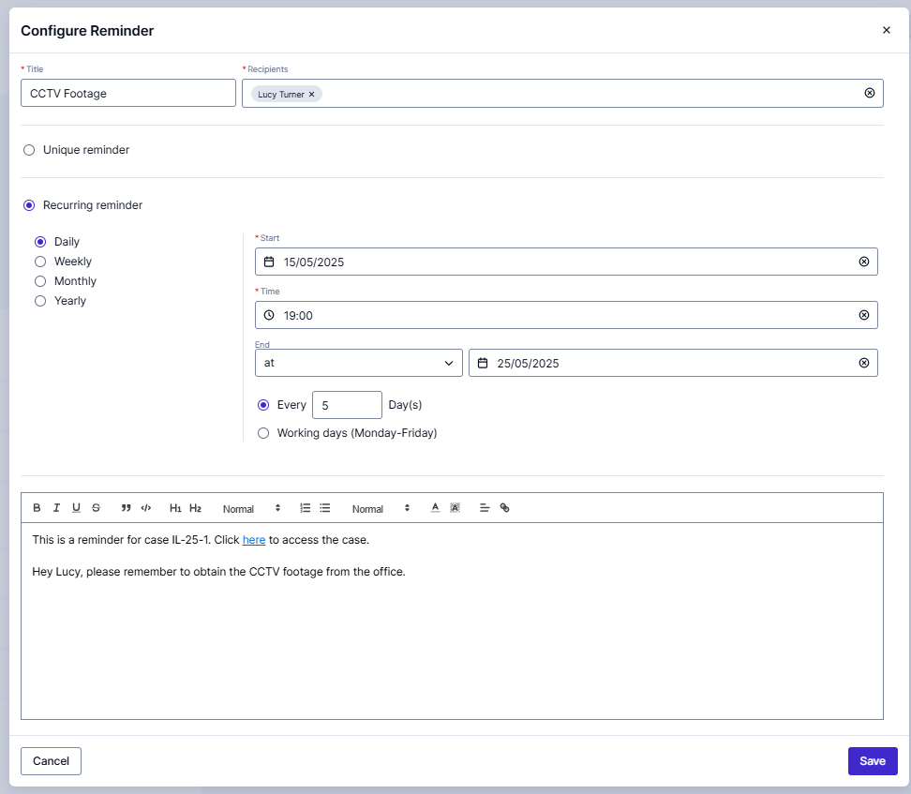
Additional Features
Reminders
    Reminders can be assigned by Case Managers to themselves or other team members to help facilitate tasks to complete.
      Reminders are only viewed by team members with access to the case (not the Reporting Party). The assignee will receive an email notification.
      Reminders can be created/assigned even after the case is closed.
      You can set a one-time reminder ‘Unique Reminder’ or a ‘Recurring Reminder’.
      Reminders can be edited or deleted.

Slide 37
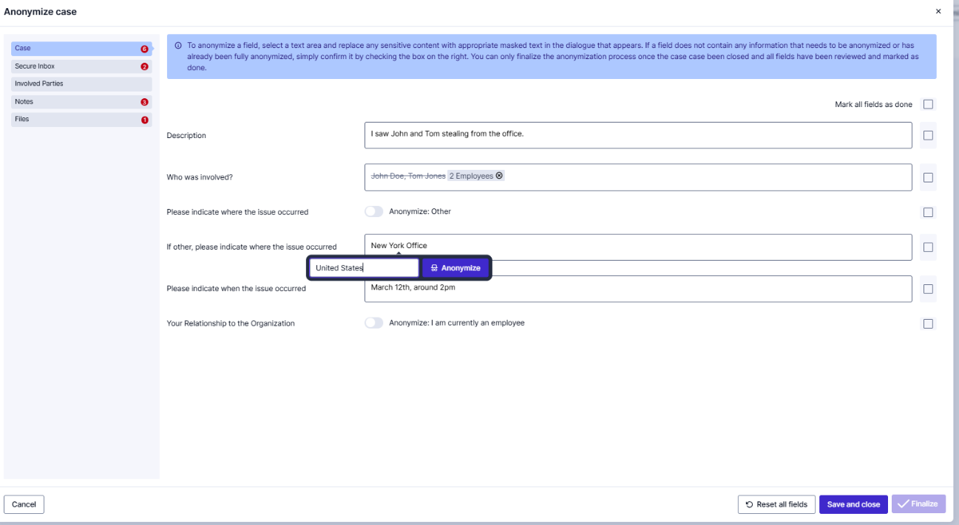
Additional Features
Anonymization
    The case can be anonymized by clicking on the Anonymize button, this allows you to delete/replace confidential information.
    After case closure, administrators with permission can finalize the anonymization, thereby permanently redacting the information.
      Before closure, while the case status is in Progress, anonymizations are saved but not finalized. Users with permission will be able to view anonymized text before the anonymization is finalized.

Slide 38
06
Closing a Case

Slide 39
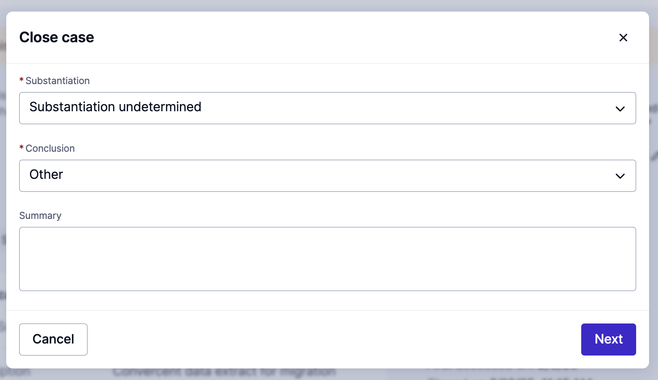
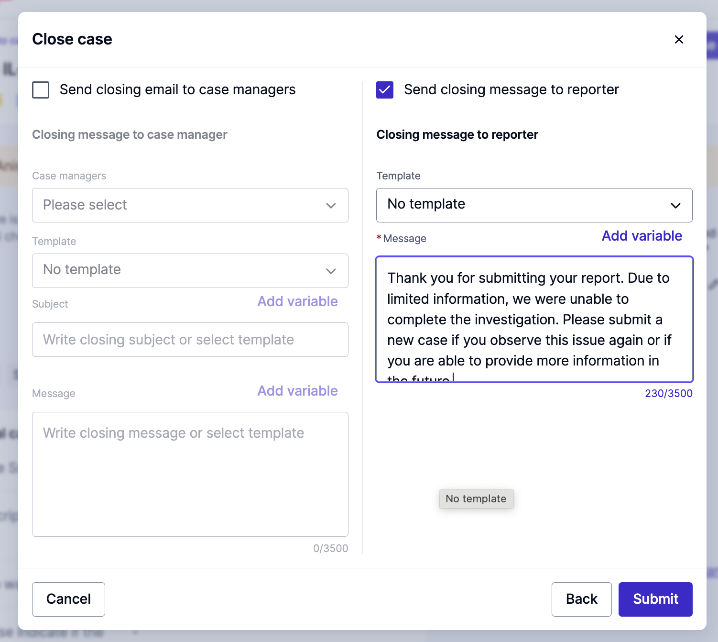
Closing a Case
    When you are ready to close out the case, click on the ‘Close case’ button in the top right corner. Then you will be able to select a Conclusion, and optionally, by ticking the boxes, you can send out a closing email to the other case managers, or to the reporting party.
    If you have ‘Message Templates’ setup, then you will be able to use them
Notes:
Level 3 = Bullet 1 (Barlow 20 PT)

Slide 40
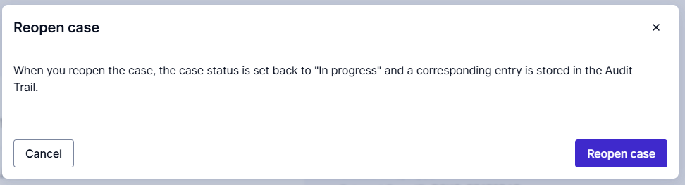
Reopening a Case
    Cases can also be re-opened if needed. Simply click the ‘Reopen case' button, and then you can make any additional amendments and updates as needed.
Notes:
Level 3 = Bullet 1 (Barlow 20 PT)

Slide 41
07
Enterprise Features

Slide 42
Enterprise Features
    Integrity Line offers more advanced features designed to enhance your case management experience. With the Enterprise package, there are some additional features.
    If you do not have the Enterprise package and are interested, please speak with your Account Executive or Customer Success Manager.

Slide 43
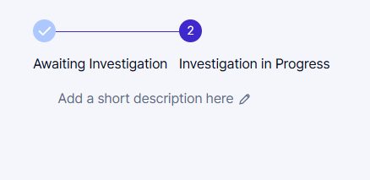
Enterprise Features
Workflows
    Workflow statuses can be used to further specify the status and progress of a case. The workflow statuses are configurable.
    When a case is moved to in progress, the Workflow Statuses will show up above the Short Description. The case can then be moved through the workflow.
    Workflow statuses can be linked to custom case tabs to define requirements to progress the case to the next status.
Notes:
Level 3 = Bullet 1 (Barlow 20 PT)

Slide 44
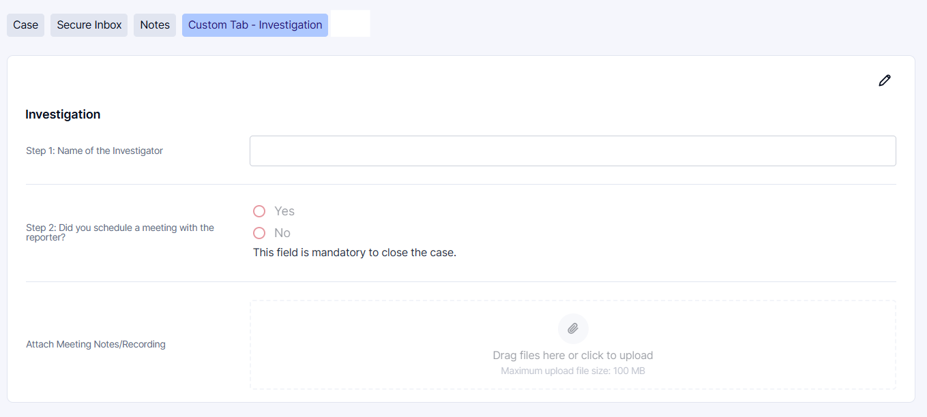
Enterprise Features
Custom Case Tabs
    You can have custom case tabs which can include additional questions and sections, where you can obtain any further required information during the case management process.
    You can have multiple custom case tabs and each of the questions within the custom tabs can be utilized in reporting.
Notes:
Level 3 = Bullet 1 (Barlow 20 PT)

Slide 45
Thank you for your attention

