Slide 1
Recommendations for using this training presentation
Delete this slide before sharing this presentation
We recommend customizing this deck before using this presentation. The format (PPT) is editable so that you can add screenshots and notes about processes that are specific to your own organization
Intended audience: All employees in your organization who will need to interact with policies
Note: remove references to “action items” if unused by your organization (section 3)
Note: remove references to “Policy Buddy” if you do not have this add-on feature (section 4)

Slide 2

POLICIES
Employee - Attesting to Policies

Slide 3
Agenda
Navigating to Integrity Hub
Viewing & Attesting to Policies As Needed
Viewing & Attesting to Policies via an Action Item
Policy Buddy

Slide 4
01
Navigating to Integrity Hub

Slide 5
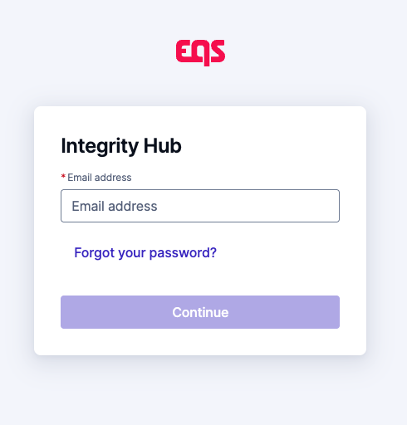
Navigating to Integrity Hub
          Integrity Hub URL: https://www.integrityhub.net or https://www.integrityhub.us
          Log in with your credentials
Note to Customer - be sure to revise the above link if you use a different Integrity Hub URL, as it could be different than one of the above. Delete this note after updating, or if not applicable.

Slide 6
02
Viewing & attesting to policies as needed

Slide 7
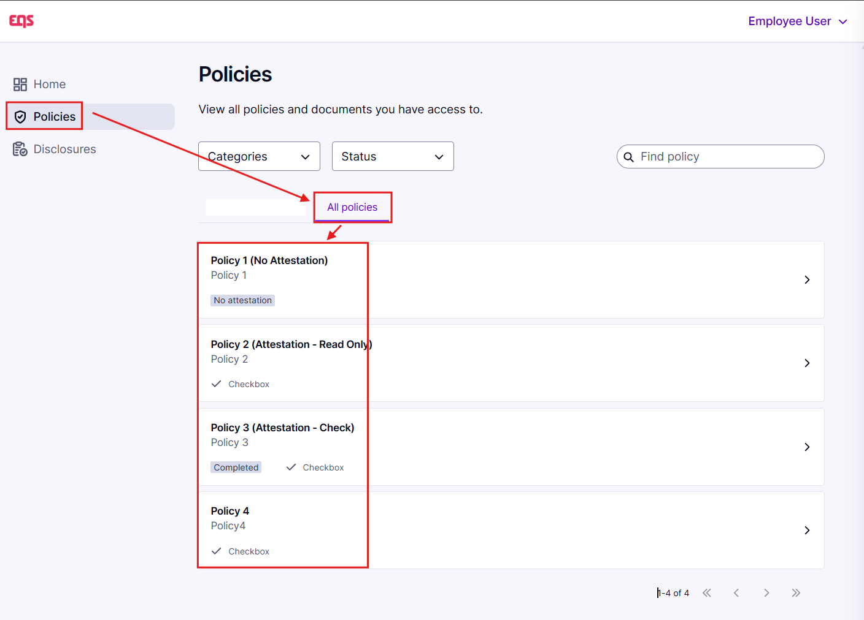
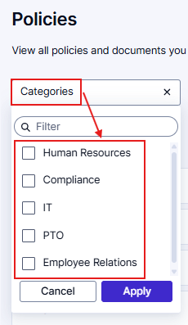

Viewing & attesting to policies as needed
          You can view all your applicable company policies under the All policies tab.
          Find specific policies by filtering on “Categories” – these are predefined lists of related policies

Slide 8
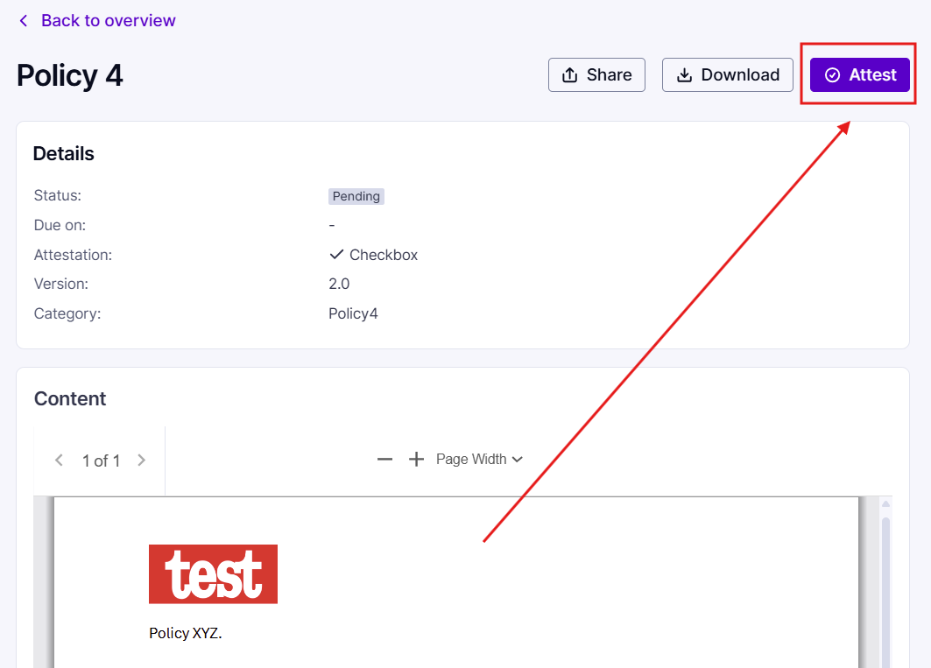
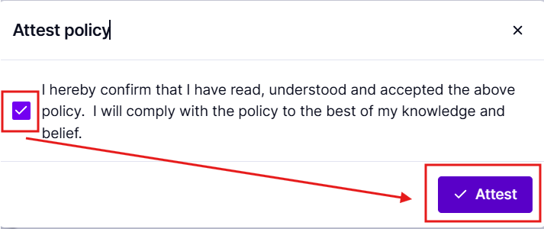
Viewing & attesting to policies as needed
          Selecting a policy from this list will open the policy details. Read the policy, then select the Attest button when ready
          Depending on the policy, this will prompt for either a confirmation checkbox, an electronic signature, or a quiz to check for understanding – complete the step to attest to the policy.

Slide 9
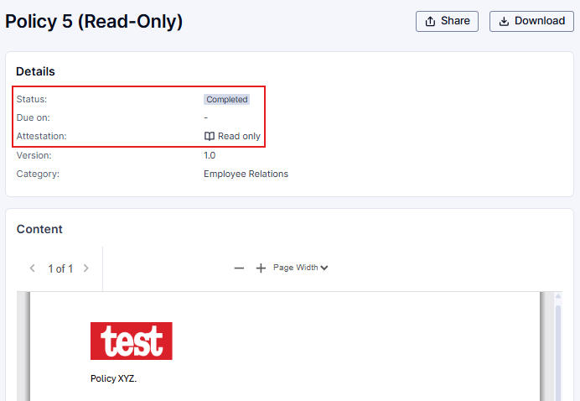
Viewing & attesting to policies as needed
          Note: Some policies may only require you to read the document, so no action needs to be taken after the policy is clicked on. The policy will immediately be marked as “Completed”
          DONE! You can continue to review and attest to policies as needed from the All policies library.

Slide 10
03
Viewing & attesting to policies via an action item

Slide 11
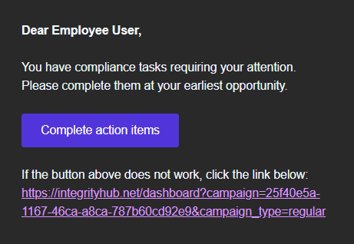
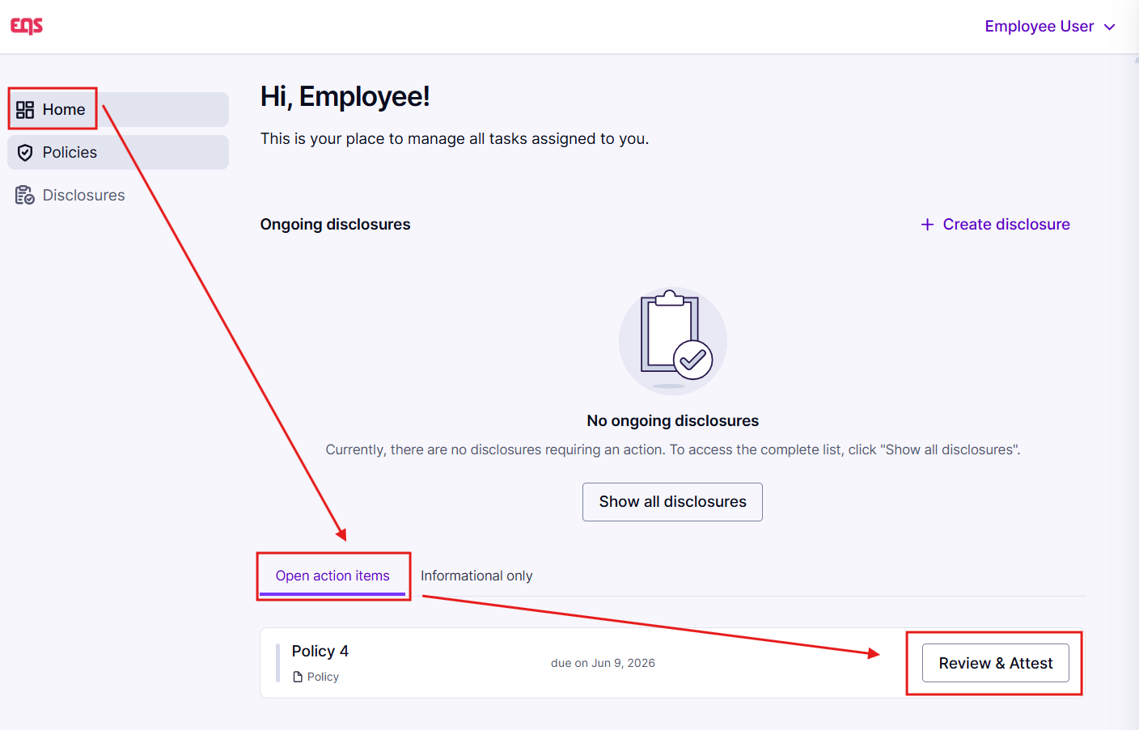
Viewing & Attesting to Policies via an Action Item
          An “action item” is first introduced to you via email, with a clickable link similar to the below:
Clicking on the link from your email will take you directly into the action item. You can also find it on your Home page in Integrity Hub
Select “Review & attest” to begin the policy attestation process
Note to Customer - be sure to revise the email screenshot if you customize the campaign email text.

Slide 12
Viewing & Attesting to Policies via an Action Item
          Read the policy, then select the Attest button when ready
          Depending on the policy, this will prompt for either a confirmation checkbox, an electronic signature, or a quiz to check for understanding – complete the step to attest to the policy.

Slide 13
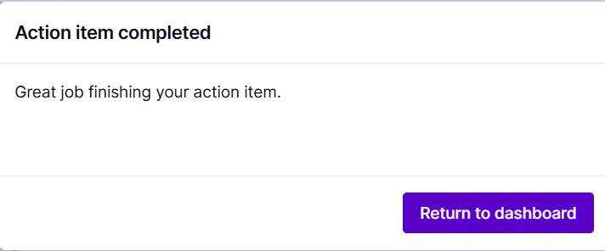
Viewing & Attesting to Policies via an Action Item
          Select the ‘Return to dashboard’ button to navigate back to your home page to complete any unfinished action items

Slide 14
Viewing & attesting to policies as needed
          Note: Some policies may only require you to read the document, so no action needs to be taken after the policy is clicked on. The policy will immediately be marked as “Completed,” and you can continue with your other action items.

Slide 15
04
Policy Buddy

Slide 16
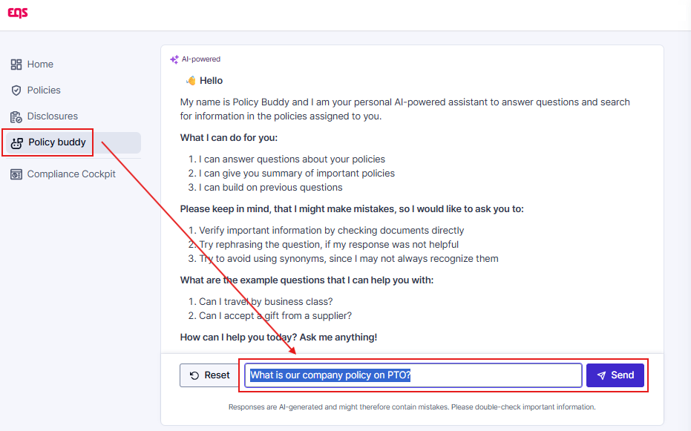
Policy Buddy Explained
          Policy Buddy is an AI-powered assistant that helps employees quickly find, understand, and interact with company policies
          Type your policy-related question into the field and hit send. Policy Buddy will review your company’s policies to provide an answer to your question.

Slide 17

Thank you for your attention

