Slide 1
Recommendations for using this training presentation
Delete this slide before sharing this presentation
We recommend customizing this deck before using this presentation. The format (PPT) is editable so that you can add screenshots and notes about processes that are specific to your own organization
Intended audience: All employees in your organization who will need to submit ad hoc disclosures.

Slide 2
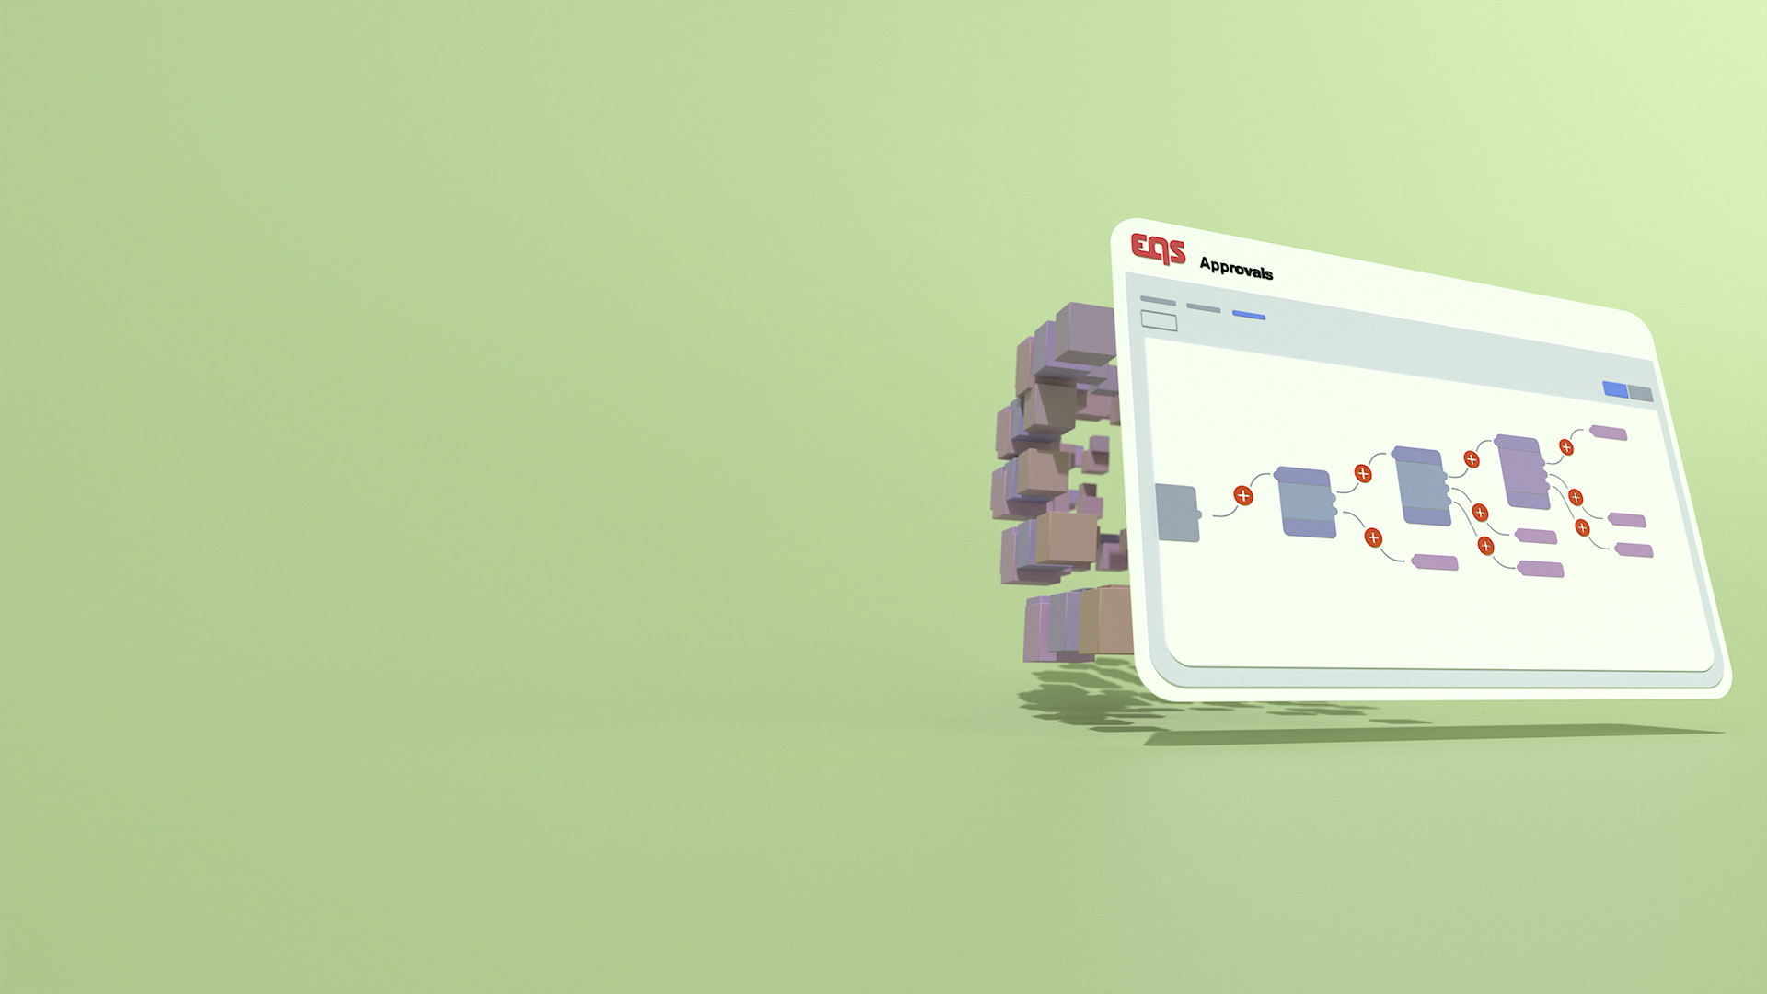
APPROVALS
Submitting a Disclosure
Training Deck

Slide 3
Agenda
Navigate to Integrity Hub
Starting a Disclosure & Types of Disclosures
Completing the Disclosure Form & Sending the Disclosure
Cancelling a Disclosure
Communicating with Approvers
Attestation
Glossary

Slide 4
01
Navigate to Integrity Hub

Slide 5
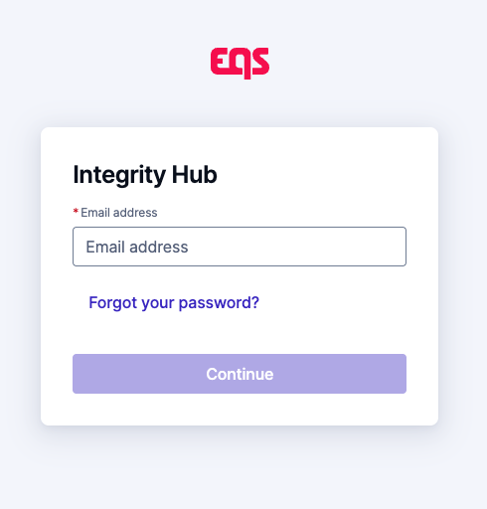
Navigate to Integrity Hub
Integrity Hub URL: https://www.integrityhub.net or https://www.integrityhub.us
Log in with your credentials
Note: Your company may have a slightly different URL. Update the URL above as needed.

Slide 6
02
Starting a disclosure & types of disclosures

Slide 7
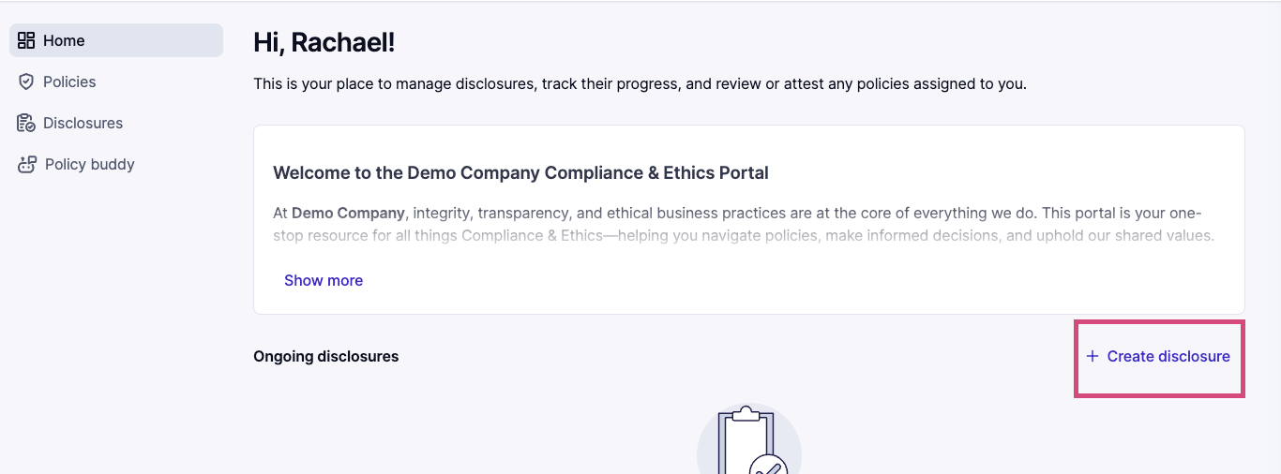
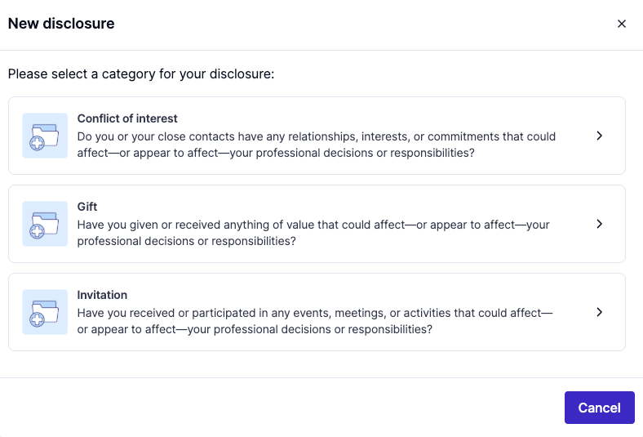
Starting a Disclosure: Option 1
On the Home screen, click ‘+Create Disclosure.’
Choose the type of disclosure
Note: Your organization may or may not have a welcome paragraph at the top of this screen

Slide 8
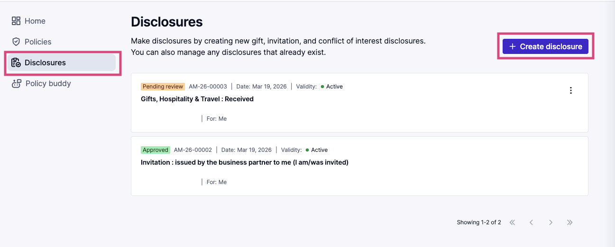
Starting a Disclosure: Option 2
Click the Disclosures icon from the left menu
Click on the ‘+ Create Disclosure’ button
Note: On this page, you will see any past Disclosures and can make updates when needed

Slide 9
03
Completing the disclosure form / Sending the disclosure

Slide 10
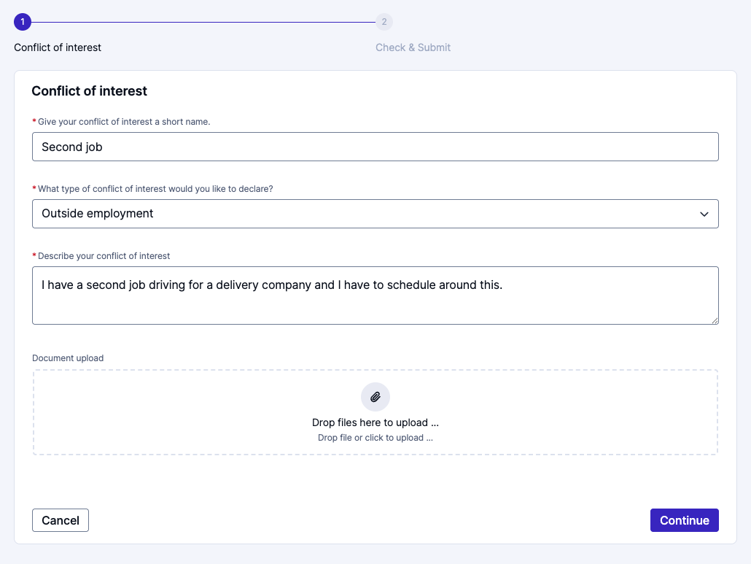
Complete the Form and Send Disclosure
Gather all information, receipts, and attachments.
Complete the form entirely.
You may be prompted to add information about the business partner(s) or other people involved.
Click the ‘Continue’ button.

Slide 11
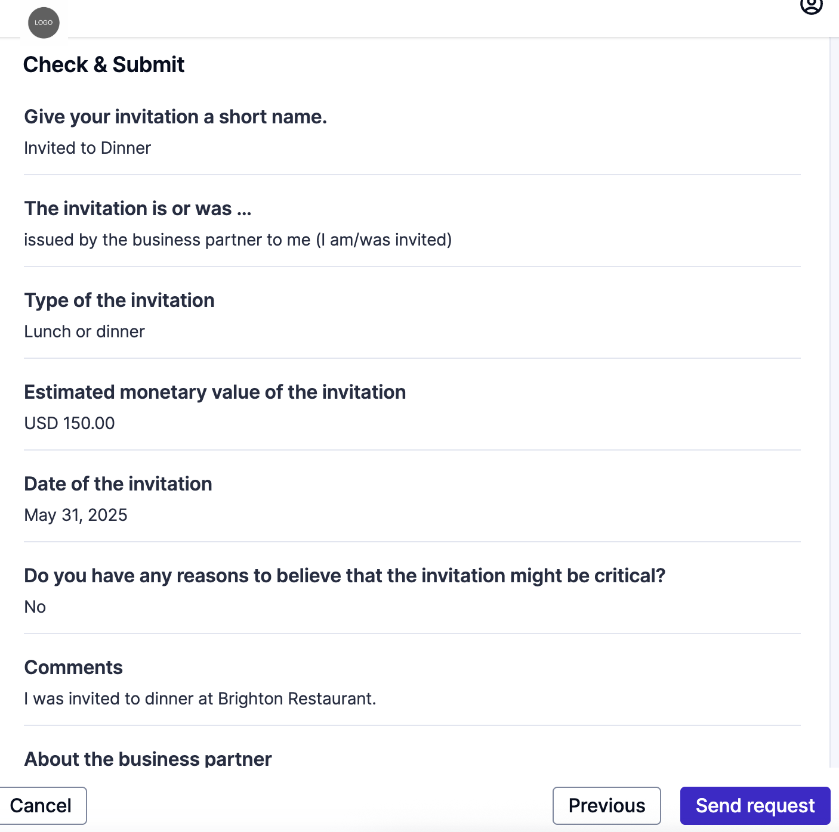
Complete the Form and Send Disclosure
Review the Disclosure for accuracy.
Click the 'Send Disclosure' button when you are ready to submit the Disclosure.

Slide 12
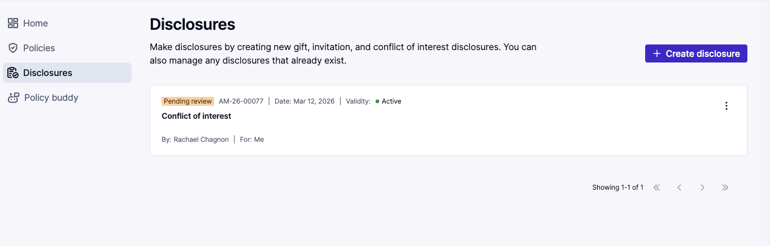
Complete the Form and Send Disclosure
After submission, you will be directed to your list of Disclosures.
You will see the Disclosure you just completed in that list. Its status will be ‘Pending Review.’

Slide 13
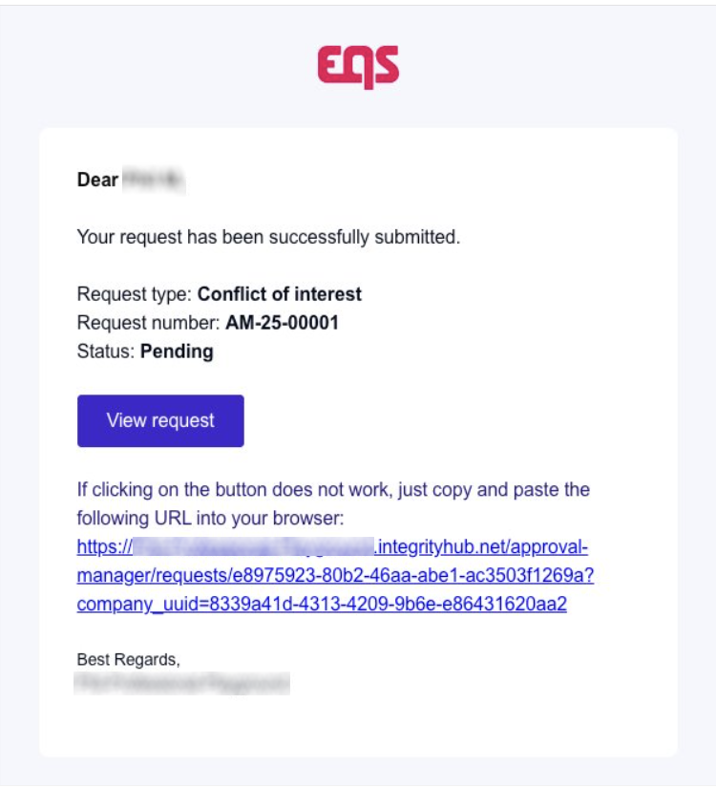
Complete the Form and Send Disclosure
You will also receive an email confirmation with a link to your Disclosure.

Slide 14
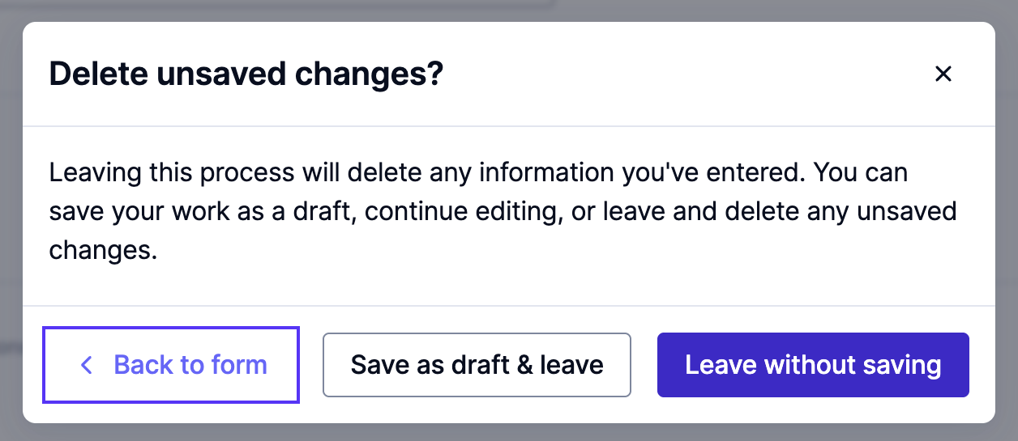
Saving the Disclosure for Later
If you need to continue your work on the disclosure later, click the cancel button instead of the Continue button.
You will see a pop-up message, and if want to save your progress, click ‘Save as draft & leave.'
Don’t forget to come back later to complete your disclosure.

Slide 15
04
Communicating with approvers

Slide 16
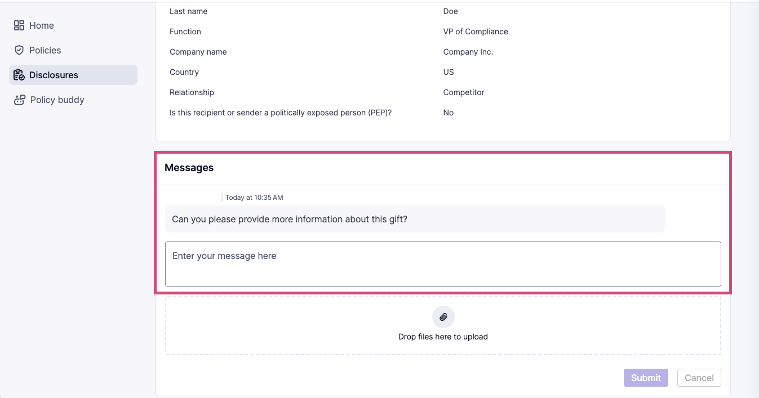
Communication from an Approver
If the approvers need more information, have questions, or need to communicate with you, you will receive an email. Click the link in the email to be directed to your Disclosure.
Open the Disclosure, then scroll to the bottom of the Disclosure. You will find the communication in the messages section of the Disclosure.

Slide 17
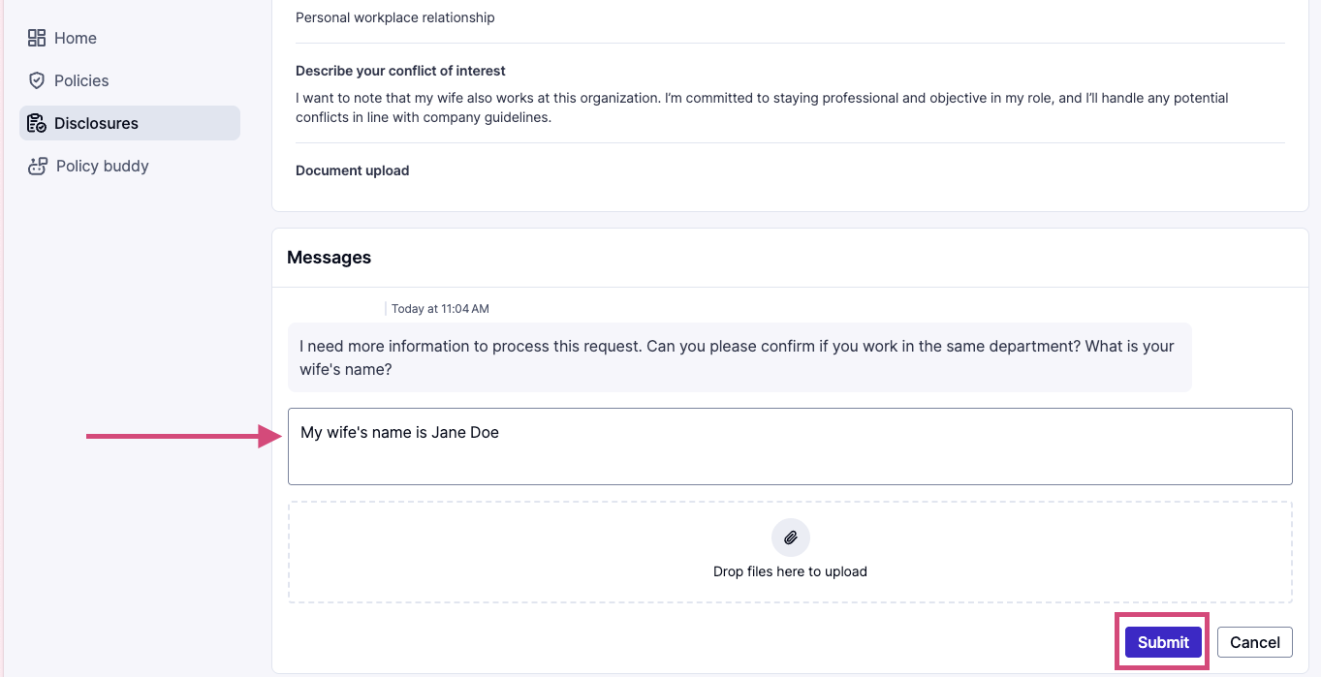
Communication to an Approver
To respond to an approver, respond in the box under the message in the Messages section.
You can add attachments to your response.
When you are finished with your response, click the ‘Submit’ button.

Slide 18
05
Attestation

Slide 19
Attestation
You may be asked to attest to the result of the Disclosure.
You will receive an email requesting your review and attestation to the result of the Disclosure from the approvers.
Click the link in the email. You will be directed to the Disclosure.
You will see that an attestation is required.

Slide 20
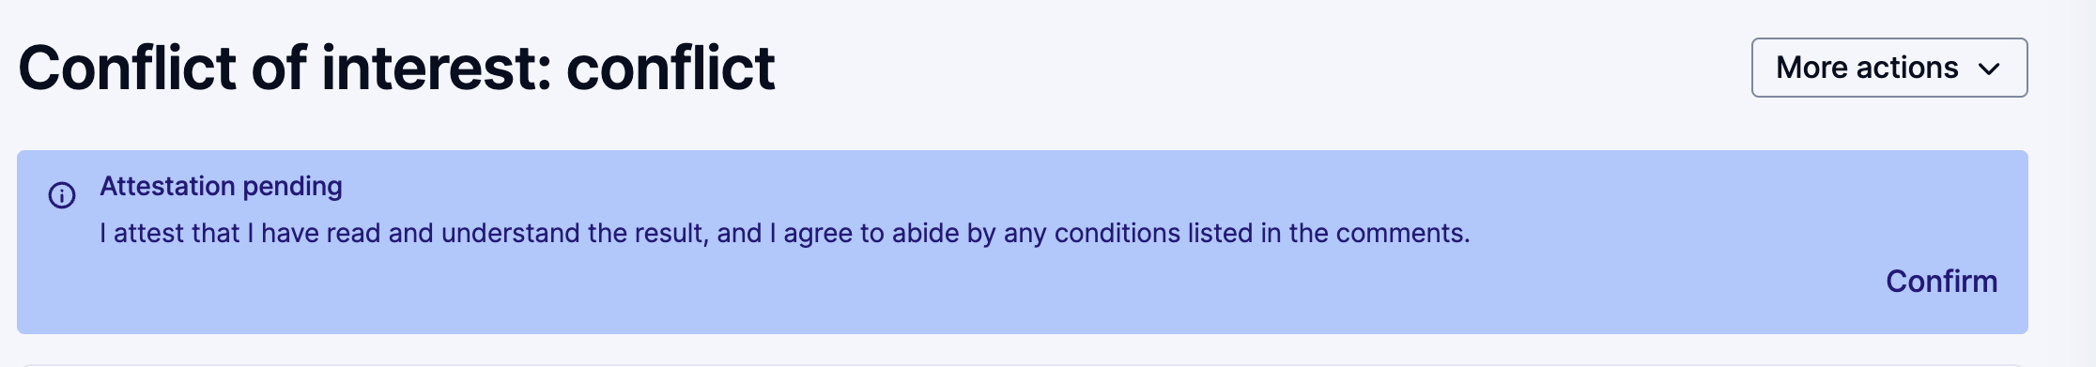
Attest to the Disclosure Conclusion
At the top of the Disclosure, you will see there is an Attestation pending.
Click the ‘Confirm’ button.

Slide 21
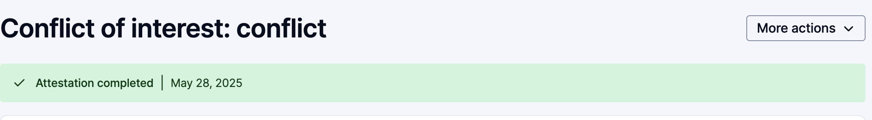
Attestation / Disclosure is Completed
Once you complete the attestation, you will see this reflected in green. Your Disclosure is now fully complete.

Slide 22
06
Cancelling and deleting a disclosure

Slide 23
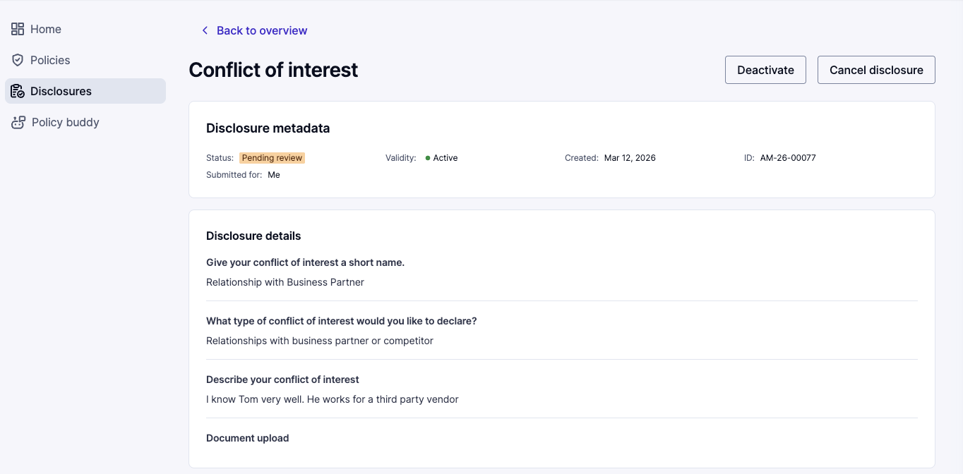
Cancel a Disclosure
There might be an instance when you need to cancel a Disclosure. For example, during the course of the Disclosure, the gift or invitation may have been taken back.
Navigate to Integrity Hub.
Click on the Disclosure you need to cancel.
Inside this Disclosure, click on ‘More actions,’ then choose ‘Cancel Disclosure.’

Slide 24
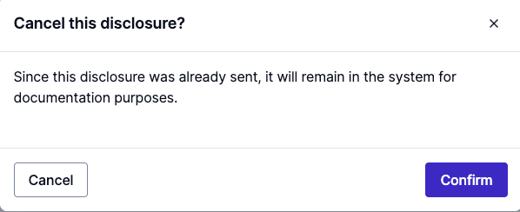
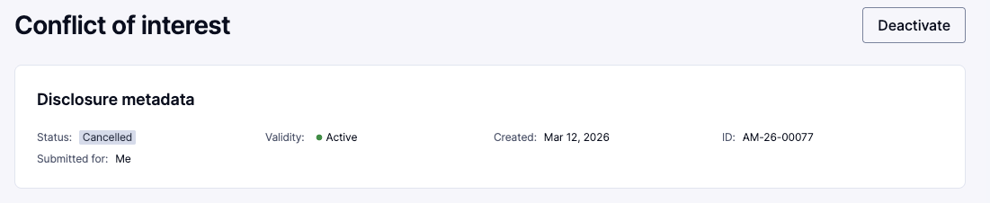
Cancel a Disclosure
You will be prompted to ‘Confirm’ you want to cancel the Disclosure.
The status of your Disclosure will then show as ‘Cancelled.’

Slide 25
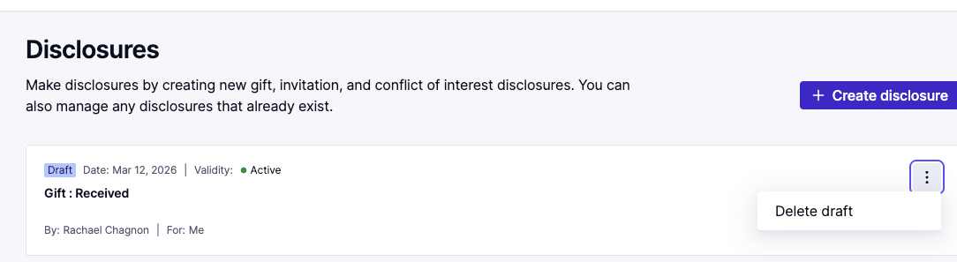
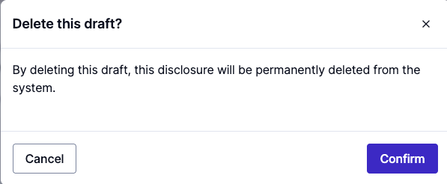
Delete a Draft Disclosure
If you have started a Disclosure and it is in draft status, you can delete that draft. You might want to do this if the Disclosure no longer applies and you no longer need to send it.
Click the three dots on the right side of the Disclosure you want to delete.
Click ‘Delete draft.’
You will be prompted to confirm you want to delete the draft. Click the ‘Confirm’ button. This action is permanent.

Slide 26
07
Past disclosures and statuses

Slide 27
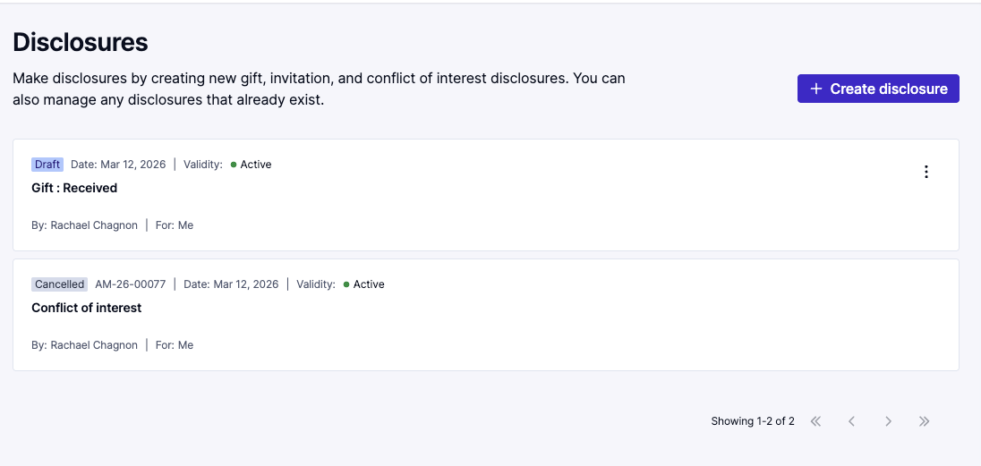
Past Disclosures
You may review any past Disclosures. They will have different statuses.
From the Home screen or Disclosure screen you will see a list of all past Disclosures.
If you need to view any past Disclosure, click on it to open the full details of the Disclosure.

Slide 28

Thank you for your attention

