Slide 1
Recommendations for using this training presentation
Delete this slide before sharing this presentation
We recommend customizing this deck before using this presentation. The format (PPT) is editable so that you can add screenshots and notes about processes that are specific to your own organization
Intended audience: All employees in your organization who will need to submit disclosures
Note: remove references to “action items” (section 3) if unused by your organization

Slide 2
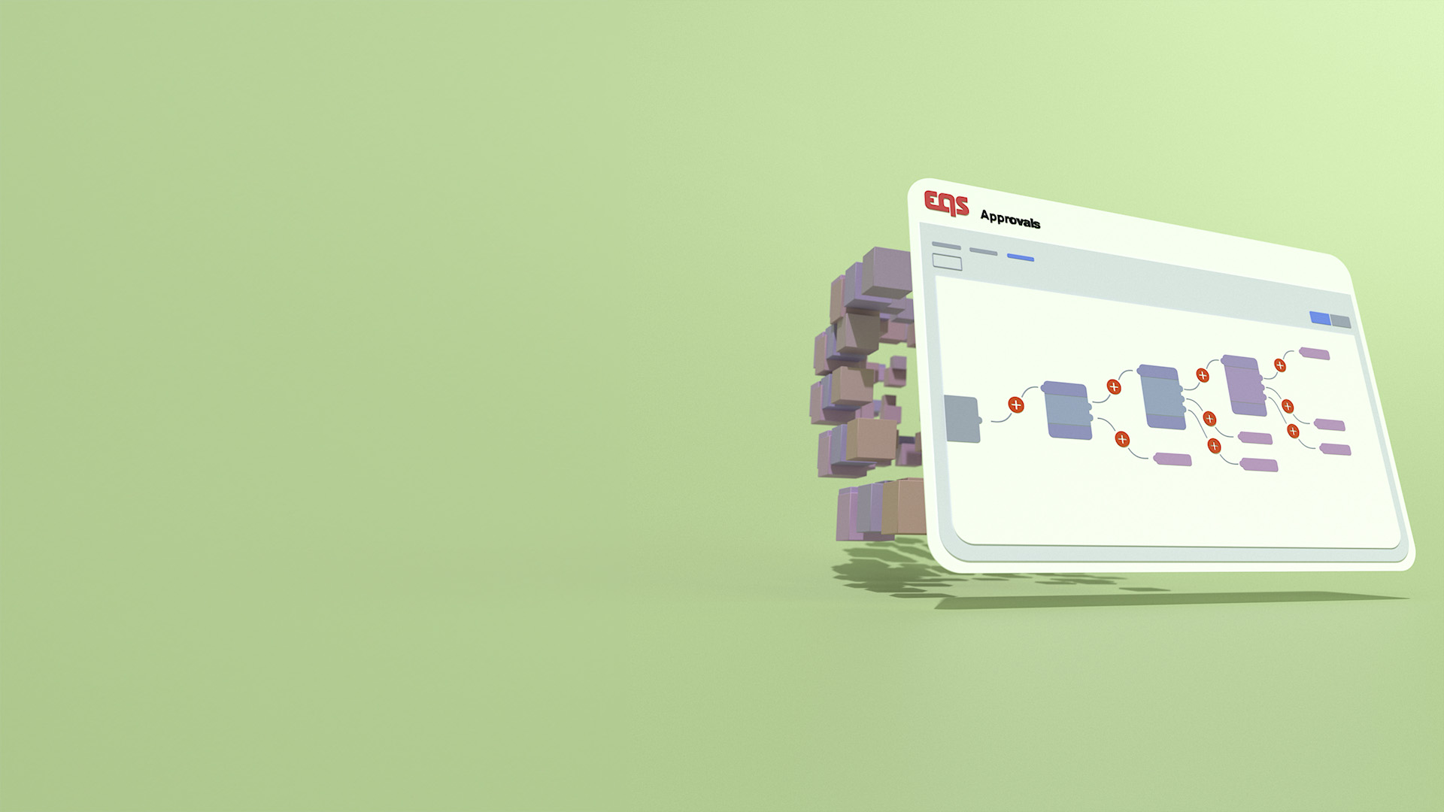

APPROVALS
Submitting a Disclosure
Training Deck

Slide 3
Agenda
Navigating to Integrity Hub
Submitting a Disclosure As Needed
Submitting a Disclosure via an Action Item
Completing Disclosure Questions & Finalizing the Submission
Communicating with Reviewers
Attestation
Cancelling & Deleting a Disclosure
Previously Submitted Disclosures & Statuses

Slide 4
01
Navigating to Integrity Hub

Slide 5
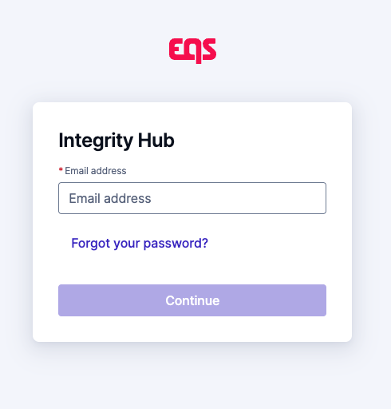
Navigating to Integrity Hub
          Integrity Hub URL: https://www.integrityhub.net or https://www.integrityhub.us
          Log in with your credentials
Note to Customer - be sure to revise the above link if you use a different Integrity Hub URL, as it could be different than one of the above. Delete this note after updating, or if not applicable.

Slide 6
02
Submitting a disclosure as needed

Slide 7
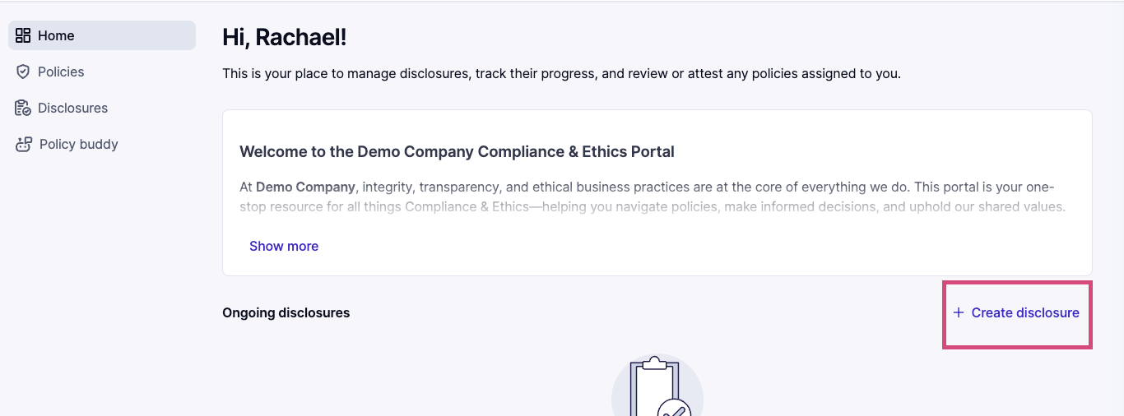
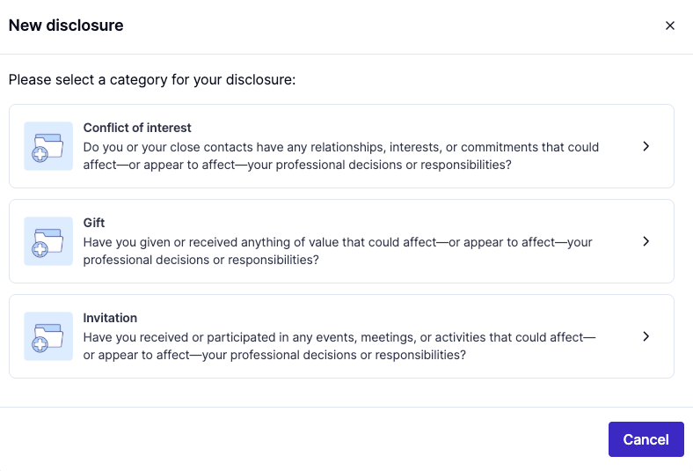
Submitting a Disclosure: Option 1
          On the Home screen, click ‘+Create Disclosure’
          Choose the category of disclosure that applies

Slide 8
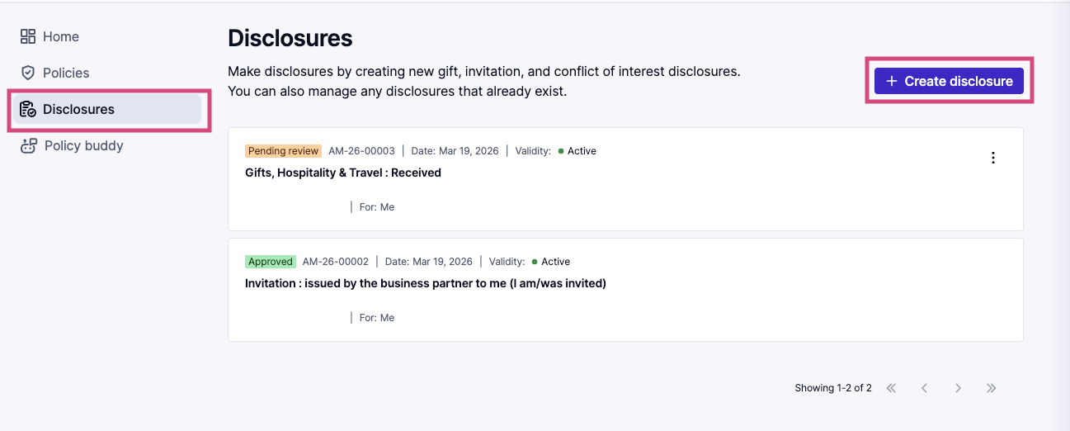
Submitting a Disclosure: Option 2
          Click the Disclosures icon from the left menu
          Click on the ‘+ Create Disclosure’ button
          Note: You will see any previously submitted Disclosures on this page and can make updates when needed

Slide 9
03
Submitting a disclosure via an action item

Slide 10
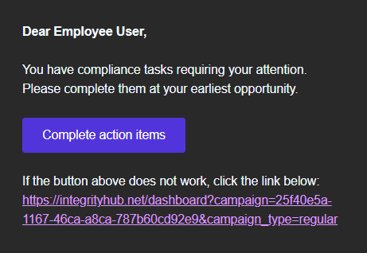
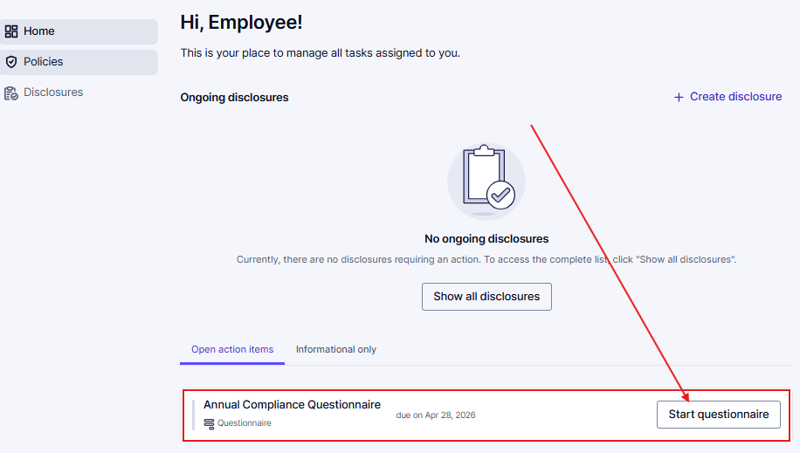

Submitting a Disclosure via an Action Item
          An “action item” is first introduced to you via email, with a clickable link similar to the below:
Clicking on the link from your email will take you directly into the action item, but you can also find it on your Home page in Integrity Hub
Select “Start questionnaire” to begin the disclosure questionnaire process
Note to Customer - be sure to revise the email screenshot if you customize the campaign email text.

Slide 11
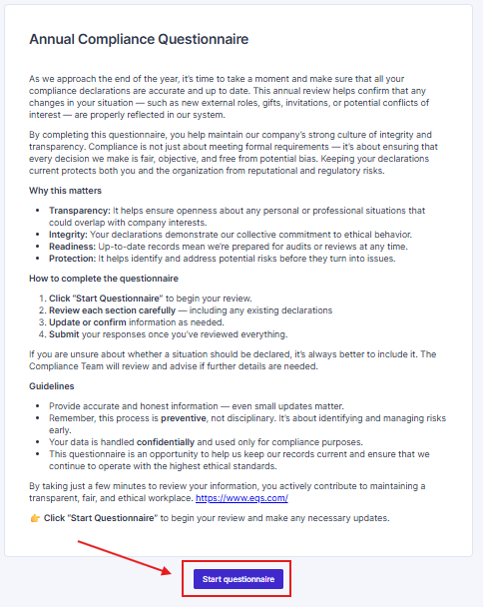
Submitting a Disclosure via an Action Item
          Before you can begin the action item, you will see a welcome section with supporting guidance or additional context on the questionnaire.
          Click ‘Start questionnaire’ to move to the next screen.

Slide 12
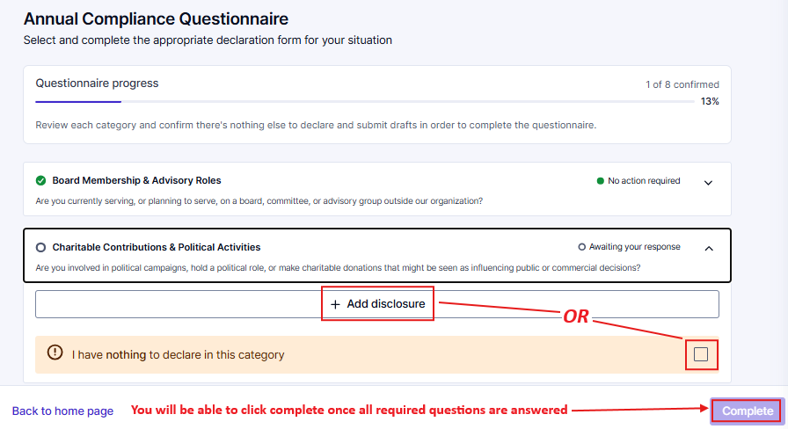
Submitting a Disclosure via an Action Item
          Review each category carefully – if a disclosure applies, select ‘+ Add disclosure’
          If the category does not apply, select the checkbox next to ‘I have nothing to declare in this category’ and move on
          Note: You will only be able to click ‘Complete’ once each category on the page is answered

Slide 13
04
Completing disclosure questions & finalizing the submission

Slide 14
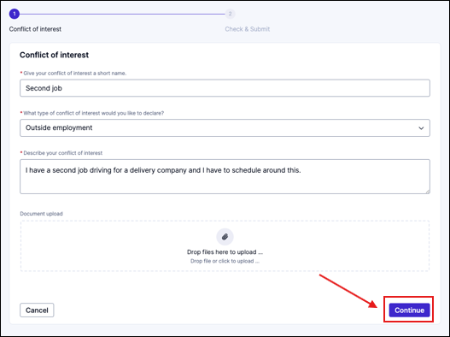
Completing the disclosure questions
          After selecting your disclosure category, a series of questions will follow
          Click the ‘Continue’ button when finished
              Note: this button will be unclickable until ALL required questions are answered

Slide 15
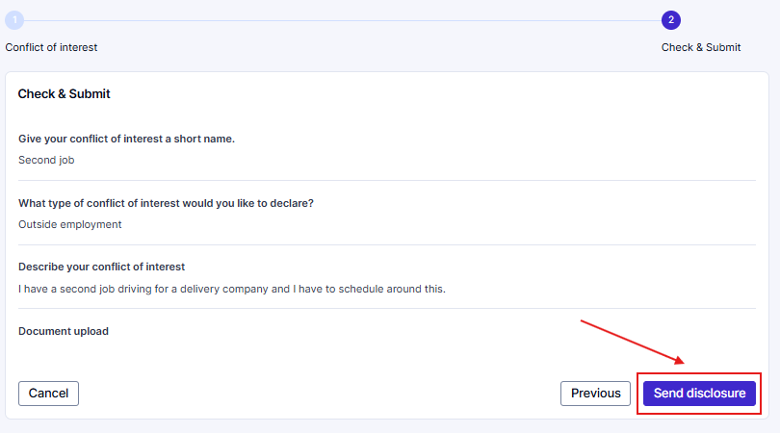
Finalizing the Submission
          Review the Disclosure for accuracy. Click ‘Previous’ if you need to revise any of your responses
          Click the 'Send Disclosure’ button when you are ready to submit

Slide 16
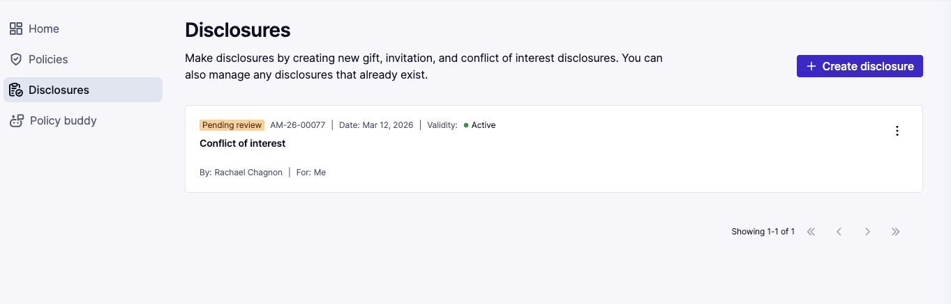
Finalizing the Submission
          After submission, you will be directed to your list of submitted disclosures
          You will see the disclosure you just sent in that list , with the status of ‘Pending Review,’ which means that it is now with a reviewer at your organization

Slide 17
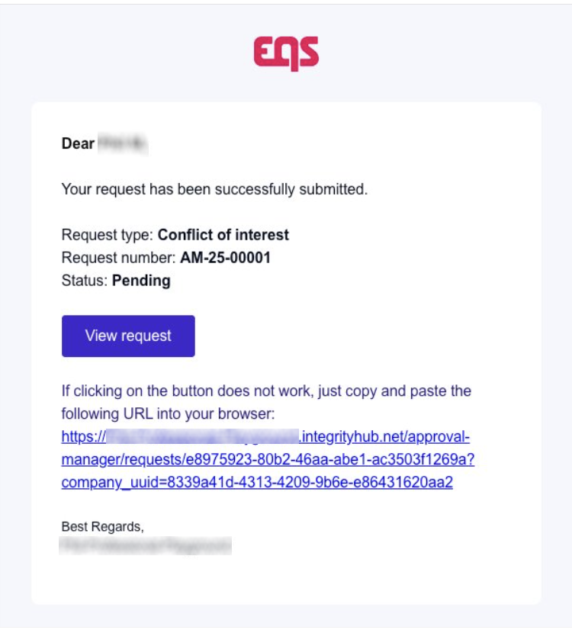
Complete the Form and Send Disclosure
          You will also receive an email confirmation with a link to your disclosure

Slide 18
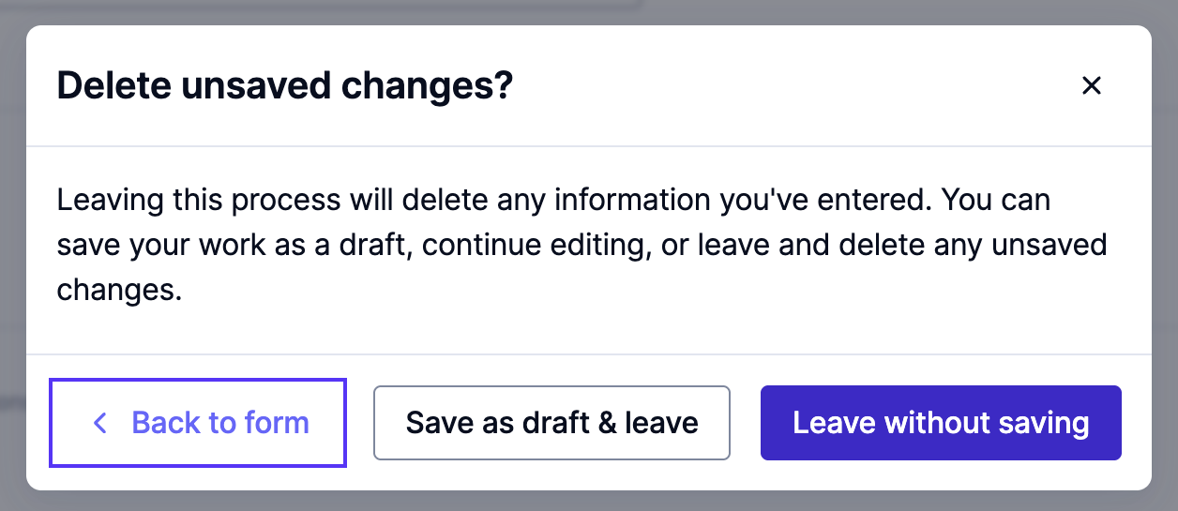
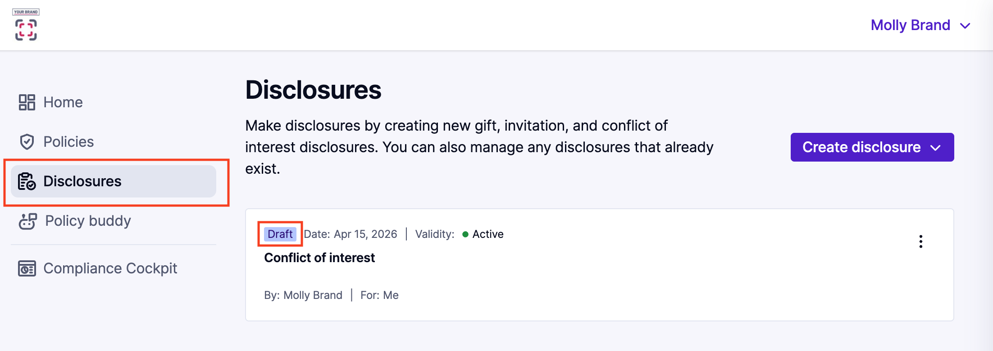
Saving the Disclosure for Later
          If you need to continue your work on the disclosure later, click the Cancel button instead of the Continue button.
          You will see a pop-up message – click ‘Save as draft & leave’ to continue the disclosure submission in the future
          Don’t forget to come back later to complete your disclosure!
              In Integrity Hub, navigate to the Disclosures section to see your saved drafts. Click into the draft to continue filling out the form.

Slide 19
05
Communicating with reviewers

Slide 20
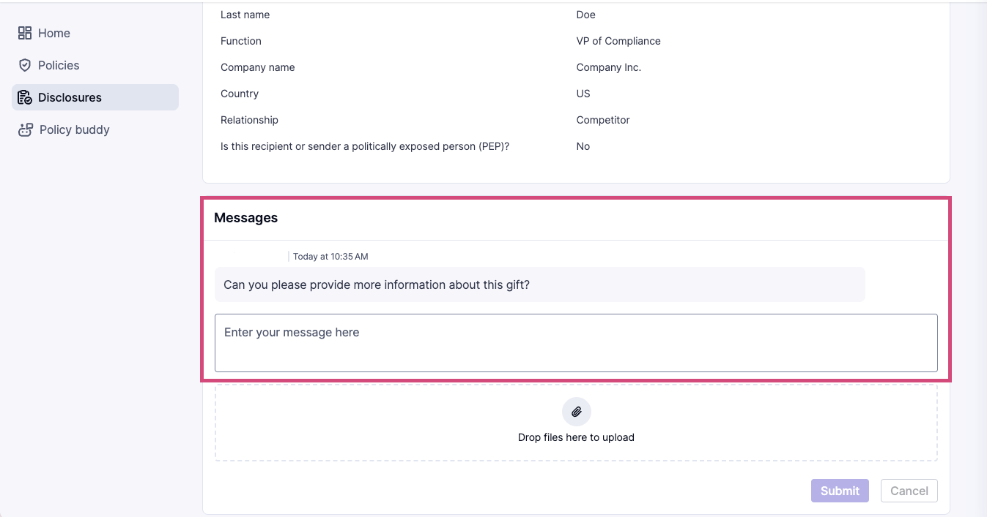
Communication from a Reviewer
          If the reviewer needs more information, has additional questions, or needs to communicate with you for any reason, you will receive an email from the system. Click the link in the email to be directed to your disclosure.
          Scroll to the ‘Messages’ section at the bottom. You will find the message.

Slide 21
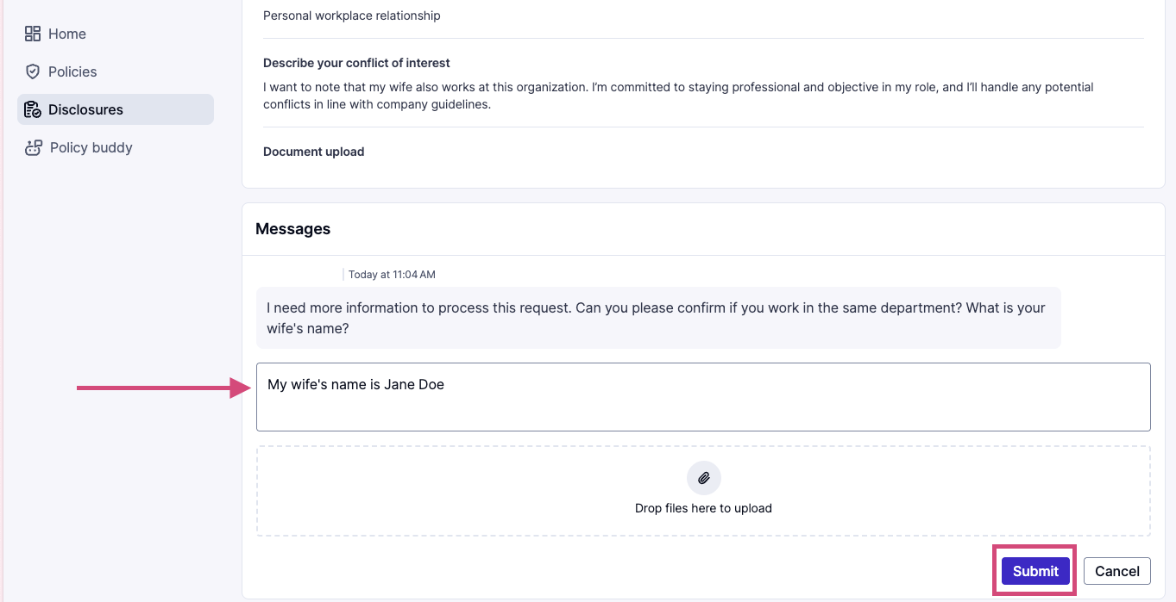
Communication to an Approver
          To respond to a reviewer, write your reply in the box under their latest message.
          You can add attachments to your response.
          When you are finished with your response, click the ‘Submit’ button.

Slide 22
06
Attestation

Slide 23
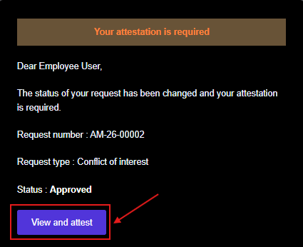
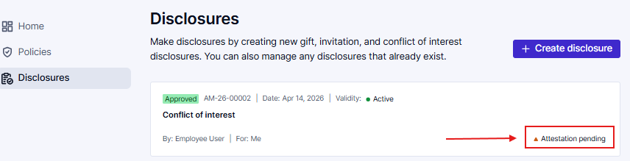
Attestation
          You may be asked to attest to the conclusion of your disclosure by the reviewer.
              If so, you will receive an email requesting you view and attest to the conclusion.
          Click the ‘View and attest’ button to view your submitted disclosures
          Then, click on the ‘Attestation pending’ disclosure to view the attestation:

Slide 24
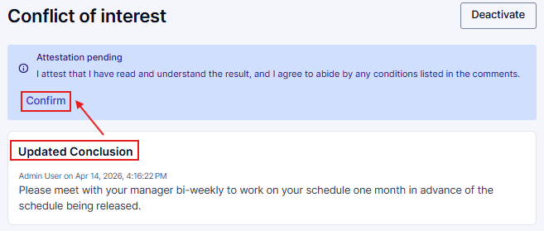
Attest to the Disclosure Decision
          Review the conclusion message, if provided, then click the ‘Confirm’ button to finalize your attestation.

Slide 25
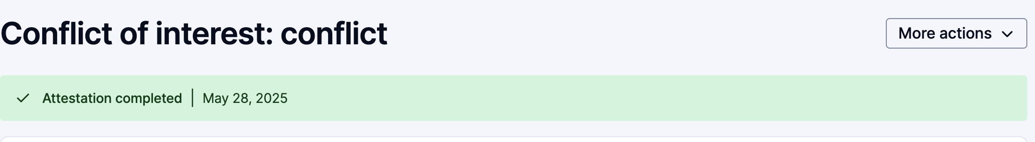
Attestation / Disclosure is Completed
          Once the attestation is finalized, you will see this reflected in green. The disclosure process is now fully complete.

Slide 26
07
Cancelling & deleting a disclosure

Slide 27
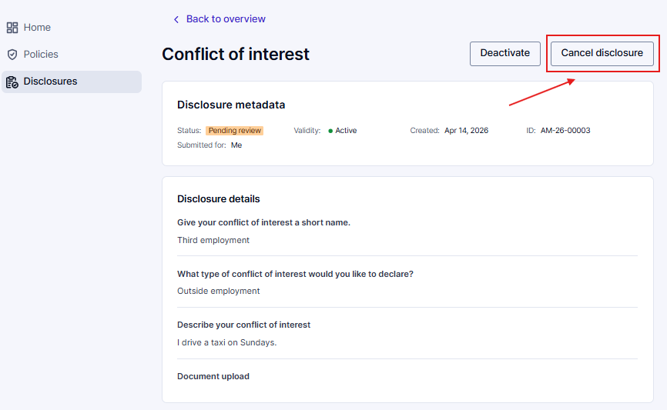
Cancel a Disclosure
          If you need to cancel a ‘Pending review’ disclosure – for example, a gift is returned and the disclosure no longer applies – you can cancel the disclosure altogether
          Navigate to the Integrity Hub → Disclosures screen
              Click on the disclosure you need to cancel
              Inside this disclosure, click on ‘Cancel Disclosure’

Slide 28
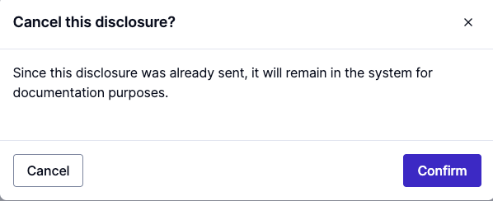
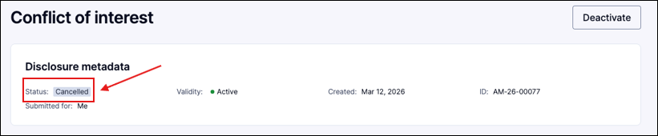
Cancel a Disclosure
          You will be prompted to ‘Confirm’ your cancelation
          The status of your disclosure will then show as ‘Cancelled’

Slide 29
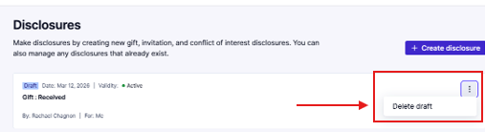
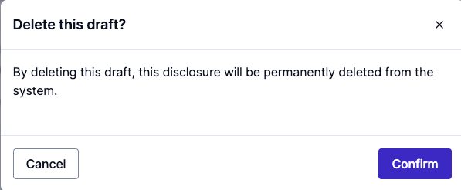
Delete a Draft Disclosure
          If you started a disclosure and it is in draft status, you can delete that draft
          Click the three dots on the right side of the Disclosure you want to delete.
              Click ‘Delete draft’
              You will be prompted to confirm your deletion. This action is permanent.

Slide 30
08
Previously submitted disclosures & statuses

Slide 31
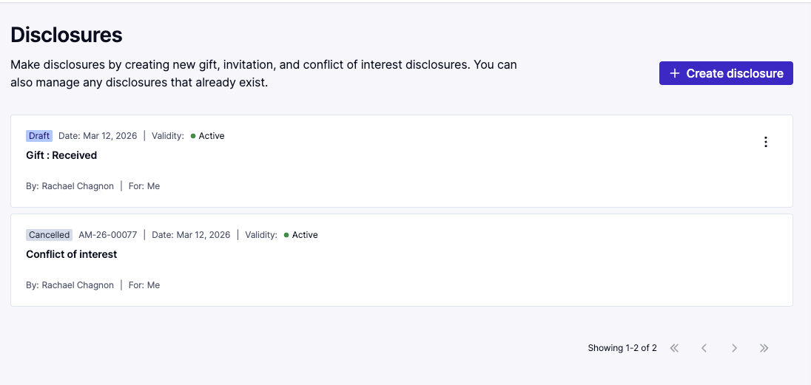
Previously Submitted Disclosures
          For later reference, you can view all your previously submitted disclosures via the Disclosures page.
          Click on the specific disclosure tile to view the submission details.

Slide 32

Thank you for your attention

