Slide 1
Recommendations for using this training presentation
Delete this slide before sharing this presentation
We recommend customizing this deck before using this presentation. The format (PPT) is editable so that you can add screenshots and notes about processes that are specific to your own organization
Intended audience: The people in your organization who will be creating, reviewing, publishing and managing the policies management process.
      This is likely to include members of your Ethics & Compliance team

Slide 2
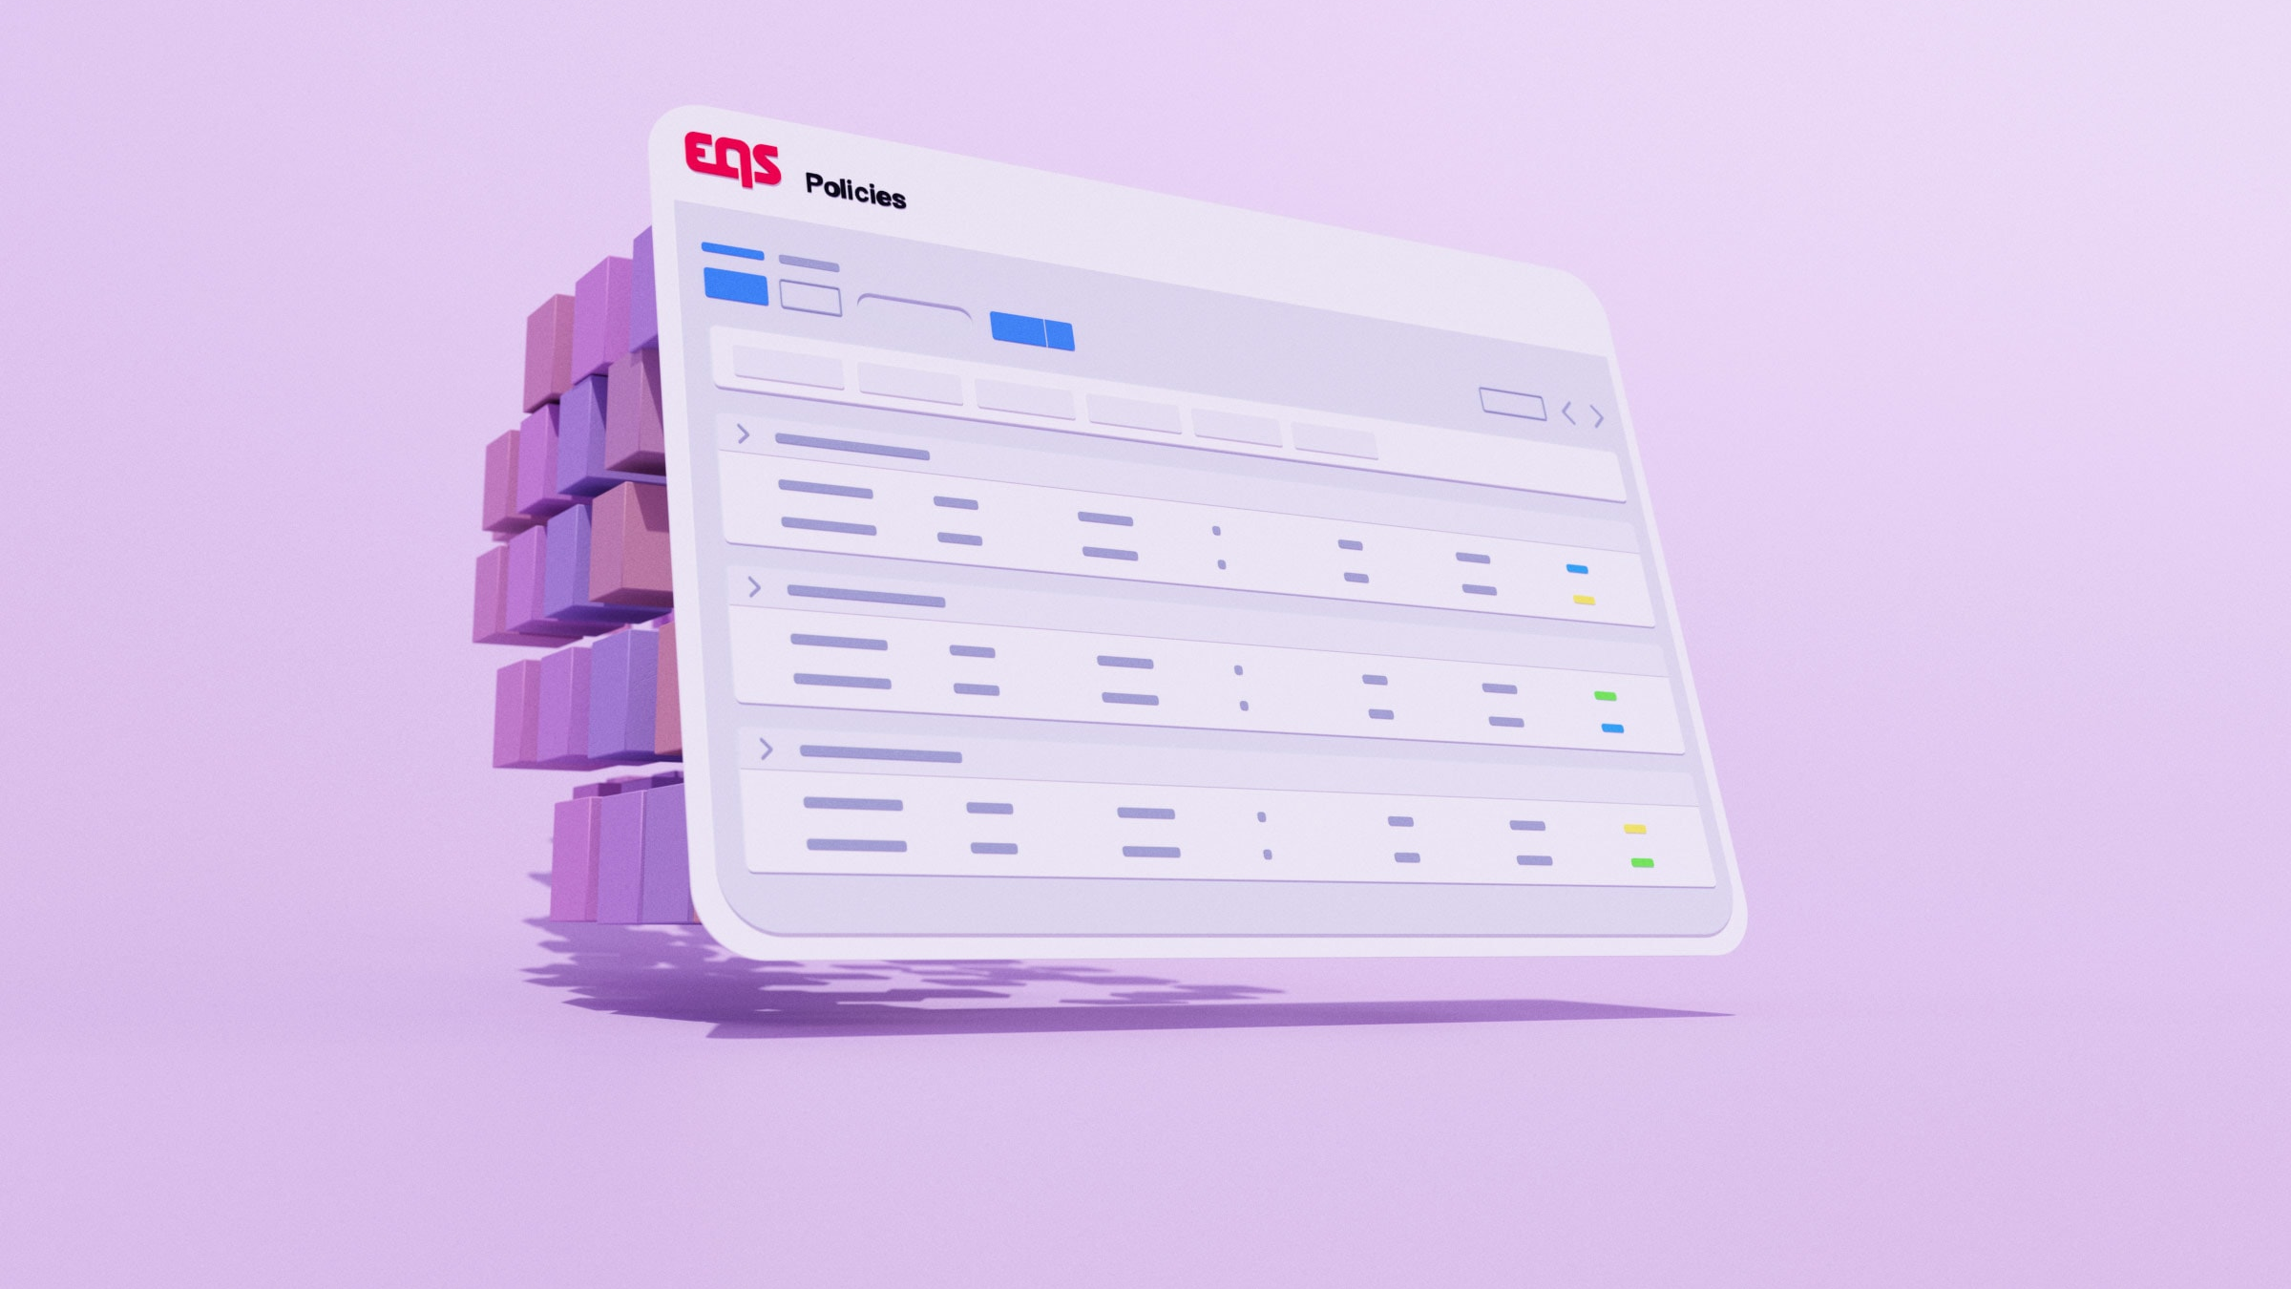
Policies
Managing Policies
Training Deck
Notes:
his version is intended for customers migrating policies into the new Policies experience.

Slide 3
Agenda
Policy Attestations and Campaigns
Accessing the Policies module and your assigned policies
Reviewing a Policy
Editing a Published Policy
Creating a New Version of a Published Policy

Slide 4
01
Policy Attestations and Campaigns

Slide 5
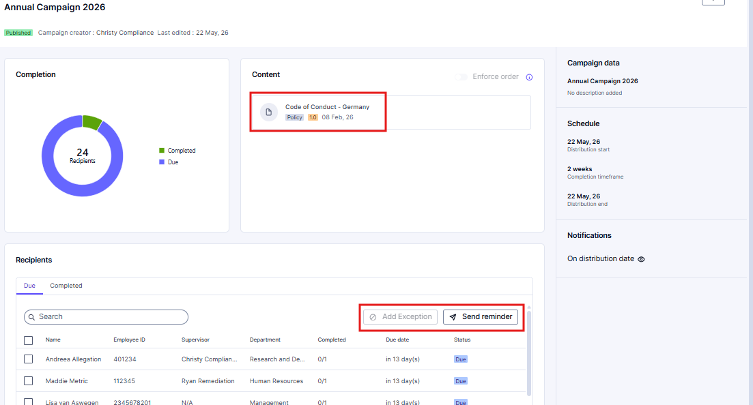
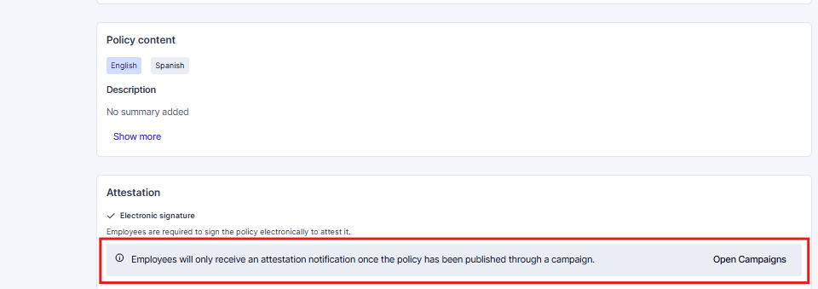
Policy distribution via the Campaign module
          The Policies module is where you will define content, access and attestation method.
          Publishing a policy allows it to be selected for a Campaign.
          Campaigns distribute policies and collect attestations.
          Reminders to attest can only be sent by Campaign administrators.

Slide 6
02
Accessing the Policies module and your assigned policies

Slide 7
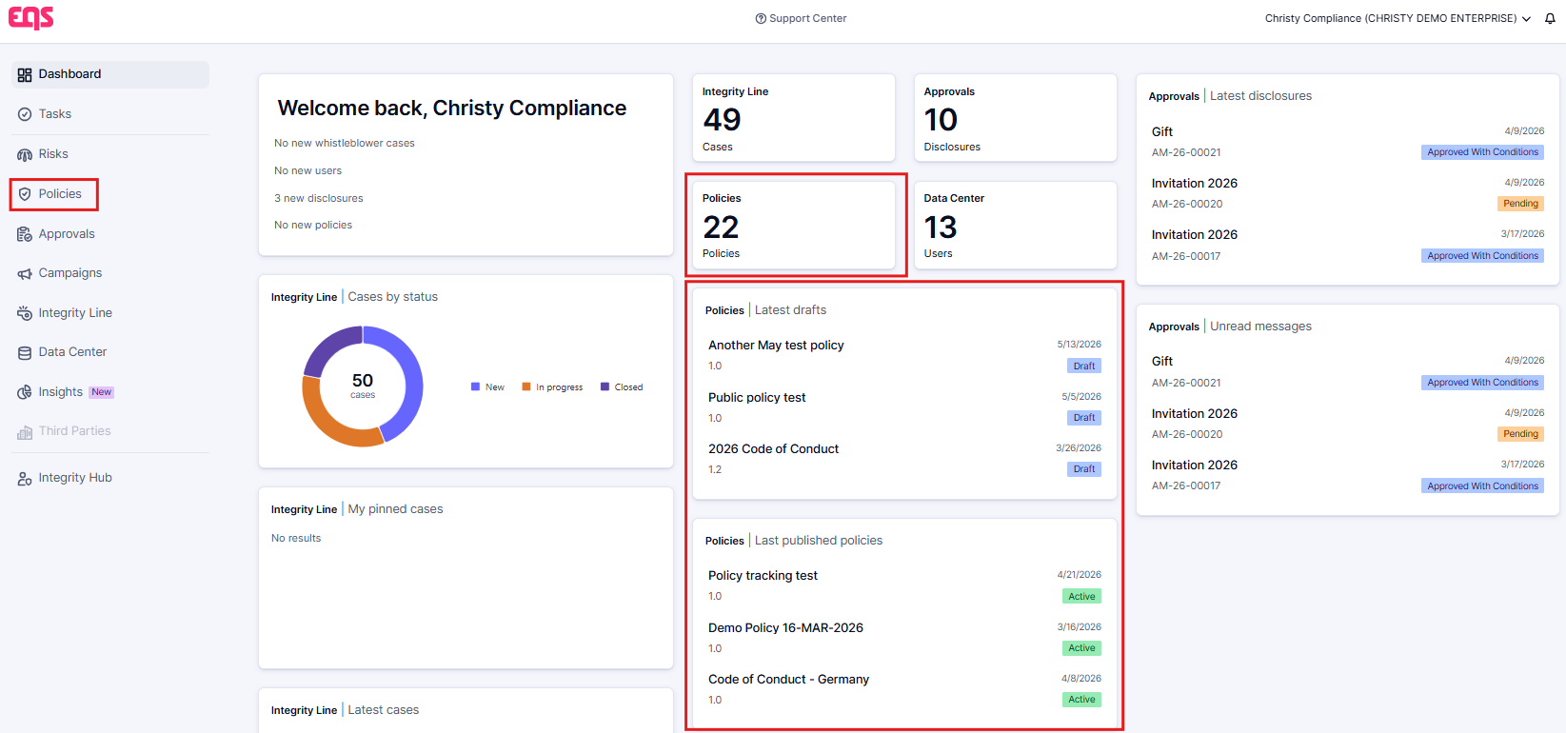
Accessing Policies Module
This image shows how to access the full Policies module via the left-side menu and highlights the widgets that provide an overview of the policies that you have access to.
          The Policies module includes functionality to create, manage, publish, and version policies, including policy content, access settings, attestation requirements, approval workflows, and reporting.
          This presentation is focused on reviewing, updating, and versioning policies within the Policies module.

Slide 8
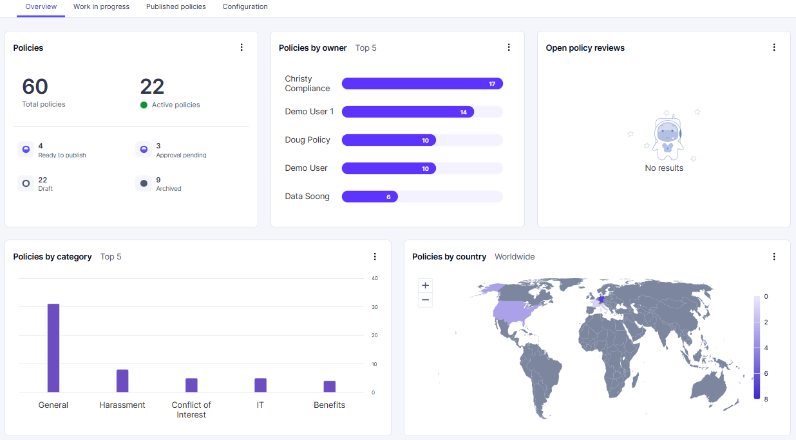
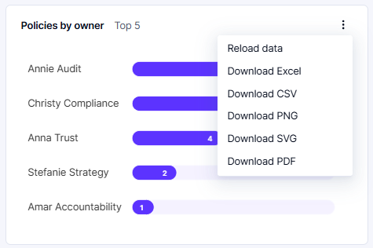

Policy Dashboard Overview
    The Dashboard displays an overview of all policies that the user has access to, and statistics related to those policies
    For each of the different sections, you can download the graphic by clicking on the ‘Ellipses’ and selecting the preferred filetype.

Slide 9
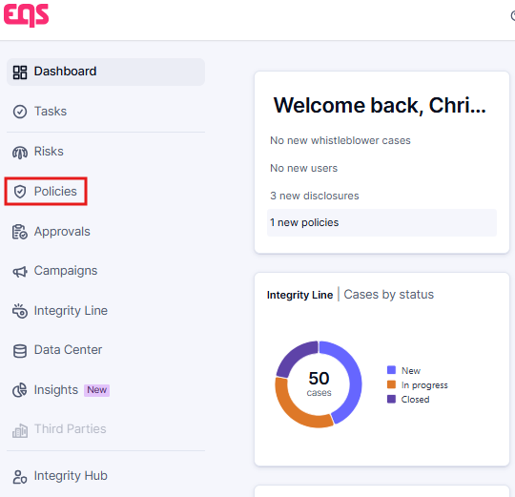
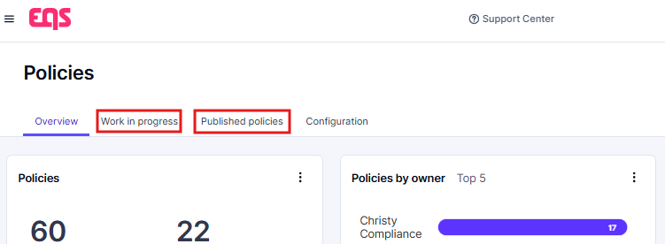
Accessing Your Assigned Policies
          You can navigate to your assigned policies in Compliance COCKPIT.
          From the home page, choose ‘Policies’ from the left-side menu, then select the ‘Work in progress’ or ‘Published policies’ tab.

Slide 10
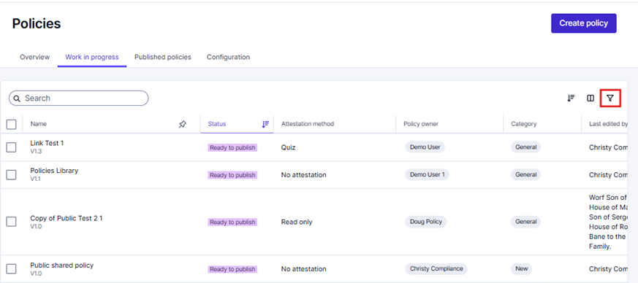
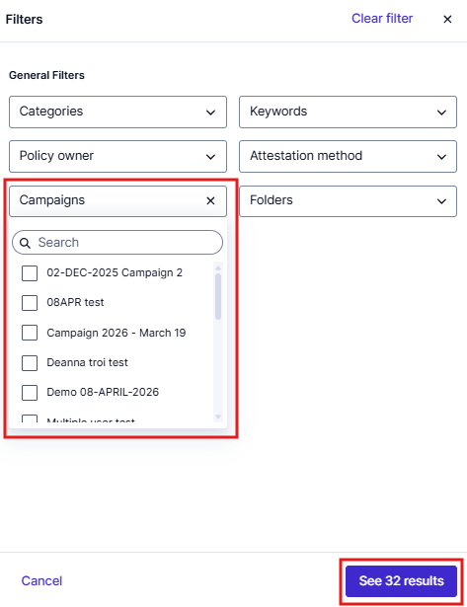
Work in Progress tab
          You will see a list of policies that you have access to, with a status of ‘draft’, ‘approval pending,’ or ‘ready to publish’ along with details such as the Status, distribution status and the attestation method.
          Click the ‘Filter’ icon in the top right to open the filter panel. We recommend using the Campaigns filter to quickly identify the Policies associated with a specific campaign. Click ‘See results’ to apply the filter.

Slide 11
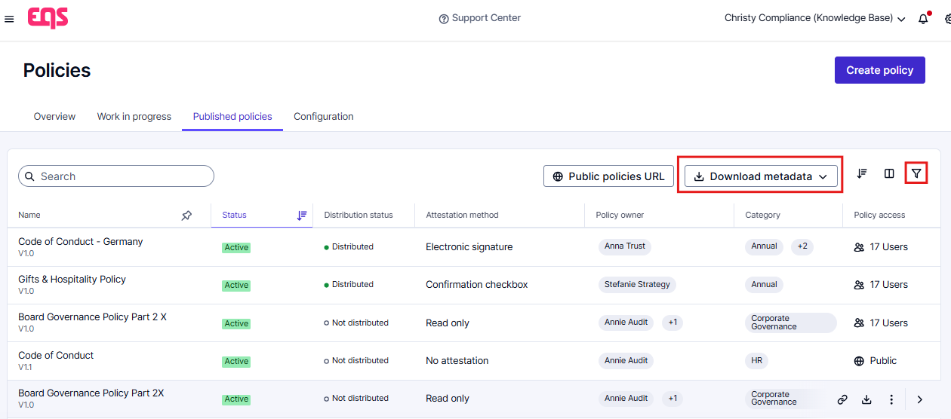
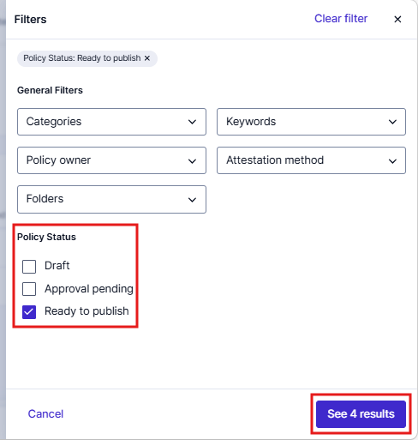
Published Policies tab
          When a policy is ‘Active,’ that means that the defined audience of users have been given access to the policy. Those assigned employee users will be able to find the policy in Integrity Hub.
          Use the ‘Download metadata’ button on the top right to download metadata for all published policies

Slide 12
03
Reviewing a Policy

Slide 13
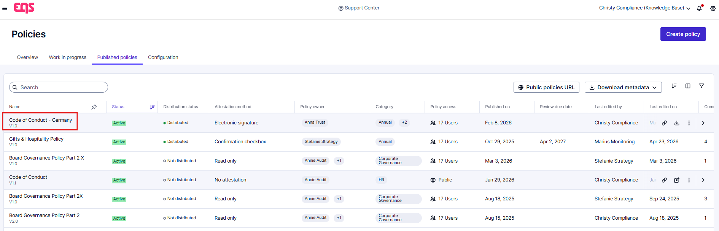
Open and Review a Policy
Open an ‘In Progress’ or ‘Published’ policy by clicking the ‘Policy Name’ located in the left of the Dashboard pane.

Slide 14
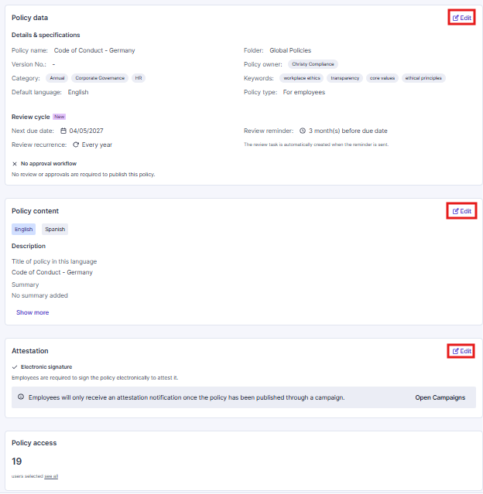
Reviewing a Policy
    Once in the Policy you can view the content, details, attestation and policy access showing who can view the policy in Integrity Hub.
    When accessing ’Draft’ policies, you can use the ‘Edit’ button next to each section to make changes.

Slide 15
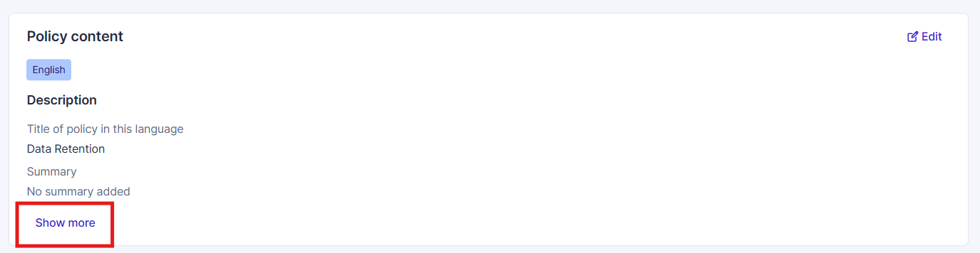
Reviewing a Policy
    To view the full policy content, you will need to click ‘Show more’ under the policy Content section

Slide 16
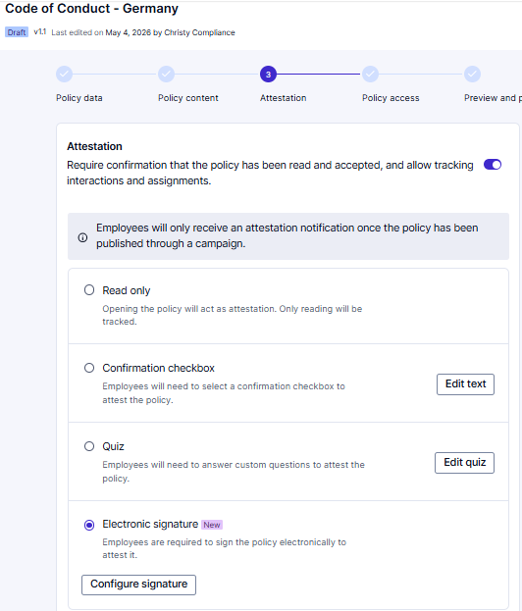
Reviewing a Policy
    If you need to collect attestations, turn on the ‘Attestation’ toggle
    Select one of the following Attestation Methods
      Read only
      Confirmation checkbox
      Quiz
      Electronic signature
    Note: Attestations methods are set per policy.

Slide 17
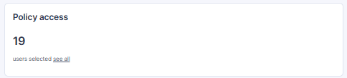
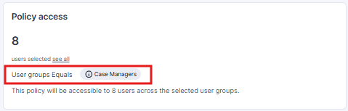
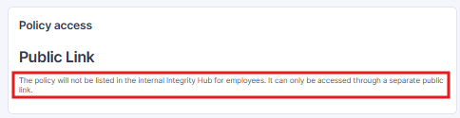
Reviewing a Policy
    Policy access outlines the users or employees who have access to the policy in Integrity Hub. If Campaigns is enabled, users can only attest through a Campaign.
    There are three ways in which the audience of a policy can be defined.
      All users in the data base will be assigned the policy
      The policy can be assigned based on user criteria
      OR the policy will only be available via a public link.
      Note: Public link policies do not allow attestation

Slide 18
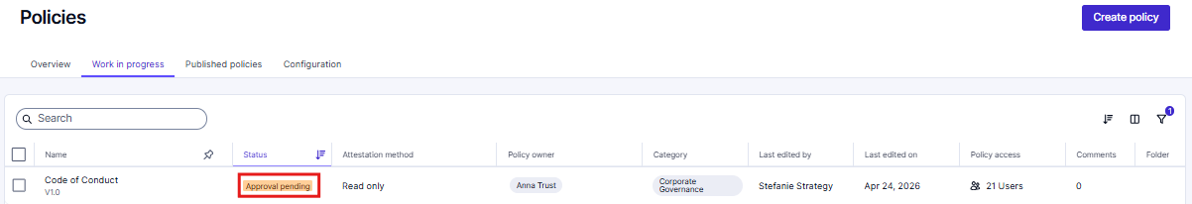
Reviewing a Policy
    Policies ‘pending approval’ will be flagged with the appropriate status on the work in progress screen
    To begin your review, click into the policy, review all appropriate fields, then click ‘Start Review’ in the upper right-hand corner

Slide 19
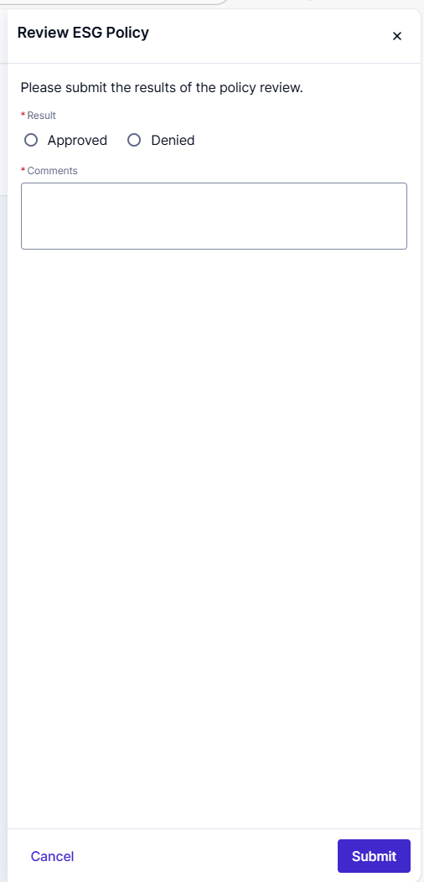
Reviewing a Policy
    After clicking ‘Start Review’ you will see a pop up on the right-hand side to ‘Approve’ or ‘Deny’ and add Comments as needed.
    Then click ‘Submit’
    This process will need to be completed for all rounds of approval

Slide 20
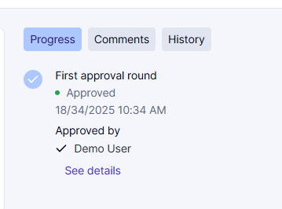
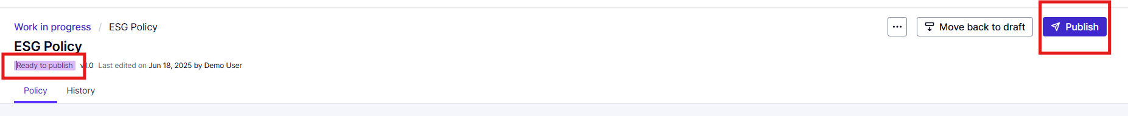
Reviewing a Policy
    Once Approved by all necessary users the Policy will be marked as ‘Ready to Publish’ and the approval process will be outlined on the right side of the screen.
    The appropriate user can then access the policy and click ‘Publish.’ This will assign the policy to all applicable employees and move it to the Published policy tab

Slide 21
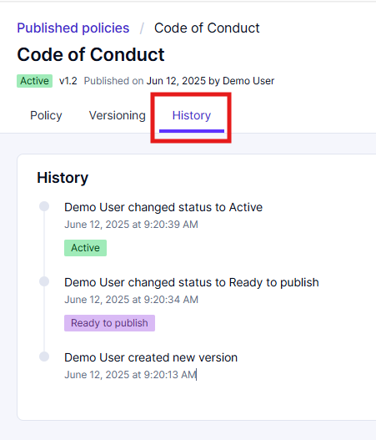
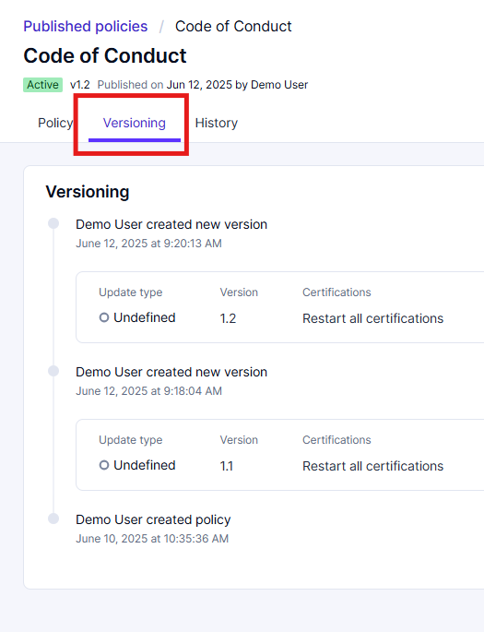
Reviewing a Policy
    On the History tab you can view when that version of the policy was moved through each previous stage prior to publication.
    On the Versioning tab you can view the previous versions of that policy, the updates that were made, and if re-attestation was required.

Slide 22
04
Editing a Published Policy

Slide 23
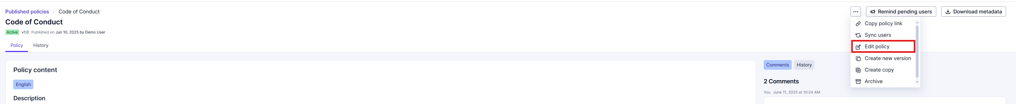
Editing A Published Policy
Making small changes to a policy
    The Policies module allows you to make a small change to an already-published version – for example to correct a typo.
    Click on the ‘Ellipses’ in the upper right corner and select ‘Edit a Policy’ to make a small change without creating a new version or restarting attestation. No notifications will be sent out. All changes will be logged in the policy history.

Slide 24
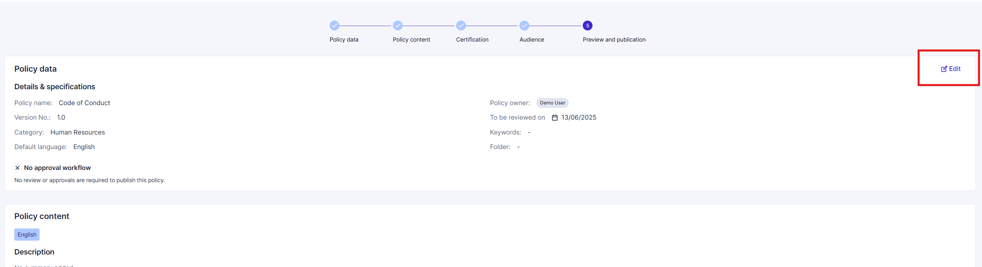
Editing A Published Policy
    Once in edit mode, click ‘Edit’ to the right of ‘Policy data’ to step through and make small edits.

Slide 25
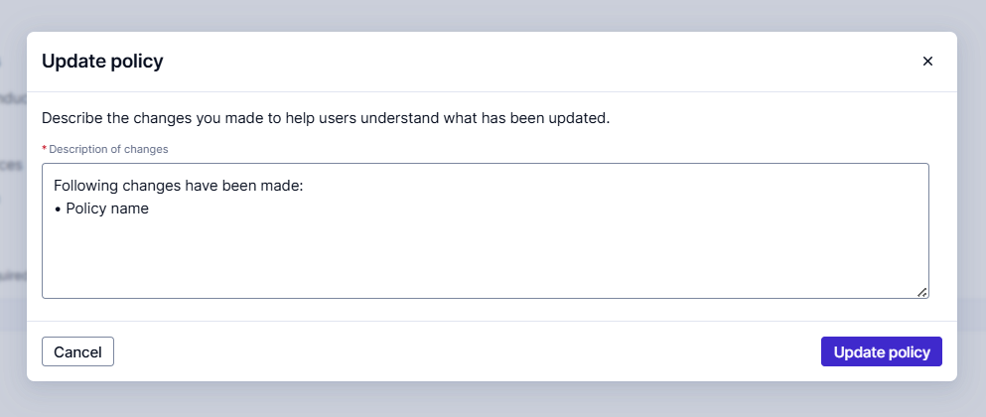
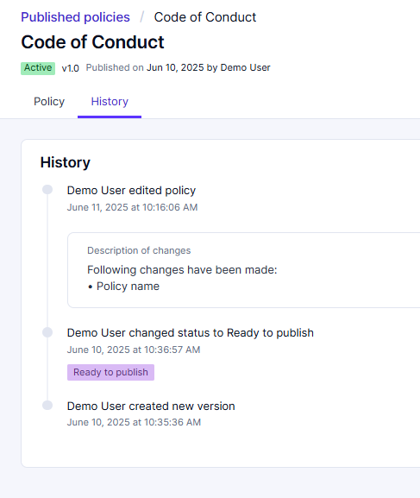
Editing A Published Policy
    After updates are made, a pop-up window will summarize the changes that have been made. You can edit this text as needed. Then click ‘Update policy.’
    The summary of changes will then be displayed in the policy History tab.

Slide 26
05
Creating a New Version of a Published Policy

Slide 27
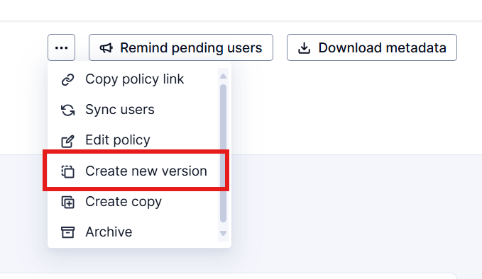
Creating a New Version of a Published Policy
For significant updates that require reattestation
    Using the same ellipses menu, you can ‘Create new version’ of a policy.
    When creating a new version, you can make major edits to the policy.

Slide 28
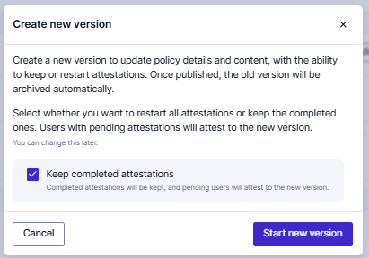
Creating a New Version of a Published Policy
    When you click ‘Create new version’ you will see a pop up that asks if you would like to keep completed attestations.
    If you would like all employees who have already attested to this policy to re-attest uncheck this box.
    Otherwise, leave as is and the policy will be updated for all future attestations.

Slide 29
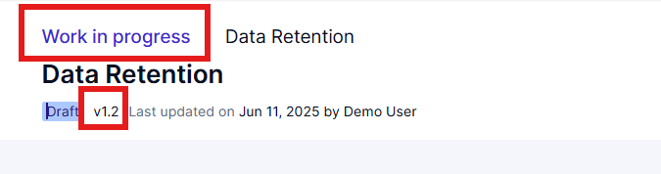
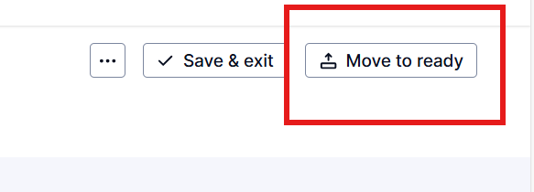
Creating a New Version of a Policy
    After creating a new version, you can find it in the Work in progress tab with the applicable version number.
    You can ‘Edit’ each section as needed.
    Once edits are complete, select ‘Request Approval’ or ‘Move to Ready.’ This will move the new version of the policy through the appropriate approval flow.

Slide 30
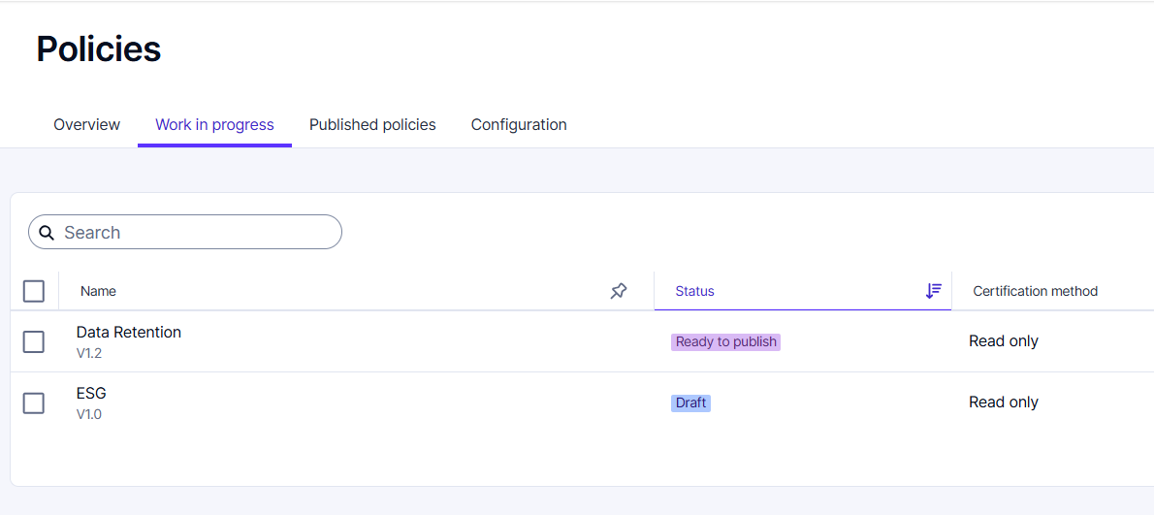
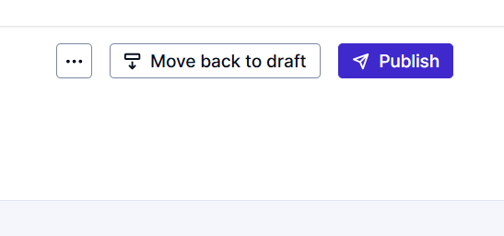
Creating a New Version of a Policy
Publishing the new version
    Once all approvals are complete the policy will be marked as ‘Ready to publish.’
    The appropriate admin user can open the policy and click ‘Publish’ in the upper right corner.
    This new version of the policy will then be ‘Active’ and displayed in the Published policies tab

Slide 31
Thank you for your attention

