Slide 1

Reporting Party
Submitting a Case Training Deck

Slide 2
Contents
Making a Report
Creating a Password
Obtaining Case ID
Accessing a Case
Call Us

Slide 3
01
Making a Report

Slide 4
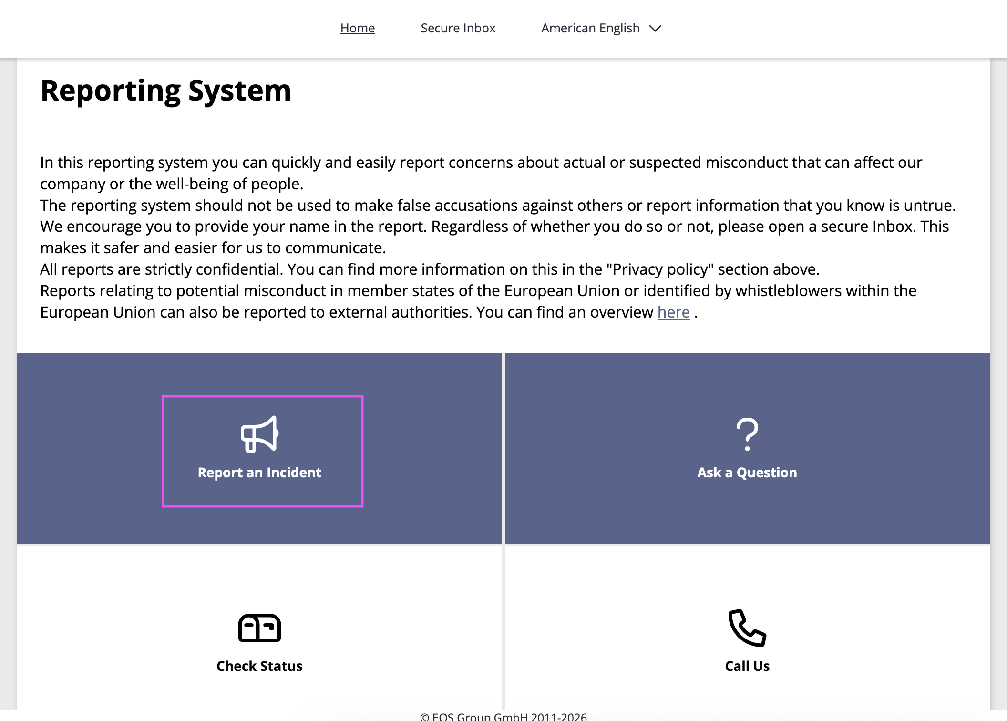
Making a Report
          Once your organization has published a branded Integrity Line, you can use the portal’s intake form to submit the details of your report. This training deck outlines the process to submit a case, obtain a case ID, and create a case password.
          Submitting your report
              When you first access the Integrity Line, you will be greeted by the portal’s welcome screen. Start your report by clicking Report an Incident.
              Alternatively, you can make a report over the phone. Click Call Us to access your organization's phone number(s). Learn more about this option at the end of this presentation.

Slide 5
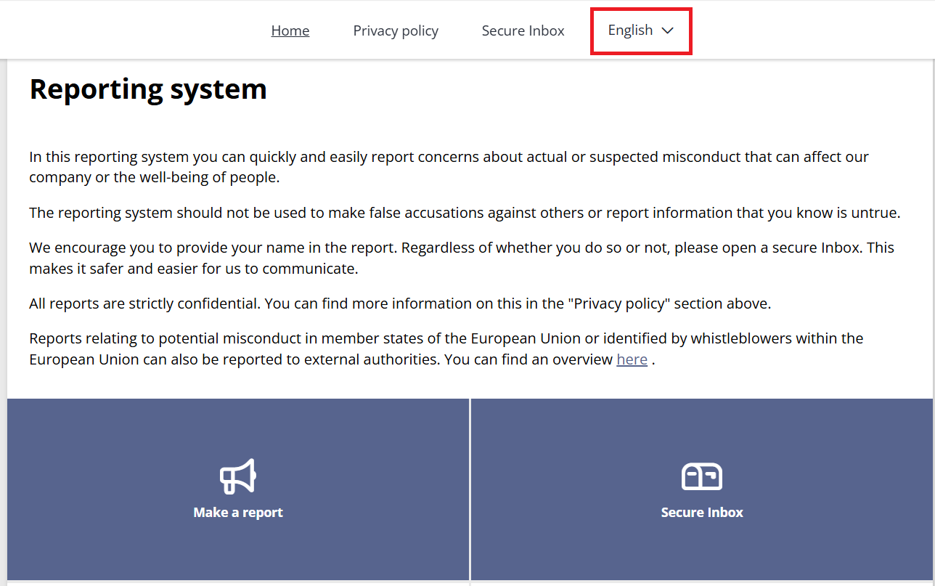
Making a Report
          Language Selection
              Please note, on the welcome screen, you can select the language you wish to report in. The language drop-down will only appear if there is more than one intake language enabled.

Slide 6
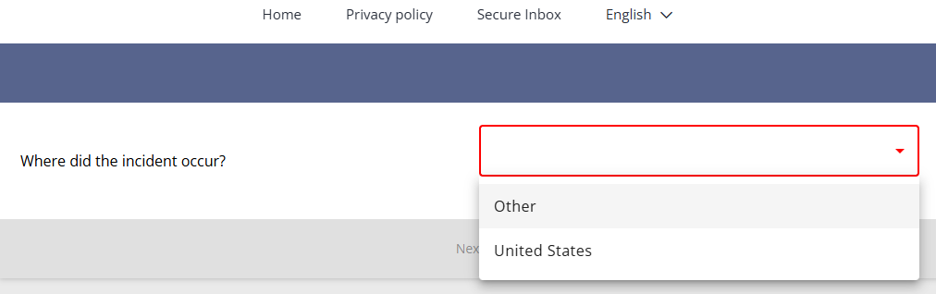
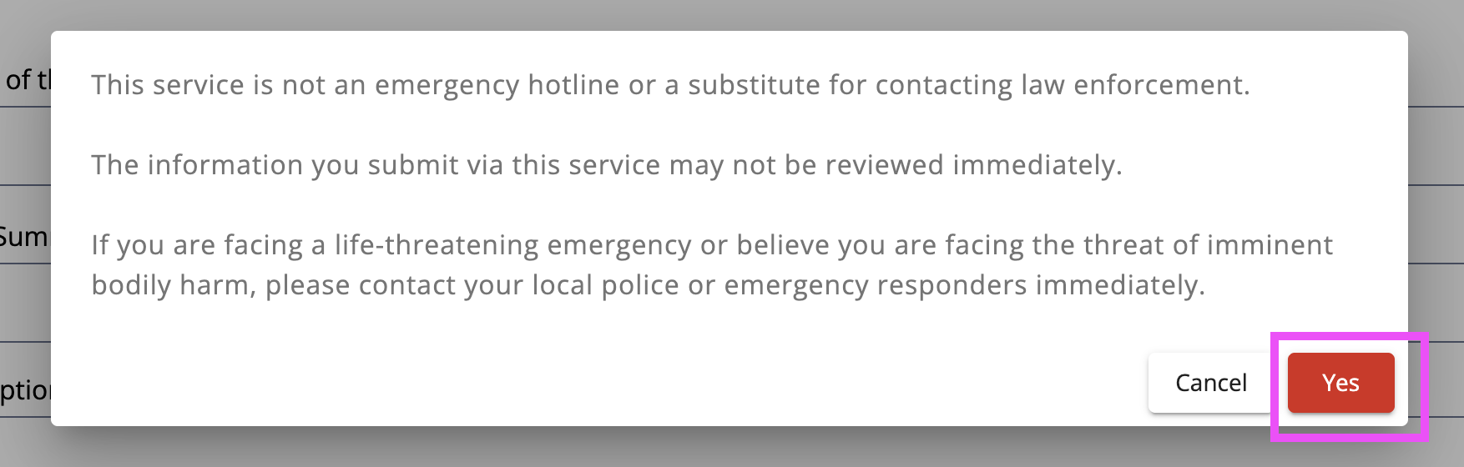
Making a Report
          If you see this question, select the appropriate country from the list. Your organization may not require this question, and if not, you will go straight to the description of the incident (see next slide) .
          Based on your country, you may see a pop-up message with disclaimer text. If you see this pop-up, click "Yes" to agree with these terms before continuing.

Slide 7
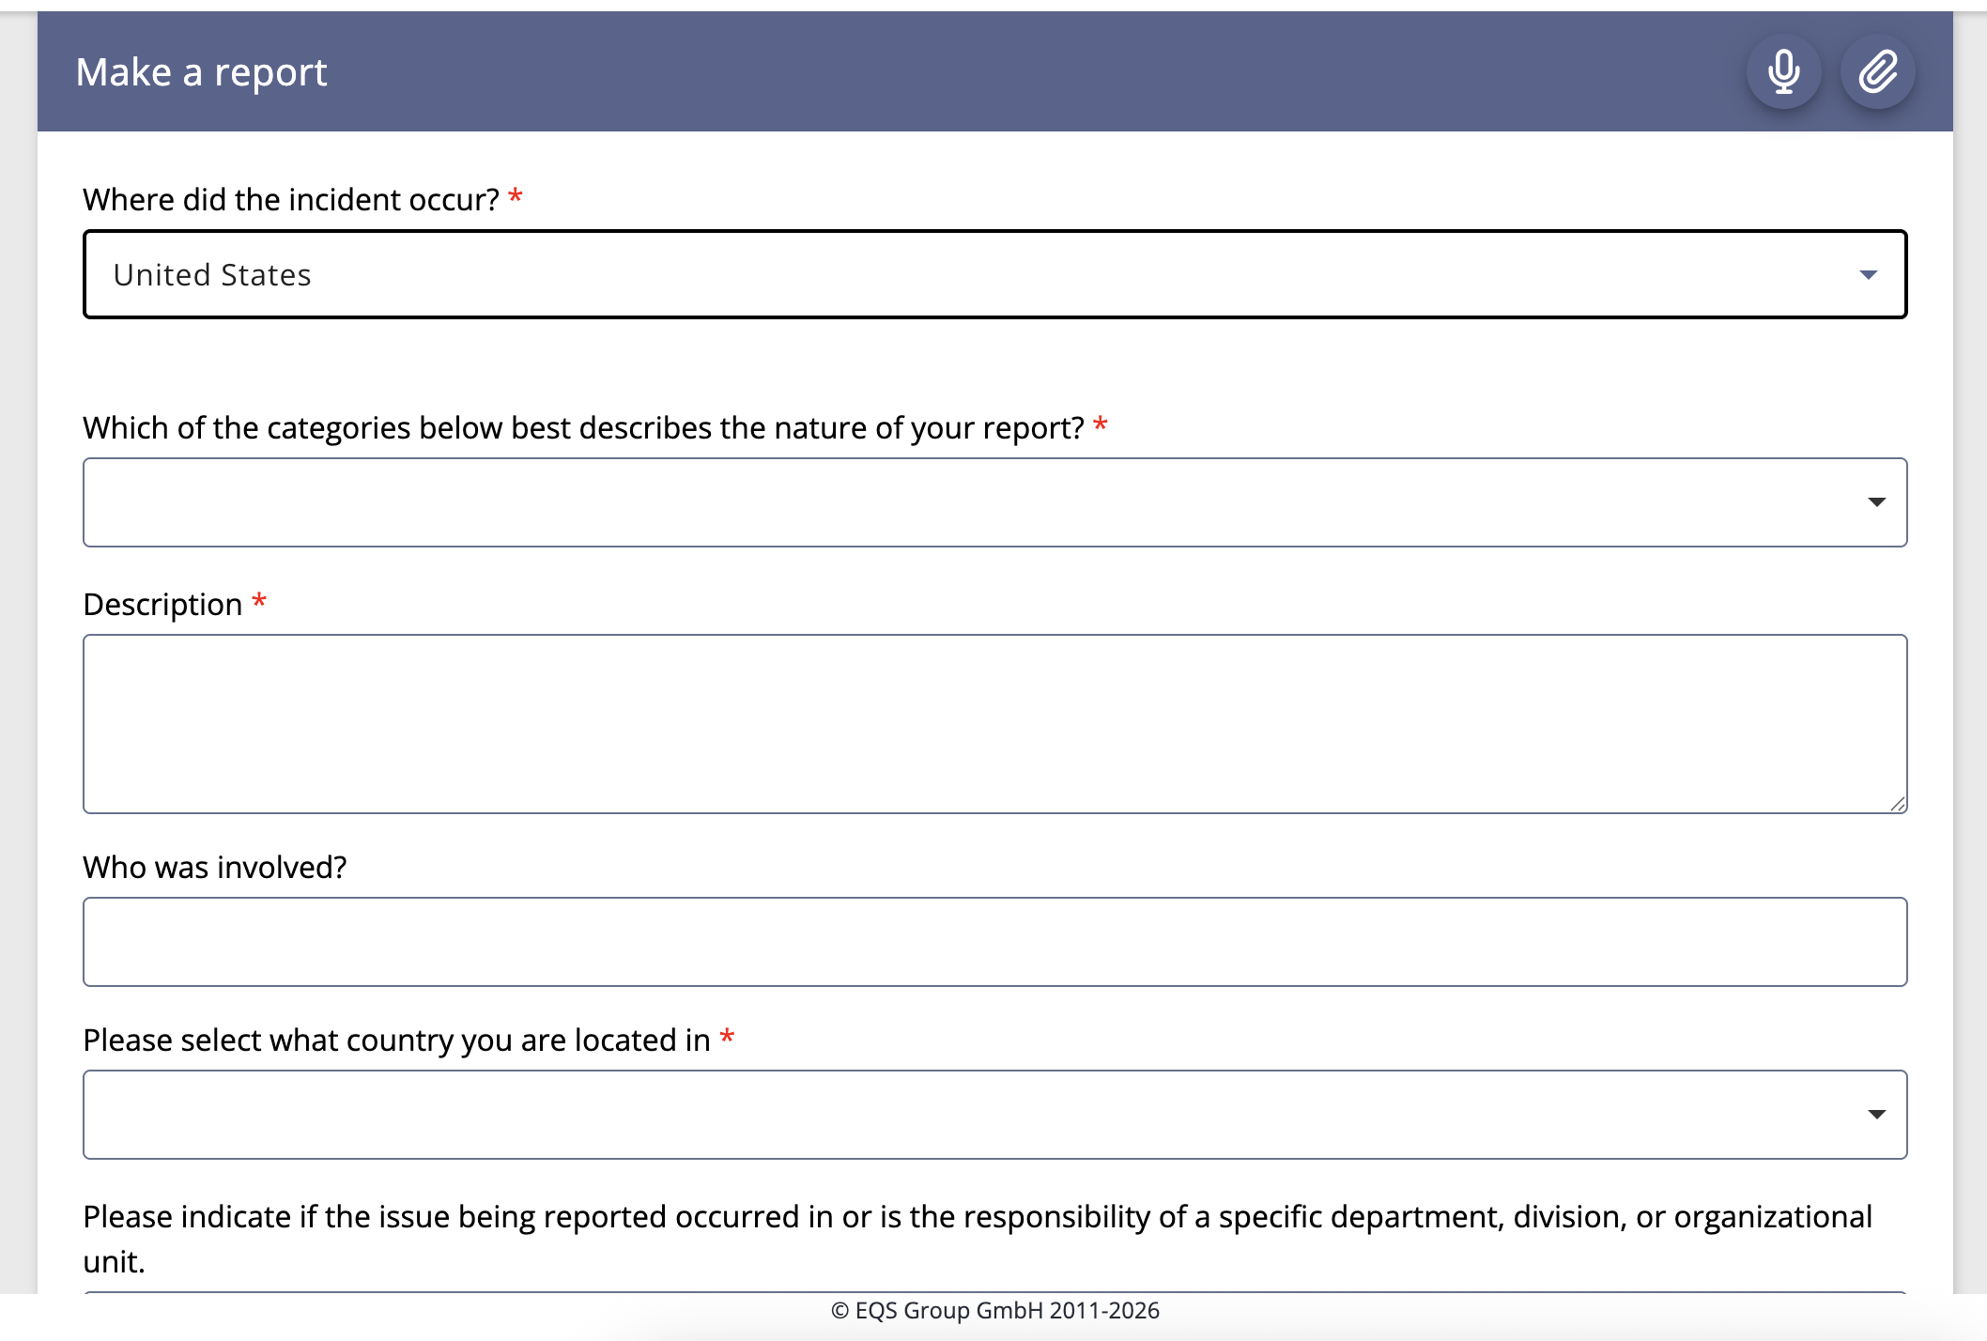
Making a Report
          Enter the details of the report. The table in a following slide describes the questions and options that might be available on the intake form.

Slide 8
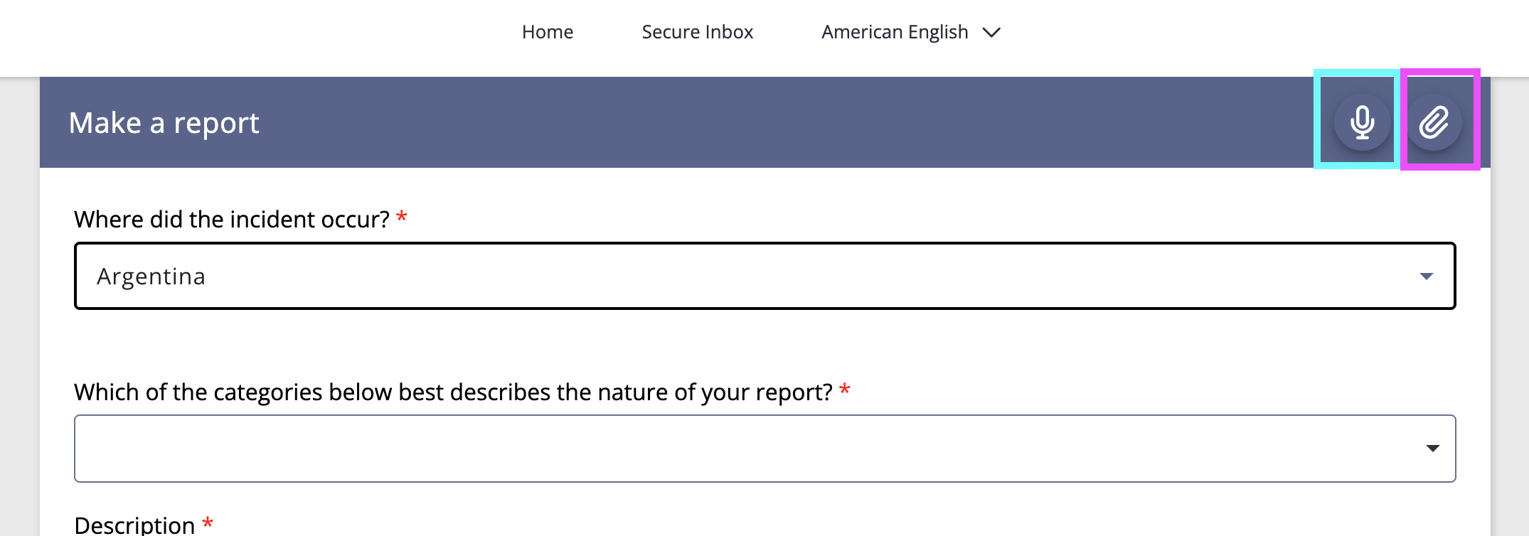
Making a Report
          Optional feature: If you choose, you can record an audio clip to describe the details of your report (see top right, in blue). If you choose to make an audio recording, your voice will automatically be distorted to protect your identity.
          Optional feature: In the top right (pink emphasis), you can also attach any supporting files to the case.

Slide 9
Making a Report
Field | Description
Please describe the details of the incident | Provide a report of what happened. These details will be viewed by the internal compliance team and appear in the Case Management screen. Click the microphone button to record an audio clip. Your voice will be automatically distorted to safeguard your anonymity throughout the process.
Who was involved | List the individuals who were involved in the incident.
Please indicate where the issue occurred | Select one of the following i.e.: Company Location Other Location
Please indicate when the issue occurred | Provide a specific date and time or a general timeframe.
Photos or File Uploads | Click the attach file icon to add any files that are relevant to your report, including any images.
Your Relationship to the Organization | Select one of the following: I am currently an employee I am a former employee Non employee (this includes contractor, student, supplier, partner, member, etc.)

Slide 10
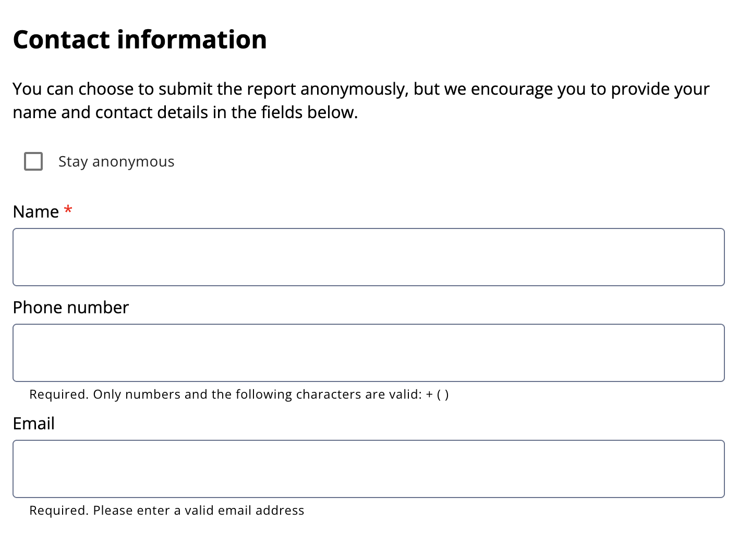
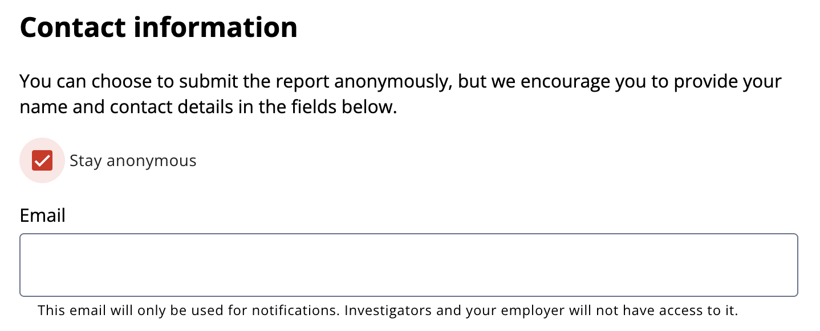
Making a Report
          In the contact information section, you can choose to stay anonymous or provide your name, phone number and email.
              Note: You can make an anonymous report and still provide an email address for notifications.
          If you provide your email address, you will receive email notifications when new messages are posted to the Secure Inbox.
          If you do not want to provide an email address, please log into the Secure Inbox regularly to check for any new messages.

Slide 11
02
Creating a Password

Slide 12
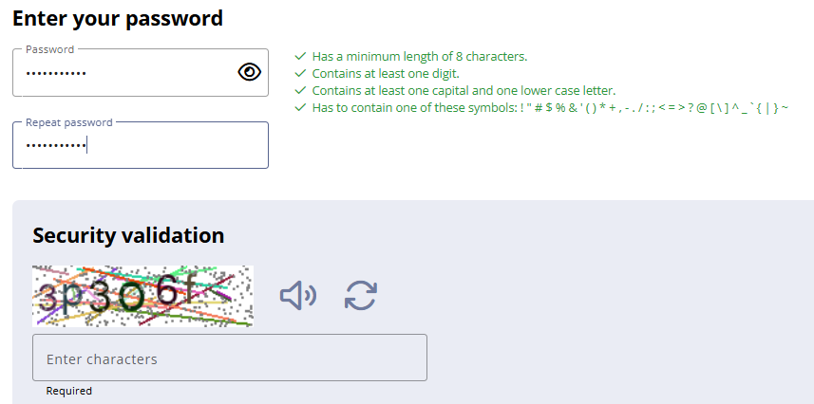
Creating a Password
          You will need to create a password that you will use to access your case through the Secure Inbox. A security validation (captcha) is shown. Please enter characters (letters and numbers) shown.
          If you’re having difficulties in reading the captcha, you can click on the speaker icon to have it read out loud to you or click on the arrows to generate a new one.

Slide 13

Password Creation Details
        Users who lose or forget their case ID or password will not be able to access their case and you will have to submit a new case to open a new Secure Inbox.
  Password Strength Requirements
          Must be at least 8 characters long
          Must contain at least one digit
          Must contain at least one uppercase and one lowercase letter
          Must contain a special character

Slide 14
03
Obtaining Case ID

Slide 15
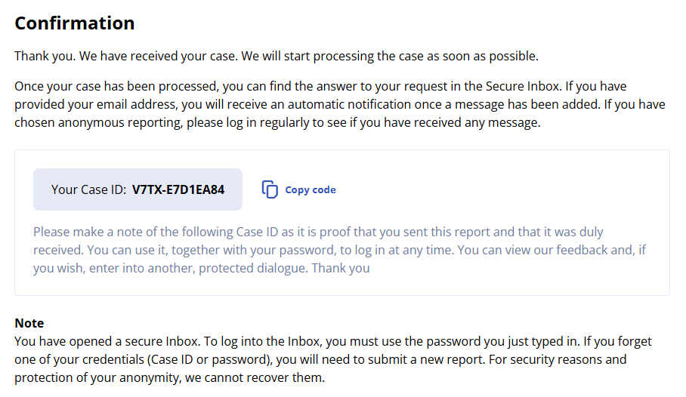
Obtaining the Case ID
          Once you click the Next button, a confirmation screen will appear with your case ID. Write this ID down in a secure location. You will need this ID and your password to access the Secure Inbox.

Slide 16
04
Accessing a Case

Slide 17
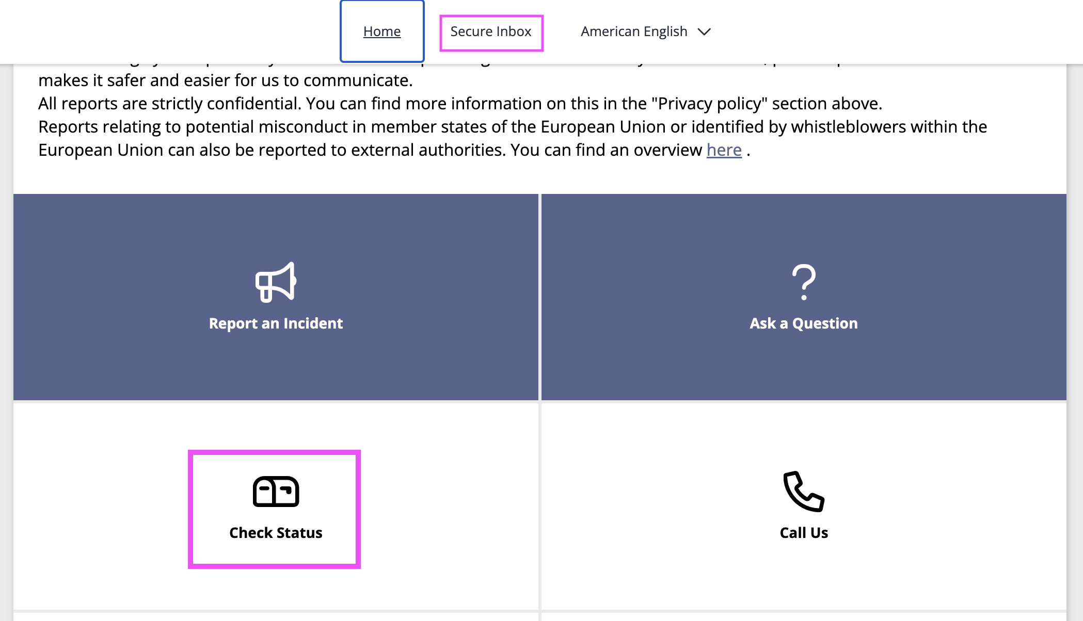
Accessing a Case
          To access your case, start at the same Integrity Line landing page where you submitted your case.
          Click the ”Check Status” tile or navigate to the Secure Inbox from the menu at the top of the screen.

Slide 18
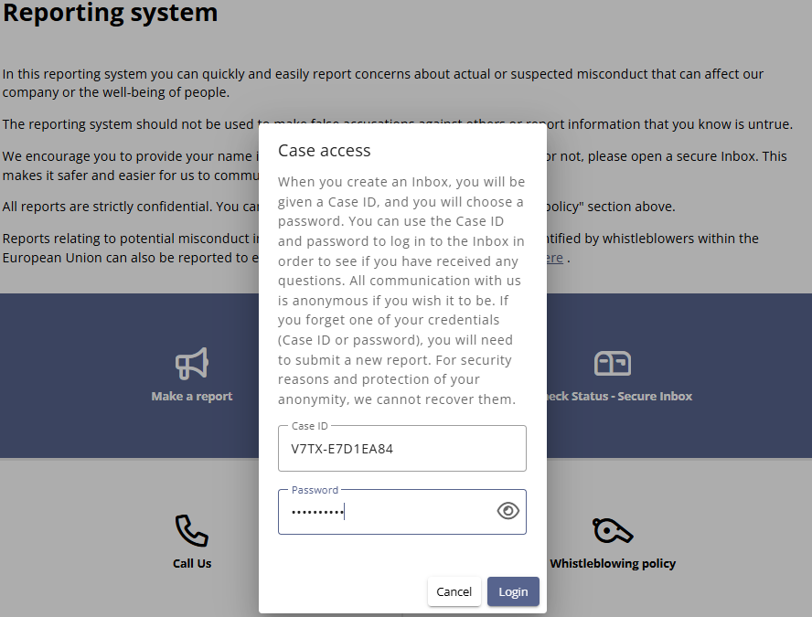
Accessing the Case
          You will see a pop-up about Case Access, and can enter your Case ID and Password.
          Click Login to proceed.

Slide 19
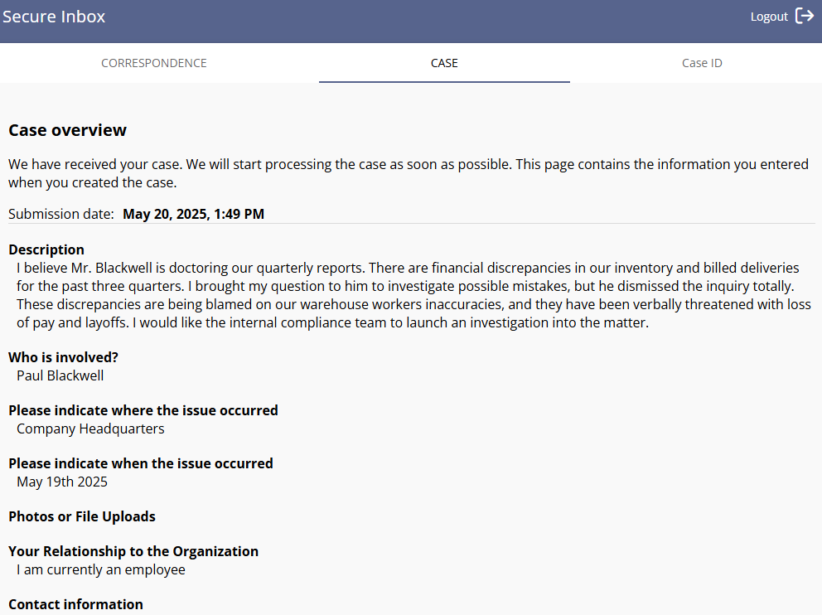
Accessing the Case
          In the Secure Inbox, you will see the information that you submitted, along with any messages that have been added to the case by the case manager or investigator. You can send new messages or respond using the Correspondence tab.
          If you need to add any additional details to your case, you can send a note via the Secure Inbox.

Slide 20
05
Call Us

Slide 21
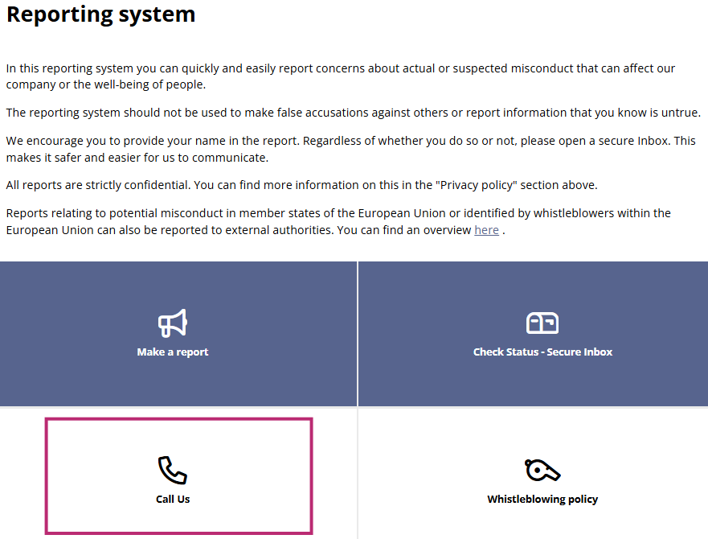
Call Us
          You can also make a report over the phone. Click on the Call Us tile to see your organization’s default phone number as well as a comprehensive list of international phone numbers.
          After dialing, you will reach a call center agent who will take your report . They will ask you the same questions that are present on the web form, and will record your answers carefully. They will provide a case ID and password upon the completion of your report.

